Slide 6
FUNCTIONS

Slide 7
AJK: Note on use of global above: comment on use

Slide 13
HTTP Header info (ajk)
header info must be completed before any HTML info is sent
  e.g. the header info must be sent first
header info contains control info
  for a request
  for a response
a header can redirect to another location
  accompanied by a 301, 302 or 307 HTTP status code
    301 – Moved permanently
    302 – Found (moved temporarily)
      default for PHP header Location redirect
    307 – Temporary redirect

Slide 16
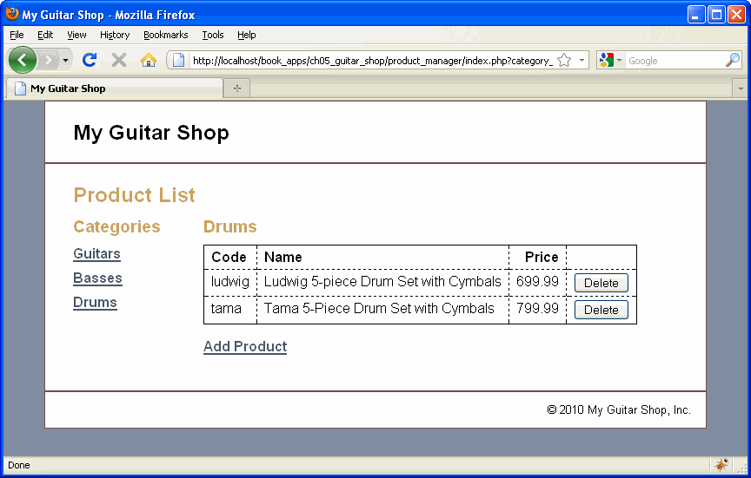

Slide 17
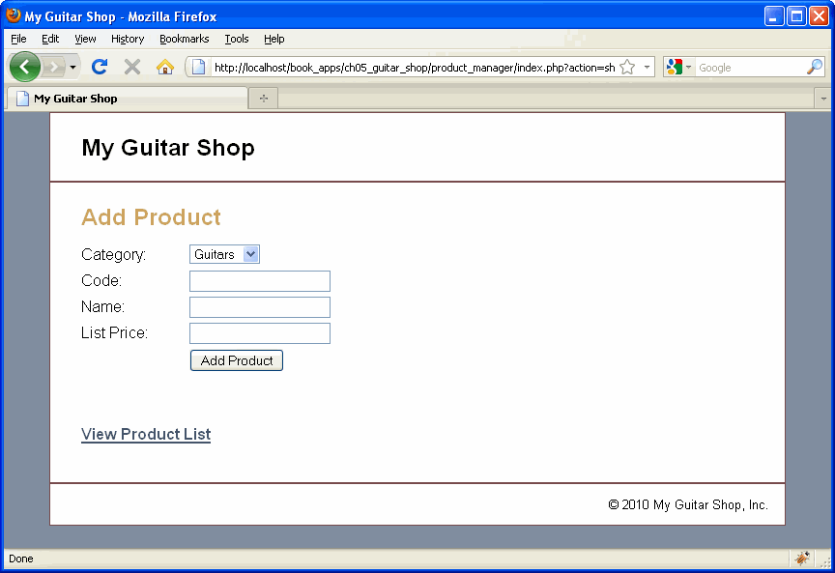

Slide 18
MODEL

Slide 19
AJK Note: does anything look funny above?

Slide 22
CONTROLLER

Slide 23
AJK Note: $_REQUEST could have been used also

Slide 24
AJK Note: should have used isset() better here, where and how?

Slide 27
VIEW

Slide 36
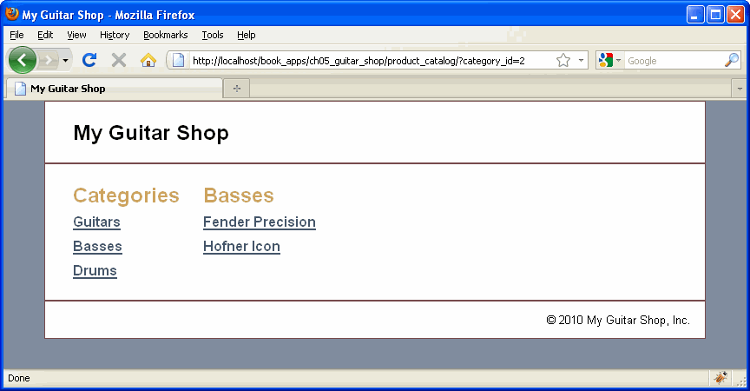

Slide 37
