Slide 4
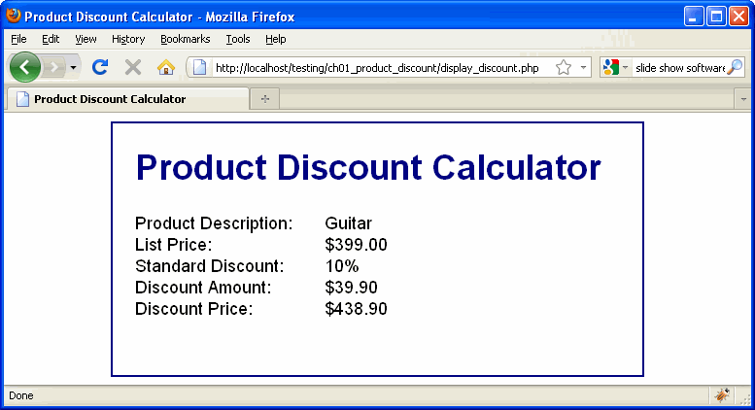

Slide 5
AJK Reality check:
  All errors will never be completely removed.
  Still need to ensure all the egregious and obvious errors are removed.
  Then remove as many of the others as possible with the given time and money constraints.

Slide 8
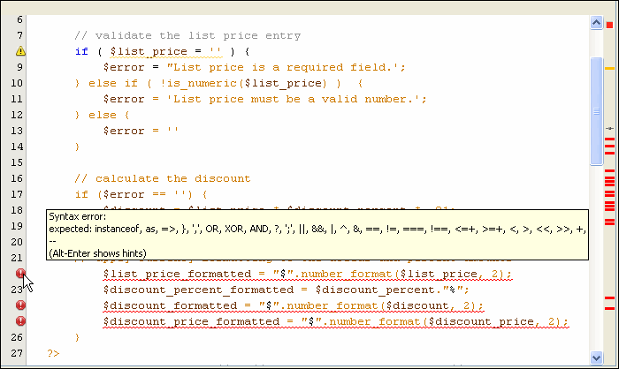
AJK Note: an error message does not always note where the error is, it notes where an error of some sort was first noticed. The cause of the error may have been many lines above, or even sourced on another Web page.

Slide 11
ajk hint: put variables results encased within brackets:
echo '$i: [' . $i . ‘]<br />';
echo '$future_value: [' . $future_value . ‘]<br />‘
Then you can clearly see if the value is not there or if it has weird values or extra blanks, etc.

Slide 12
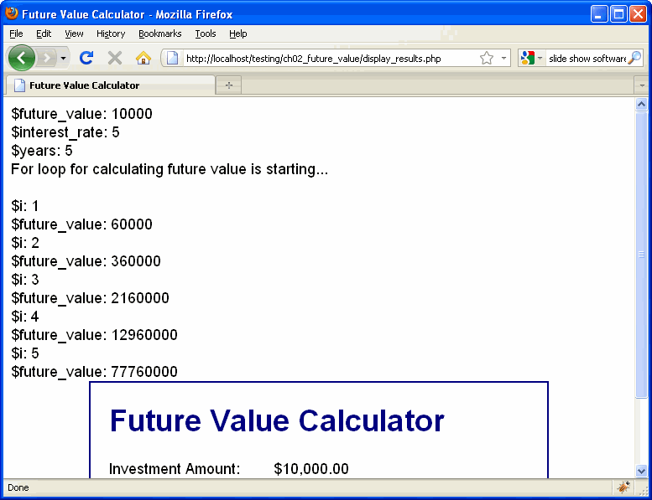
AJK Note: when done debugging do not delete the added code, comment it out to be able to re-enable it in the future. For some cases you might want to use a conditional to turn the debugging on and off, e.g. testing = true; .

Slide 13
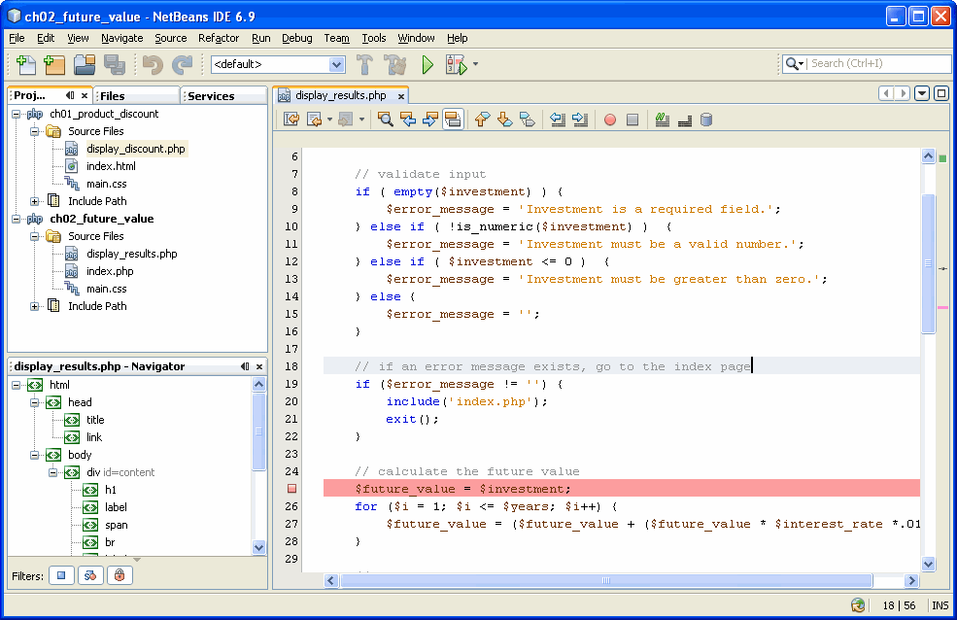

Slide 14
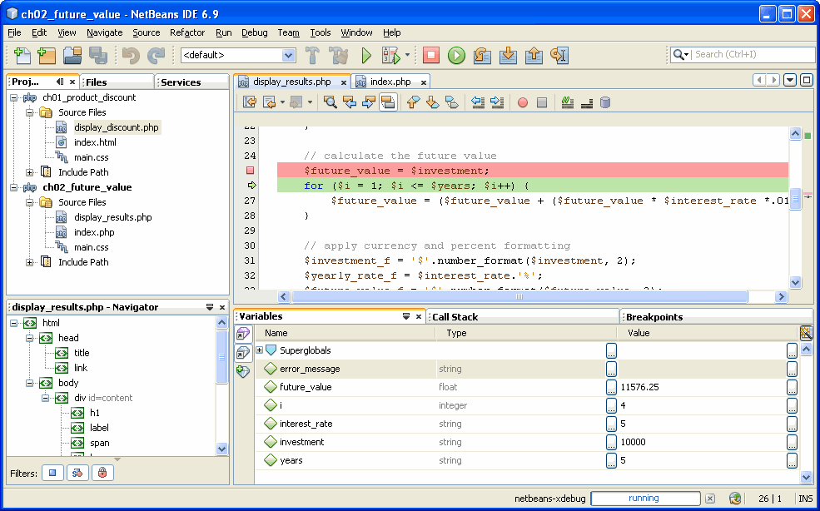
AJK Note: some debuggers will allow one to dynamically change variables at checkpoints. This can facilitate the testing process, especially when checking for bad data.

Slide 15
