Slide 5
ajkExample: Ch09/varSub.php

Slide 6
ajkExamples: Ch09/hereDoc.php, hereDoc2.php

Slide 9
ajkExample: Ch09/htmlEntities.php

Slide 10
http://www.php.net/manual/en/ref.strings.php

Slide 13
ajkExample: ch09/findString.php

Slide 17
ajk side question: How would you remove multiple spaces inside a string?
e.g. " This is a space in a string"

Slide 19
ajkExamples: Ch09/stringToArray.php

Slide 21
ajkExamples: Ch09/strcmp.php

Slide 30
ajkExamples: Ch09/rand.php

Slide 32
ascii chart on next page

Slide 33
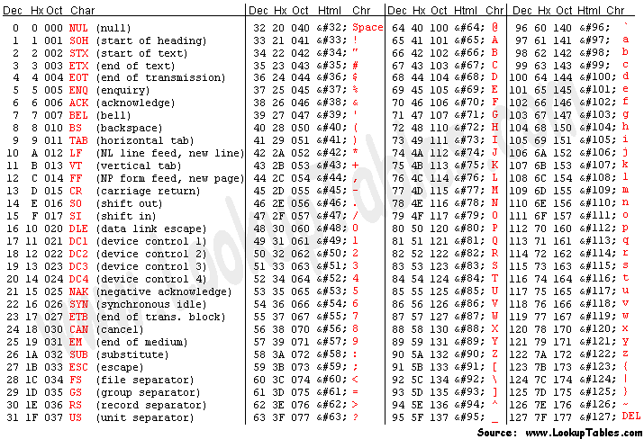

Slide 37
ajkExamples: Ch09/formatting.php
Note: why do s3 and s4 look wrong?
Question on next page:

Slide 38
Why do $s3 and $s4 look wrong?
sprintf did not format the string be cause of a typo
sprinf does not generate multiple blanks
sprintf worked and the browse did its "thing" properly

Slide 40
ajkExamples: Ch09/convInt.php
Note: what happened to value_9?
Use value_9a as a clue.

