Slide 5
ajkExample: Ch11/createArrays.php

Slide 7
ajkExamples: Ch11/workWithArrays.php

Slide 11
ajkExamples:
Ch11/gaps1.php (with error)
Ch11/gaps2.php (with check)

Slide 13
Resume 9/30

Slide 17
ajkExamples: Ch11/associative.php
Note: the warning for the 2nd fix boss
Note: the associative element and numeric elements are mixed in the var_dump
Uncomment bad boss and show effects

Slide 18

ajkExamples: Ch11/forEach.php

Slide 19


Slide 20
Note: the foreach loop eliminates the gap problem we had earlier

Slide 21
range:
The 1st and 2nd parm specifies start and stop
The optional 3rd parm specifies the interval

Slide 22
ajkExamples: Ch11/splice.php

Slide 26
Note: optional 3rd parm on the 4th line is a boolean $strict:
true: data types must match

Slide 28
ajkExamples: Ch11/sortArray.php
Note: the sort reindexes the array
Note: what happened to the associative element in the array?

Slide 29
In the second set, the true parm (2nd parm) retains the original keys,
otherwise the array is reindexed

Slide 30
ajkExamples: Ch11/shuffle.php
New and improved!

Slide 37
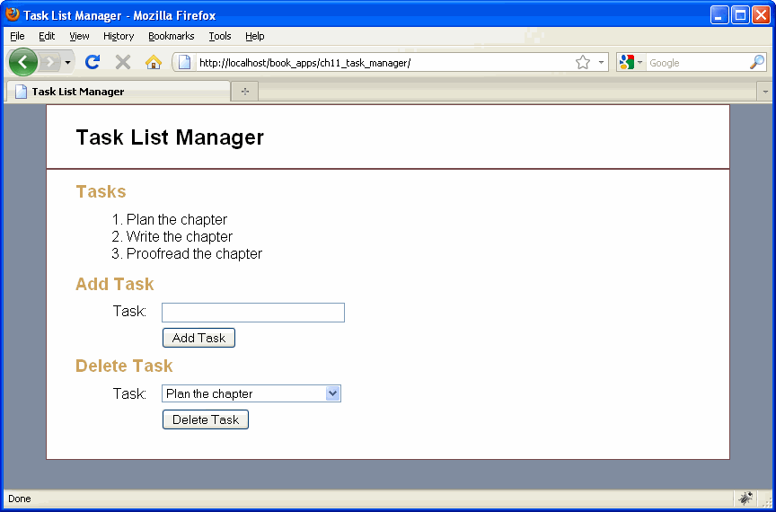
Show ch11_task_manager in book_apps

