Slide 14
ajkExamples: Ch12/session1.php

Slide 15
ajkExamples: Ch12/sessionArray.php

Slide 19
ajkExamples: Ch12/session2.php

Slide 20
One last example: counter
Notice the difference between FireFox and IE with this example
ajkExamples: Ch12/count.php

Slide 21
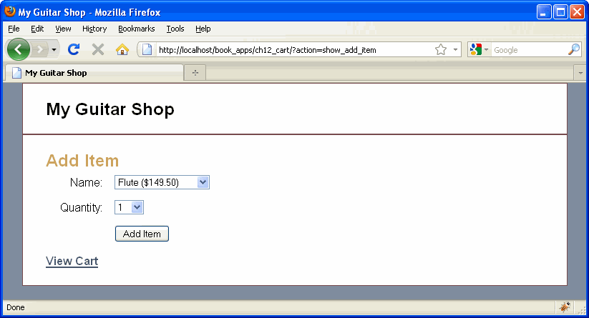

Slide 22
