Slide 13
Resume 9/21
Why OO?
    Classic reasons
        encapsulation
          tie together data and manipulation
        inheritance
        etc.
    Not often discussed
          Reusable code
          Makes programming easier
            All required data checking can be done by methods
            Will be done on all objects as created
Why classes?
  Templates for date you wish to use

Slide 16
Note: constructors are good places to put data checks. For the an object made for the Category class, for example, the id could be checked to enforce it is numeric.

Slide 19
There are naming conventions for methods. One of them is to use getName, retreive the data for name. Note the first letter of the data element is capitalized to make it easier to read. Likewise setName would be used to assign a new value to the data element name. Booleans use isSomething.
Multi-word names are denoted by capitalizing the first letter of each word.

Slide 26
Note: class constants belong to the class and can also be directly accessed from that class. Class constants are public.
echo Person::MALE;

Slide 27
ajkNote: can also get a constant from the object:
$myGender = $person::FEMALE

Slide 29
ajkExamples: /Ch14/static.php

Slide 31
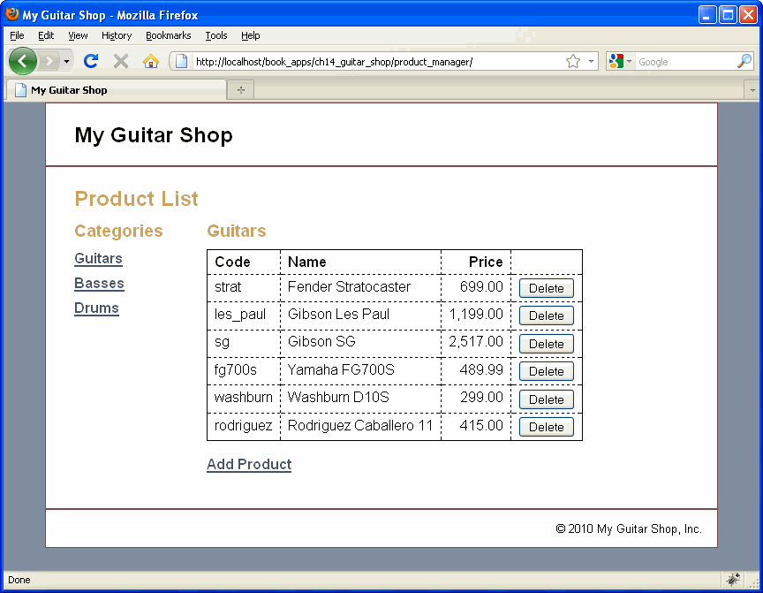

Slide 32
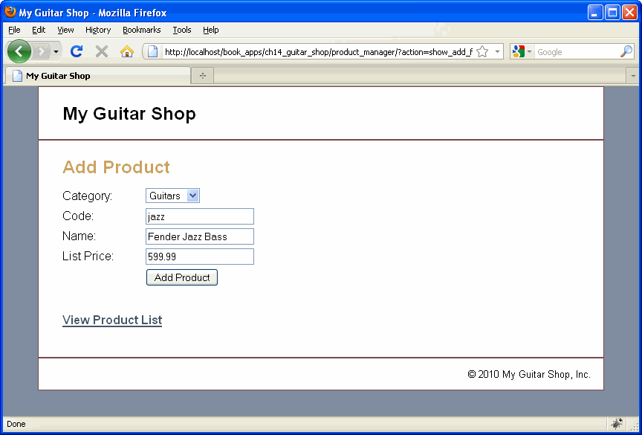

Slide 48
ajkExample: /Ch14/showAll.php

Slide 49
ajkExamples: /Ch14/showAllWithSets.php

Slide 66
ajkExamples: /Ch14/abstract.php

