Slide 5
ajkExamples: /Ch15/authorMatch.php

Slide 9
ajkExamples: /Ch15/specialChars.php

Slide 13
Note: ^ is tricky in a character class, if it is the first character in a class it negates all the following characters in the list.
In the second example the second ^ is negated by the first ^, i.e. the character after MBT cannot be a ^.

Slide 14
See bracket expressions and ascii table on next pages next page

Slide 15
Character classes
alnum | letters and digits
alpha | letters
ascii | character codes 0 - 127
blank | space or tab only
cntrl | control characters
digit | decimal digits (same as \d)
graph | printing characters, excluding space
lower | lower case letters
print | printing characters, including space
punct | printing characters, excluding letters and digits
space | white space (not quite the same as \s)
upper | upper case letters
word | "word" characters (same as \w)
xdigit | hexadecimal digits

Slide 16
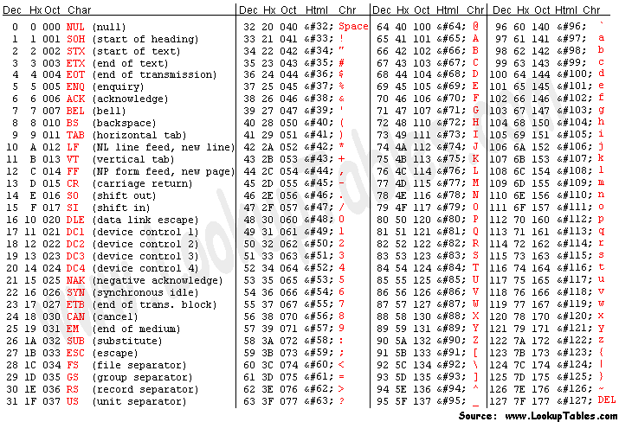

Slide 17
Note: now the ^ has a different meaning in patterns

Slide 18
ajkExamples: /Ch15/stringPos.php

Slide 19
ajkExamples: /Ch15/subPats.php

Slide 21
Note: http://php.net/manual/en/regexp.reference.assertions.php

Slide 23
ajkExamples: /Ch15/complex.php

Slide 27
ajkExamples: /Ch15/split.php

Slide 38
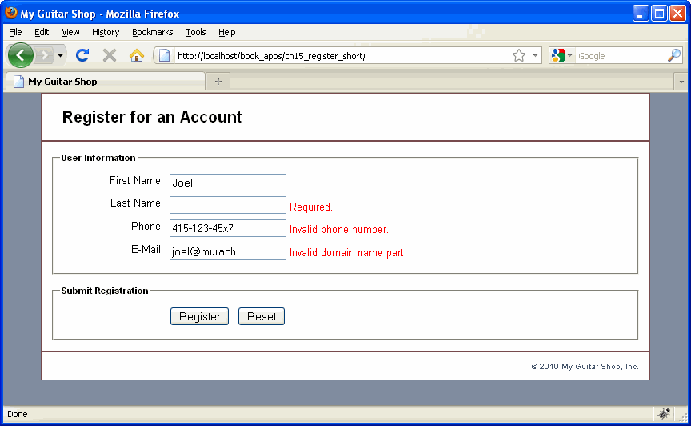

Slide 56
