Slide 2

Graeme Birchall
DB2 SQL Cookbook
Reminder: Great Reference Guide
http://mysite.verizon.net/Graeme_Birchall/cookbook/DB2V97CK.PDF
http://mysite.verizon.net/Graeme_Birchall/id1.html
The guide is DB2 oriented, but has many good query examples that are applicable for most RDB products.

Slide 6
ajkNote:
Use SQL's power to reduce your PHP programming!
Examples:
    You only need certain values (columns) from a table
        Let SQL select only those rows
    Data needs sorting
        SQL can sort the data for you!
        On the column(s) of your choice
    Data from two sources needs organization
        SQL can join the data from multiple tables
        And select only the fields of interest!
Look at the big picture of what the project needs to do
  Formulate your queries to your advantage
    → Less PHP processing required!

Slide 8
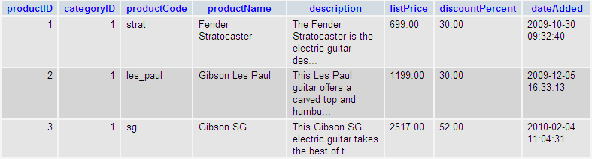

Slide 9
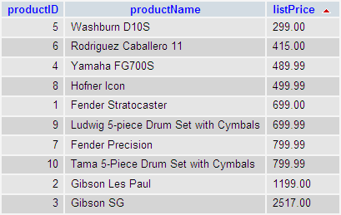

Slide 10


Slide 12


Slide 14


Slide 15


Slide 17


Slide 22
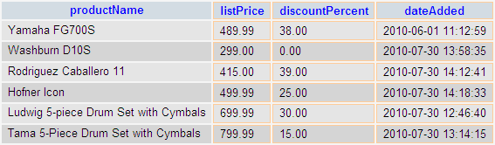

Slide 23


Slide 24


Slide 25


Slide 26


Slide 29
Resume 11/04

Slide 30
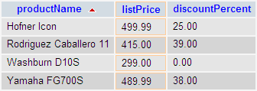

Slide 31
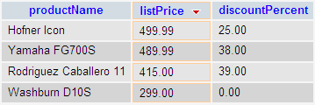

Slide 32
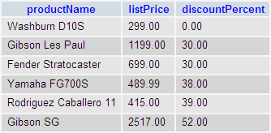

Slide 33
ajkNote: implicit syntax
  SELECT select_list
  FROM table1, table2, …
  WHERE table1.id = table2.id, tablex.id=tabley.id, …
  …
Note: there is an outer join also:
http://stackoverflow.com/questions/38549/difference-between-inner-and-outer-join

Slide 34


Slide 36
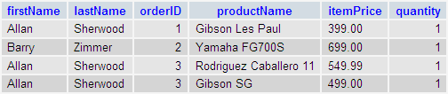
Alternate form:
SELECT firstName, lastName, o.orderID, productName, itemPrice, quantity
FROM customers c, orders o, orderItems oi, products p
WHERE c.customerID = o.customerID, o.orderID = oi.orderID, oi.productID = p.productID
ORDER BY o.orderID

Slide 37

Note: there are others, e.g. FIRST(), LAST()and some special use functions like VAR() and CORRELATION()

Slide 38


Slide 39


Slide 40


Slide 41

Example: book_apps\ch18_db2_scripts\fig18-12.sql
run without the group by and having first

Slide 42

w3schools example:
http://www.w3schools.com/sql/sql_having.asp
Notes:
WHERE:
  Can refer to any column in any of the tables
  Cannot access aggregate terms
HAVING:
  Can only refer to columns listed in the SELECT condition
  Can access the aggregate data

Slide 43


Slide 45

book_apps\ch18_db2_scripts\fig18-13.sql
run subquery first, then both

Slide 46


Slide 47


Slide 48


Slide 49
Key elements:
The number of items between the ( ) must match the number of columns in the table.
There may be as many ( ) as rows you want to insert.
If there is no column list then it is assumed the values will be for all the columns in the table.

