Slide 3
Content Management System
Want "pretty" web page data displayed
  e.g. HTML formatted
Web programmer
  No problem – enter the appropriate tags
  That's his job
Layperson
  Problem
  Doesn't know HTML
Solution
  Create a system to do simple HTML formatting using basic, simple to follow rules

Slide 10
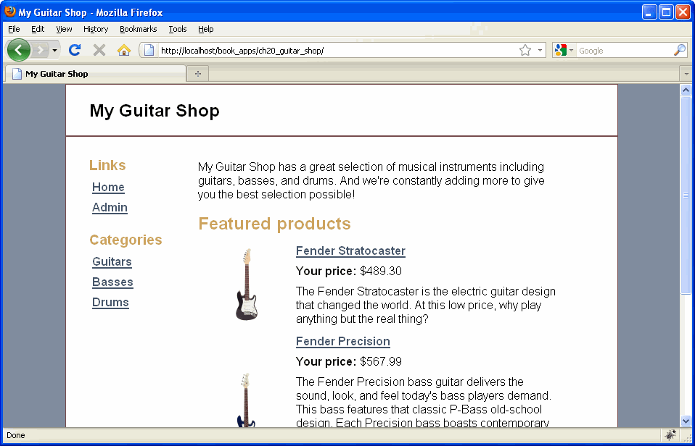

Slide 11
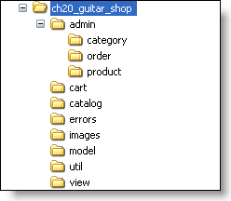

Slide 13
Notes:
Using techniques like this make it easier to migrate the application to a different server which may have a different directory structure
It also makes it easier to make changes to your Web server without needing to make changes to your application

Slide 23
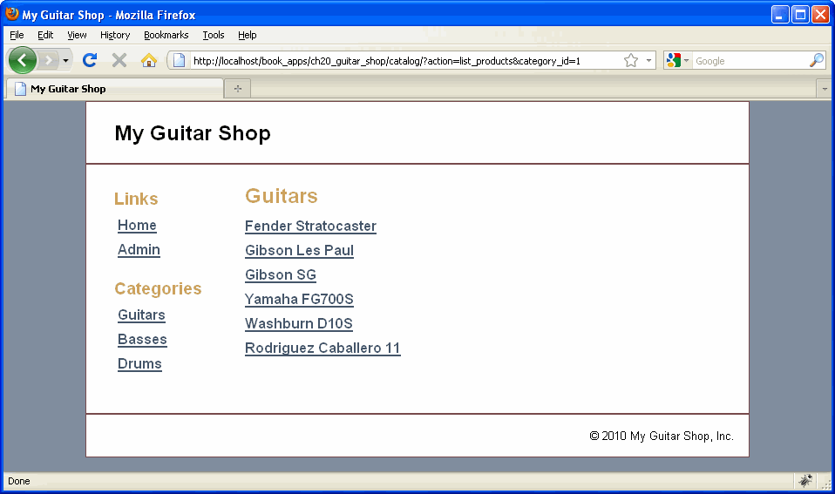

Slide 24
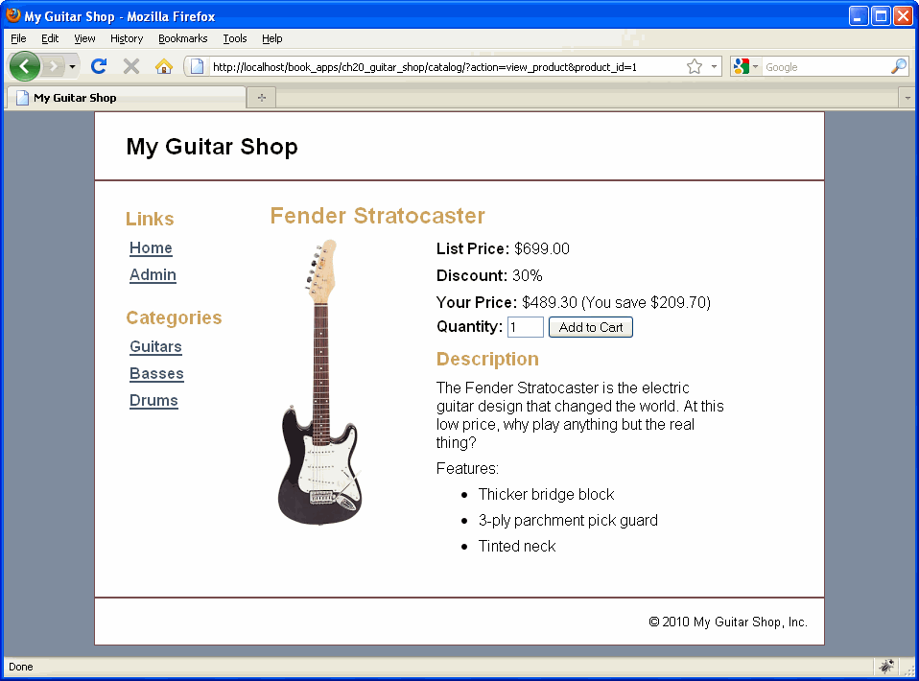

Slide 25
Note: need to know your applications file structure and how to get to the appropriate directories

Slide 30
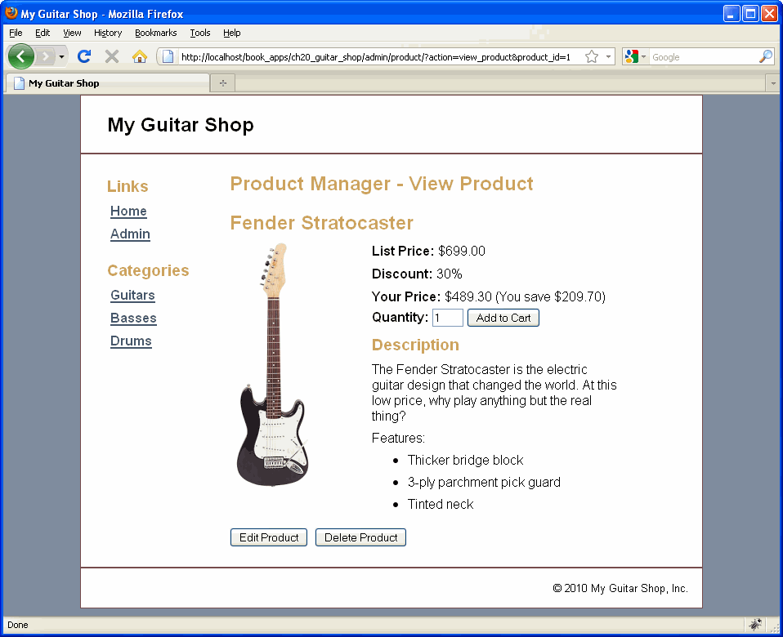

Slide 31
