Slide 4
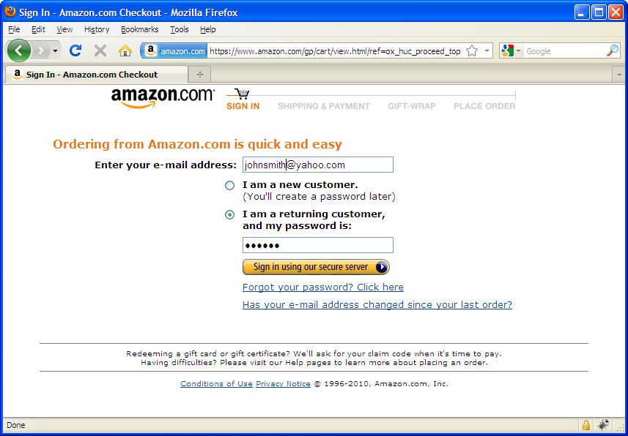

Slide 6
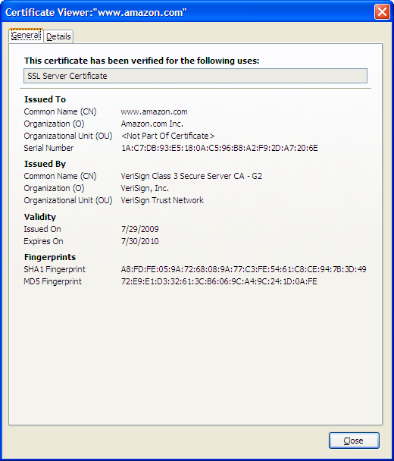

Slide 14
ajkExamples: /Ch21/redirect.php

Slide 16
ajkExample: ch21/shaTestClientSide.html
Discuss:
What is wrong with this?
Encrypt PW on client side:
Upside
Downside

Slide 20
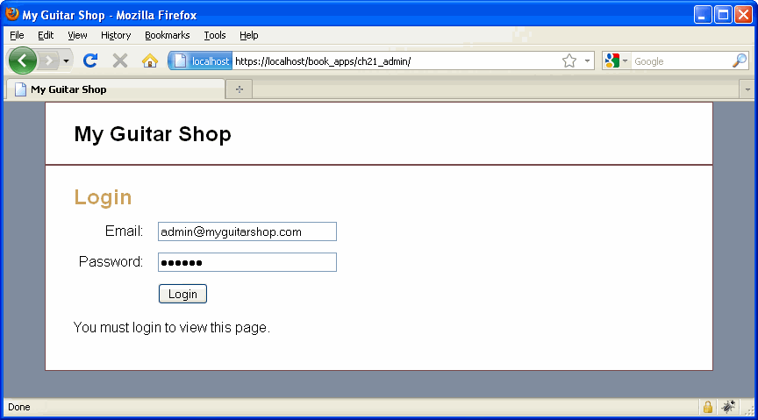

Slide 21
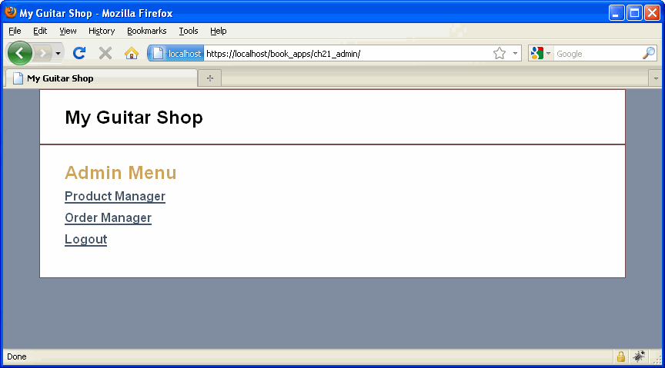

Slide 26
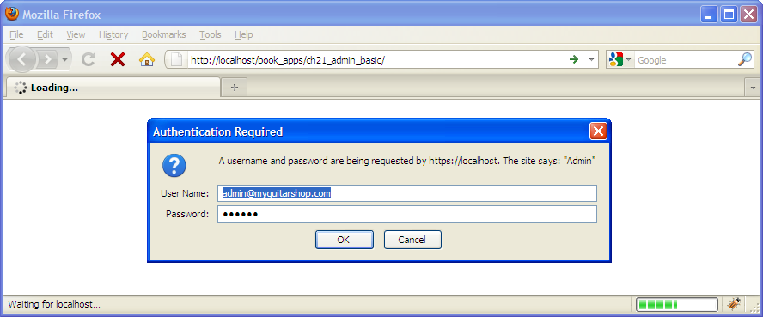

Slide 27
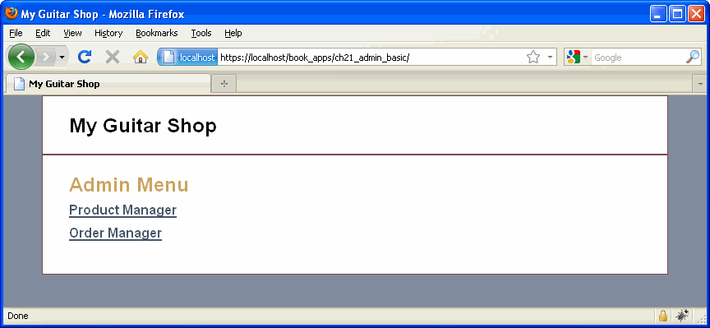

Slide 28
