Slide 6
PEAR

Slide 12
Note: factory() is a static method in the Mail class

Slide 14
Note: isError() is a static method in the PEAR class

Slide 16
Helper functions
Some task have common setup and use
E.G. mail
  Most will have the same $options
  Most will have similar $header structure
  Most will have similar $body structure
Set up a common function to assist the common tasks

Slide 24
cURL
Using PHP to access other Web pages

Slide 33
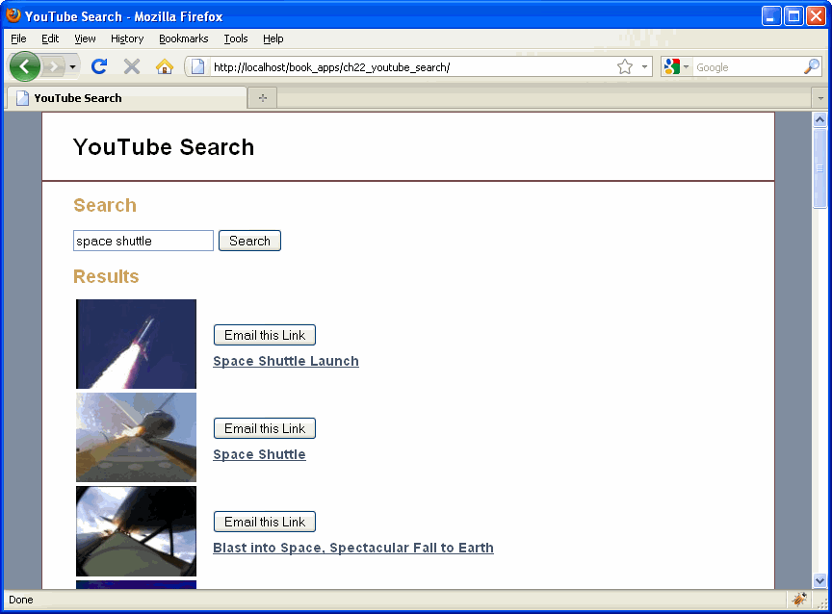

Slide 34
