Slide 14
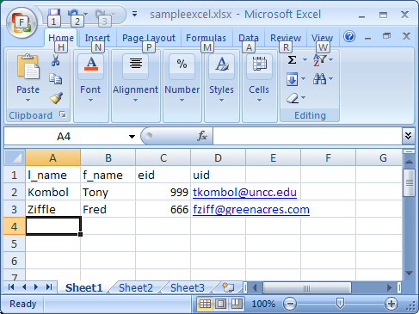

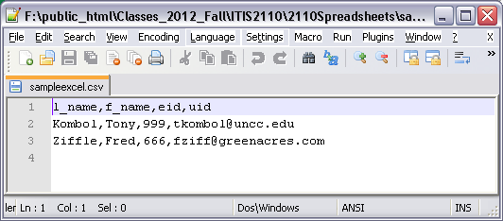
Save as .csv
Same .csv file opened with Notepad++

Slide 18
Resume 11/18

Slide 19


Slide 22
Returns an array where:
a[0] the width
a[1] the height
a[2] the IMAGETYPE_xxx constant shown above
a[3] a text string in the form: height="yyy" width="xxx"
a['mime'] the mime type
a['channel'] 3 for RGB or 4 for CMYK
a['bits'] the number of bits for each color
List of Imagetype constants:
http://php.net/manual/en/function.exif-imagetype.php

Slide 25
Another:
imagecreate($h, $w) Creates a new image

Slide 27
Note:
$image_from_file and $image_to_file are being set up to be used as a variable function later

Slide 28
Remember variable functions?

Slide 35
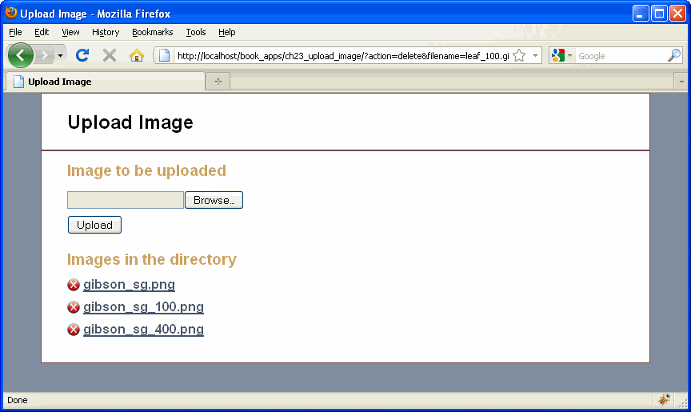

Slide 36
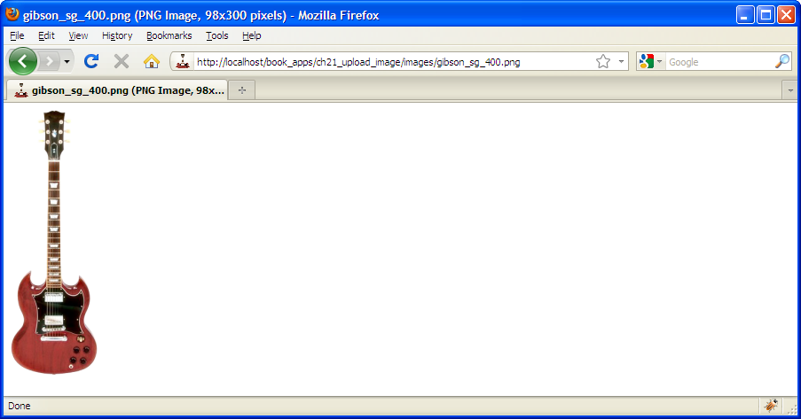
Show the program running.
Show the ch23_images directory and the ch23_upload image directory before and after running.
Class is on their own to review the Image Upload application code.

