Slide 1
JSON
ITIS 3105

Slide 2
Uses
Ability to help humans read/write code easier
Consists of name / value pairs
Specified by Douglas Crockford RFC 4627
Application/json (unlike text/javascript)
Data over networks, like XML

Slide 3
JSON Info
JSON Web Site
  http://www.json.org/xml.html
Wikipedia
  http://en.wikipedia.org/wiki/JSON

Slide 4
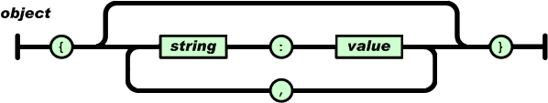
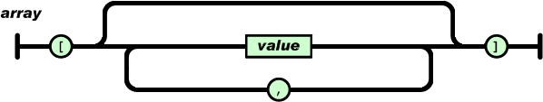
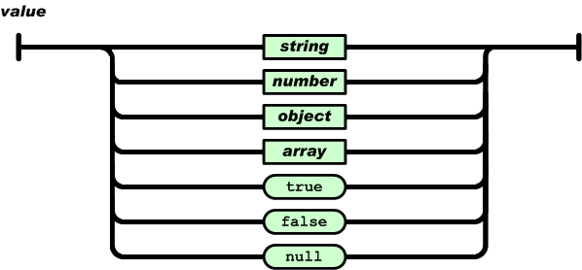
JSON Syntax Diagram http://www.json.org/fatfree.html

Slide 5
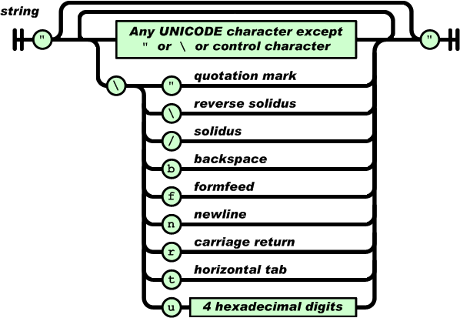
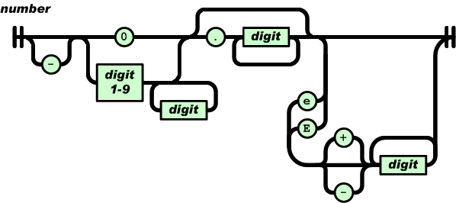
JSON Syntax
(cont.)

Slide 6
Needs a Parser just as in XML
ASP
ActionScript
C
C++
C#
Fantom
Go
PHP
Pike
PL/SQL
PowerShell
Prolog
Python
Qt
Haskell
haXe
Java
JavaScript
Lasso
Lisp
LotusScript
Lua
Objective C
Objective CAML
OpenLaszlo
Perl
R
Racket
Realbasic
Rebol
RPG
Ruby
Scheme
Squeak
Symbian
Tcl
VB
Visual FoxPro

Slide 7
Examples

Slide 8
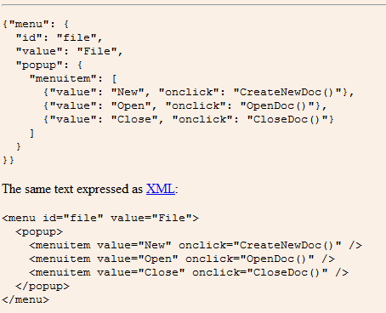

Slide 9
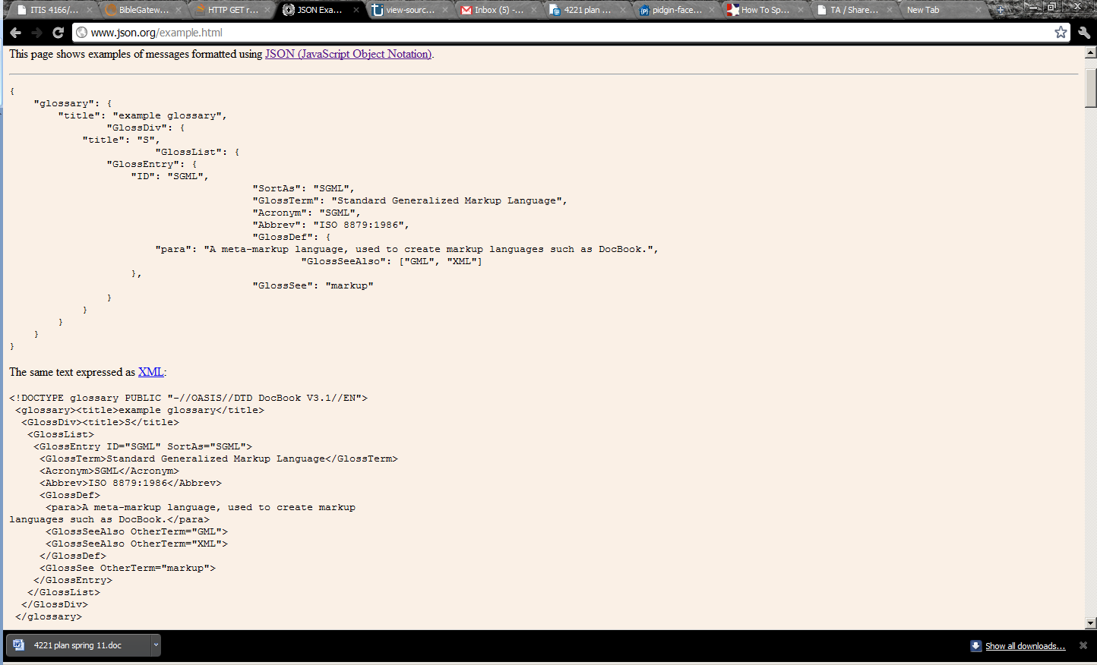
JSON vs. XML List http://json.org/example.html

