Slide 1
Introduction to AJAX
Mohamed Shehab

Slide 2
Traditional Server Request/Response
In traditional server request/response model:
  Each time a server request is made, the page must refresh to retrieve new content.
Web Server
Web Page
New Content on Web Page

Slide 3
What is Ajax
Asynchronous JavaScript and XML(AJAX)
  Makes web pages more responsive by exchanging small amounts of data
  Allows the web page to change its content without refreshing the whole page
How does it work?
  JavaScript runs on the client side.
  Works with asynchronous data transfers(HTTP requests) between the browser and the web server.
  HTTP requests are sent by JavaScript calls without having to submit a form.
XML is commonly used as the format for receiving server data but plain text may be used as well

Slide 4
What is Ajax
Asynchronous JavaScript and XML (Ajax)
  The JavaScript based XMLHttpRequest object enables Ajax to fire requests to the web server asynchronously, without having to refresh the page.
  Let’s say we have a small area on the page that needs to always have near “real time” data. Say flight times, or for a sports website, live a scorecard.
Web Server
Request/Response 1
Request/Response 2
Web Page
Request/Response 3

Slide 5
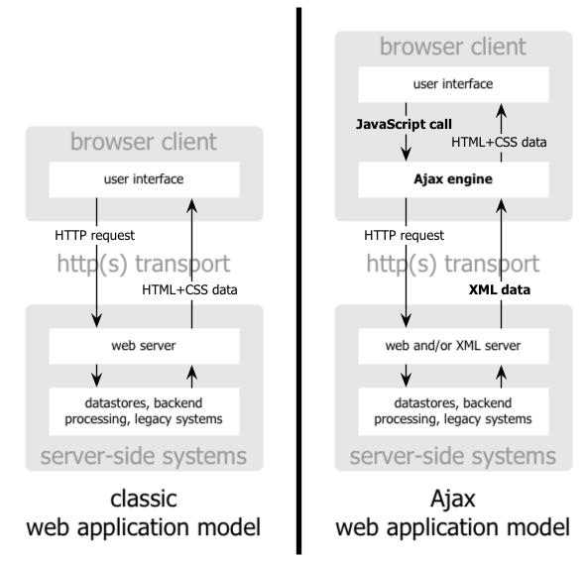
What is Ajax
Source: http://www.adaptivepath.com/publications/essays/archives/000385.php

Slide 6
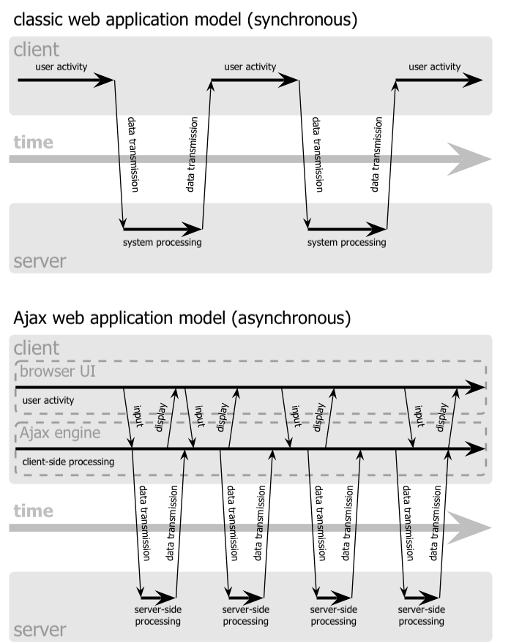
Source: http://www.adaptivepath.com/publications/essays/archives/000385.php

Slide 7
Basic Architecture
To enable Ajax the developer has to provides both server and client sides.
Server code is usually an API call (PHP).
Client code is usually JavaScript using the XMLHttpRequest object.
Web Page
Web Server
getdata.php
JavaScript

Slide 8
Basic Architecture
To implement AJAX we need to answer three questions:
  What triggers the AJAX request?
    Usually a JavaScript event (onblur, onclick, etc.)
  What is the server process that handles the AJAX request and issues the response?
    Some kind of URL/Endpoint (use a Service Locator)
  What processes the response from the server (what is the callback method)?
    A JavaScript function that gets the response and manipulates the DOM, based on the text returned.

Slide 9
JavaScript XMLHttpRequest
XMLHttpRequest is a JavaScript object that provides an easy way to retrieve data from a given URL.
XMLHttpRequest can be used to retrieve any type of data, not just XML, and it supports connections other than HTTP (including file and ftp).

Slide 10
XHR Object Methods
Method | Description
abort() | Stops the current request
getAllResponseHeaders() | Returns all header (labels/value) sets
getResponseHeader("headerLabel") | Returns value of a specified header label
open("method", "URL"[, asyncFlag[, "userName"[, "password"]]]) | The heart and soul! Sets destination URL, method, and other optional attributes
send(content) | Transmits the request
setRequestHeader("label", "value") | Assigns header to be sent with a request

Slide 11
XHR Object Properties
Property | Description
onreadystatechange | Event handler for an event that fires at every state change
readyState | Object status integer
responseText | String version of data returned from server process
responseXML | DOM-compatible document object of data returned from server process
status | Numeric code returned by server, such as 404 for "Not Found" or 200 for "OK"
statusText | String message accompanying the status code

Slide 12
Creating an XMLHttpRequest
function GetXmlHttpObject(){
if (window.XMLHttpRequest){
// code for IE7+, Firefox, Chrome, Opera, Safari
return new XMLHttpRequest();
}
if (window.ActiveXObject){
// code for IE6, IE5
return new ActiveXObject("Microsoft.XMLHTTP");
}
return null;
}

Slide 13
Using the XMLHttpRequest Object
After the XMLHttpRequest object is created, the basic syntax for opening a connection, sending the request, and retrieving the response data is as follows:
  Open the request object, specifying the request type and URL.
  Bind an event handler function to the request object; this function is called when the request finishes.
  Send the request.
  Process the results of the request.

Slide 14
Step 1: Open request object
req = GetXmlHttpObject();
req.open(“GET”, “sourceURL”, true);
The parameters are:
  Retrieval method GET or POST.
  Source URL: server side address to retrieve data.
  Synchronous=false, and Asynchronous=true
    Synchronous if you want the script to wait on the request.
    Asynchronous if you do not want the script to wait on the request.

Slide 15
Step 2: Binding the Handler Function
req.onreadystatechange=processRequest;
The request function handler “processRequest” is called when the request status changes.
You will typically only be concerned with the status changing to complete.

Slide 16
Step 3: Sending the Request
req.send(“”);
The send function sends the http request.
At this point, the request has been issued and the request function handler “processRequest()” will be called when the request state changes.

Slide 17
Step 4: Processing the Request
function processRequest(req) {
if (req.readyState == 4 && req.status == 200) {
// further processing of document here
//var xmlDoc = req.responseXML;
//vartxtDoc = req. responseText;
}
}
The request status corresponds to the response code issued by the server, 200 means OK.
The request goes through 5 ready states:
Uninitialized (0)
Loading
(1)
Loaded
(2)
Interactive
(3)
Complete
(4)

Slide 18
Step 4: Processing the Request
function processRequest(req) {
if (req.readyState == 4 && req.status == 200) {
// further processing of document here
//var xmlDoc = req.responseXML;
//vartxtDoc = req. responseText;
}
}
responseXML: returns the xml dom object returned by the server.
responseText: returns the string returned by the server.

Slide 19
Example: Get # of Friends of a User
On the server getNumFriends.php returns the number of friends
  Assumes the friend is passed using GET.
The index.html, includes all the javascript to implement such functionality.

Slide 20
Ajax Data Flow
uid=bsmith
XMLHttpRequest
<?php
@$db = new mysqli(…..);
if($db->connect_error){ exit;}
$uname = $_GET['uid'];
$query = "select count(*) as cnt from friends where user1 = '" . $uname . "'";
$result = $db->query($query);
$row = $result->fetch_assoc();
echo $row['cnt'];
$result->free();
$db->close();
?>
function processRequest(){
if (req.readyState == 4 && req.status == 200) {
//Proccessing request
}
}
function onSubmitFn(form) {
//create XMLHttpRequest
// send request
}
10
bsmith
Submit
Database
Bsmith has 10 Friends

