Slide 1
Randomize Roles

Slide 2
Create a speadsheet of Attendees
Static Roles
  SAA
  Presiding Officer
  Host/Tech Master
Random Roles
  Toastmaster
  Ah Counter
  Grammarian
  etc.

Slide 3
Random # Generator
Three columns
  Role
  Name
  Random Number
For the random roles put the function =RAND() in the 3rd column
  For as many anticipated attendees plus a few more
  Every time data is entered in the spreadsheet a new random number will be generated in those cells

Slide 4
Procedure
As people enter the meeting enter their name in the random roles column
  Leave no gaps
Continue until it is time to assign roles
Note: the random numbers will update every time a new name is entered

Slide 5
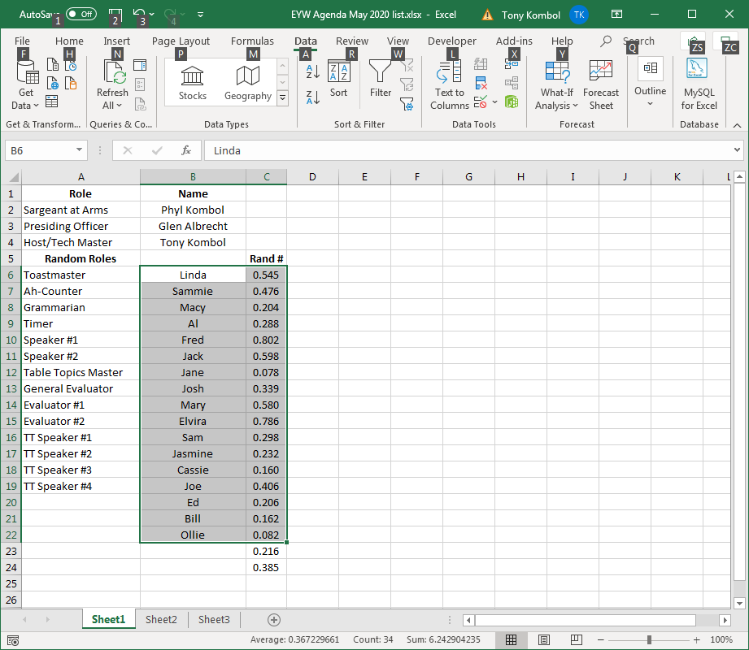
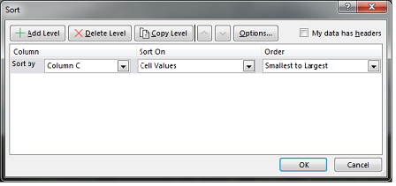
Randomize
Select columns B and C from the first person to the last person
  Note: you may need to select the row above the first person also to get all persons to shuffle
Select Data from the ribbon on top
  Click on the Sort box
  In the pop-up window under Column click on the drop-down arrow for Sort and choose Column C
  Click Ok to prime
Repeat at least 2 more times to thoroughly shuffle the names

Slide 6
Options
Save for future reference
Copy the roles to make an agenda

