Slide 1
Pathways for the NEW D37 in a New Toastmasters Year!
Phyllis Kombol, DTM
Pathways “PR”*
* “Park Ranger”

Slide 2
A couple years ago, my sister and I decided to go to South Mountain State Park to hike the High Shoals Waterfall trail. We stopped at the visitor center to chat with the Park Rangers and get a map. They said “That trail is only about a mile long, but it is strenuous.” Armed with our map and that information, we went to the trail and began on a flat area. “Not bad at all,” we thought. And then came the stairs, and more stairs, and a pause to catch our breath while we enjoyed watching the cascades. Several times, as we paused to catch our breath, we looked at each other and said, “They were right! This IS strenuous!” And then even more stairs! Up and up we climbed. Some people took a break along the way to fish in the river. And then there were even more stairs up! Finally we crossed the river and arrived, as advertised, at the observation platform with benches at the base of the lovely High Shoals Falls.

Slide 3
LESSONS from the High Shoals Falls Trail
Park Rangers/Resources
Know what to expect
Take your time
Customize the journey
Rest when you need to
Enjoy the journey

Slide 4
How can you apply these lessons to Pathways?
As a member?
As an Officer?
  SAA—
  Secretary –
  VPPR —
  VPM—
  VPE—
  President —
  IPP —
For (with) your members?
  For your members transitioning from Legacy to Pathways?
  For your new members?

Slide 5
Why do we need it?
Legacy education program concludes June 30, 2020
  Exception: “in Progress” ALS→DTM where roles will complete in 2020-2021
“Pathways adoption rates”
(from Toastmasters.org→Leadership Centrol→District Central)
  Members
  Officers
  New members

Slide 6
Data as of 6/24/2020: Pathways Adoption Rates
Division A: 17 clubs
Division B: 21 clubs
187 of 219 members 85% (not 32)
78 of 85 officers 92% (not 7)
  3 clubs are 100% of new members enrolled (total 8 of 8)
  4 clubs are NA because no new members during the year
  3 clubs 0 of their new members (4)
  7 clubs some but not all of their new members 15 of 23
  Total 23 of 35 were enrolled in Pathways 66%.
  12 new members were never enrolled in Pathways
295 of 381 members 77% (not 86)
103 of 109 officers 94% (not 6)
  6 clubs at 100% of new members (10)
  7 clubs no new members for the year
  3 clubs none of their new members (3)
  5 clubs some but not all 11 of 21
  Total 21 of 34 new members were enrolled
  13 were never enrolled in Pathways
Notes:
Data as of 6/24/2020
Division A: 17 clubs
187 of 219 members 85% (not 32)
78 of 85 officers 92% (not 7)
3 clubs are 100% of new members enrolled (total 8 of 8)
4 clubs are NA because no new members during the year
3 clubs 0 of their new members (4)
7 clubs some but not all of their new members 15 of 23
Total 23 of 35 were enrolled in Pathways 66%.
That means 12 new members were never enrolled in Pathways
Division B: 21 clubs
295 of 381 members 77% (not 86)
103 of 109 officers 94% (not 6)
6 clubs at 100% of new members (10)
7 clubs no new members for the year
3 clubs none of their new members (3)
5 clubs some but not all 11 of 21
Total 21 of 34 new members were enrolled
13 were not ever enrolled in Pathways

Slide 7
By participating, you will be able to
Identify steps for getting engaged with Pathways as a MEMBER
Explain the impact of Pathways on your role as a CLUB OFFICER
Define steps to take to help your club’s CURRENT MEMBERS transfer from the legacy education program into Pathways
Locate resources to assist your club to orient NEW MEMBERS to the Pathways Education Program
Commit to a plan of action

Slide 8
As a member, start Pathways NOW if you haven’t already!

Slide 9
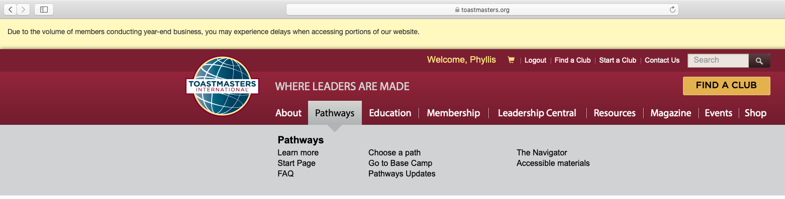
Pathways for YOU as a Member
Start your Pathways journey by logging into toastmasters.org
Look under the Pathways tab

Slide 10
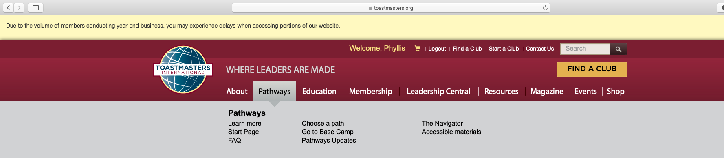
Pick a Path and get on it

Slide 11
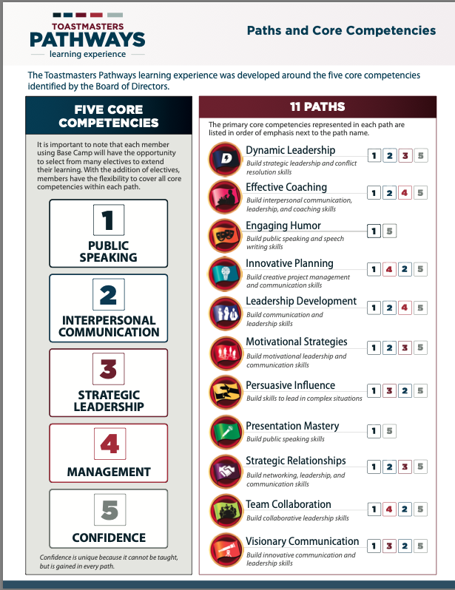
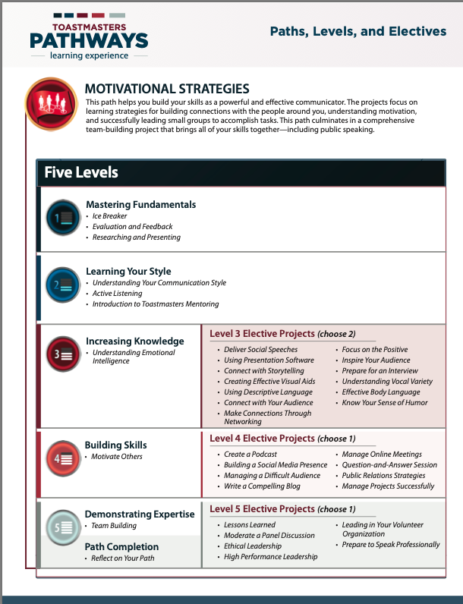
Each Path has 5 Levels
Each Path has a different balance of the 5 main Core Competencies

Slide 12
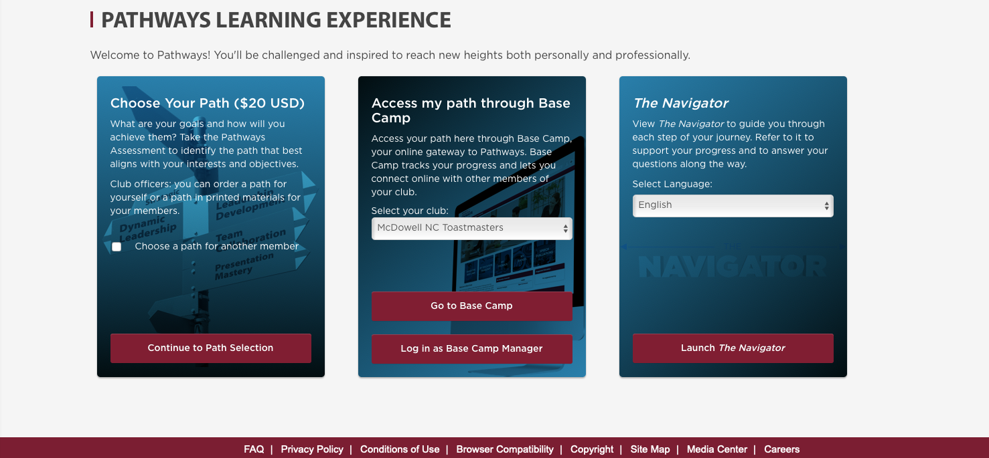
I wonder why this is here…?
Are you a member of multiple clubs?
Your first Path is included with your new member fee.
You only see this if you are a BCM

Slide 13
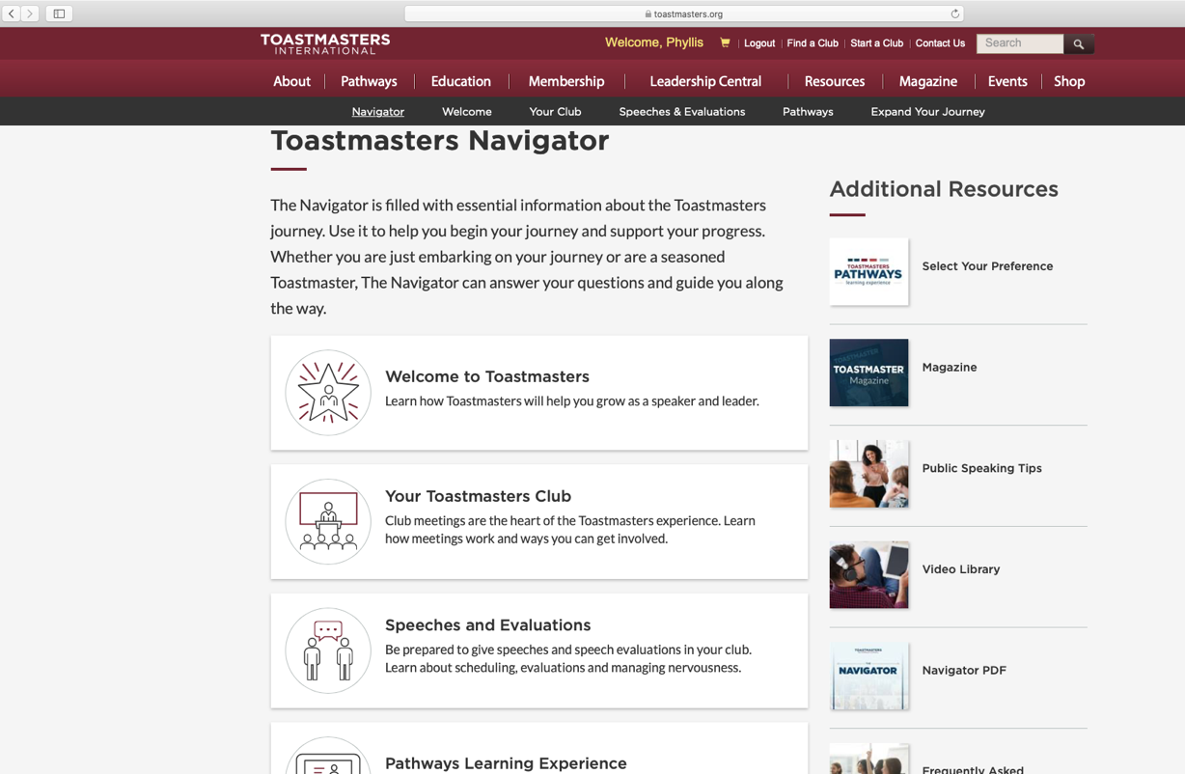

Review the Navigator, online or as a pdf

Slide 14

Base Camp home page WAS…

Slide 15
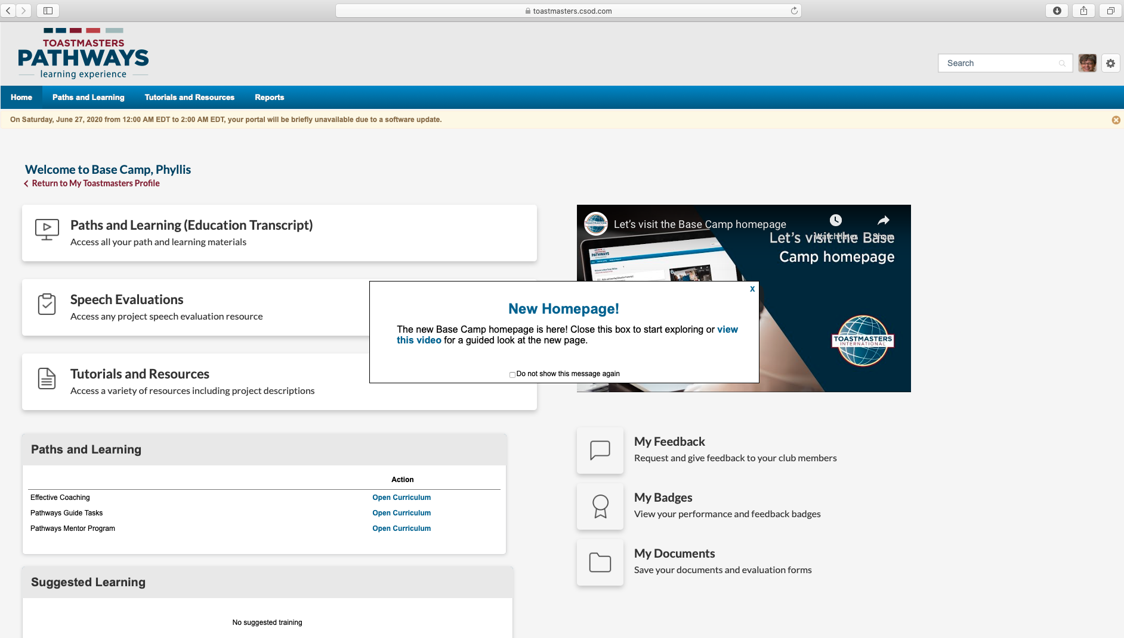
NOW…

Slide 16
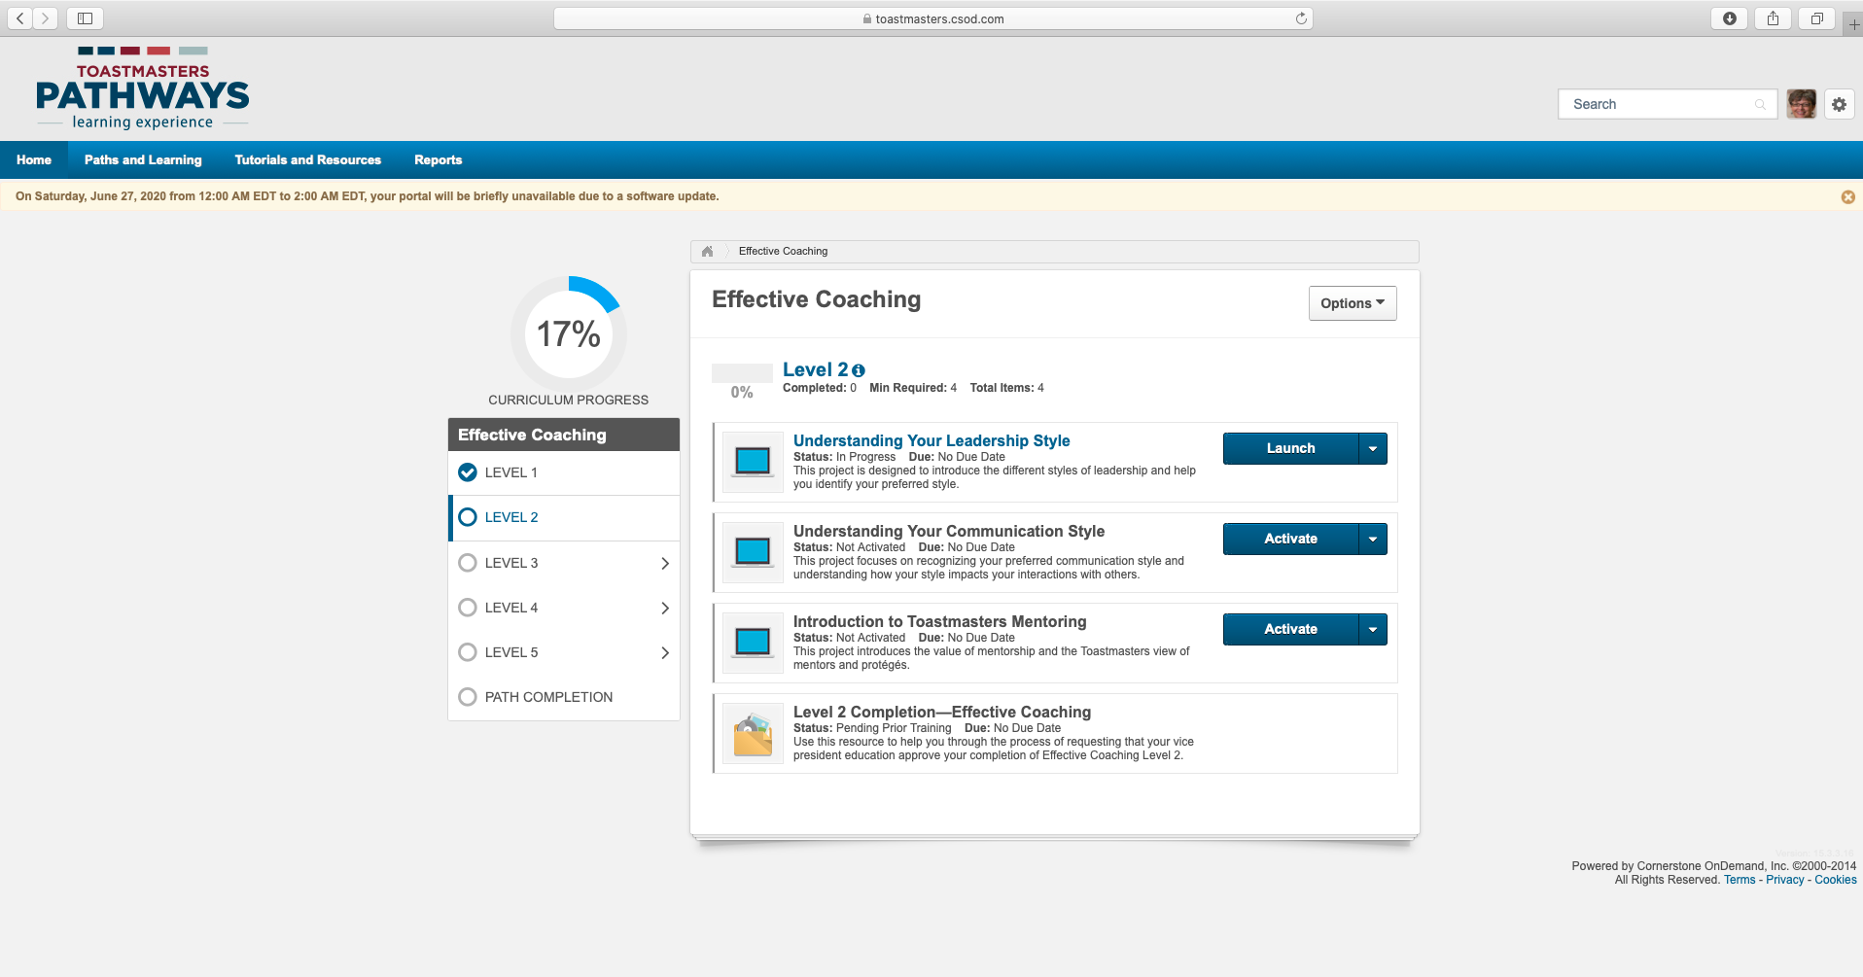
WORK IN YOUR PATH: Activate, then Launch

Slide 17
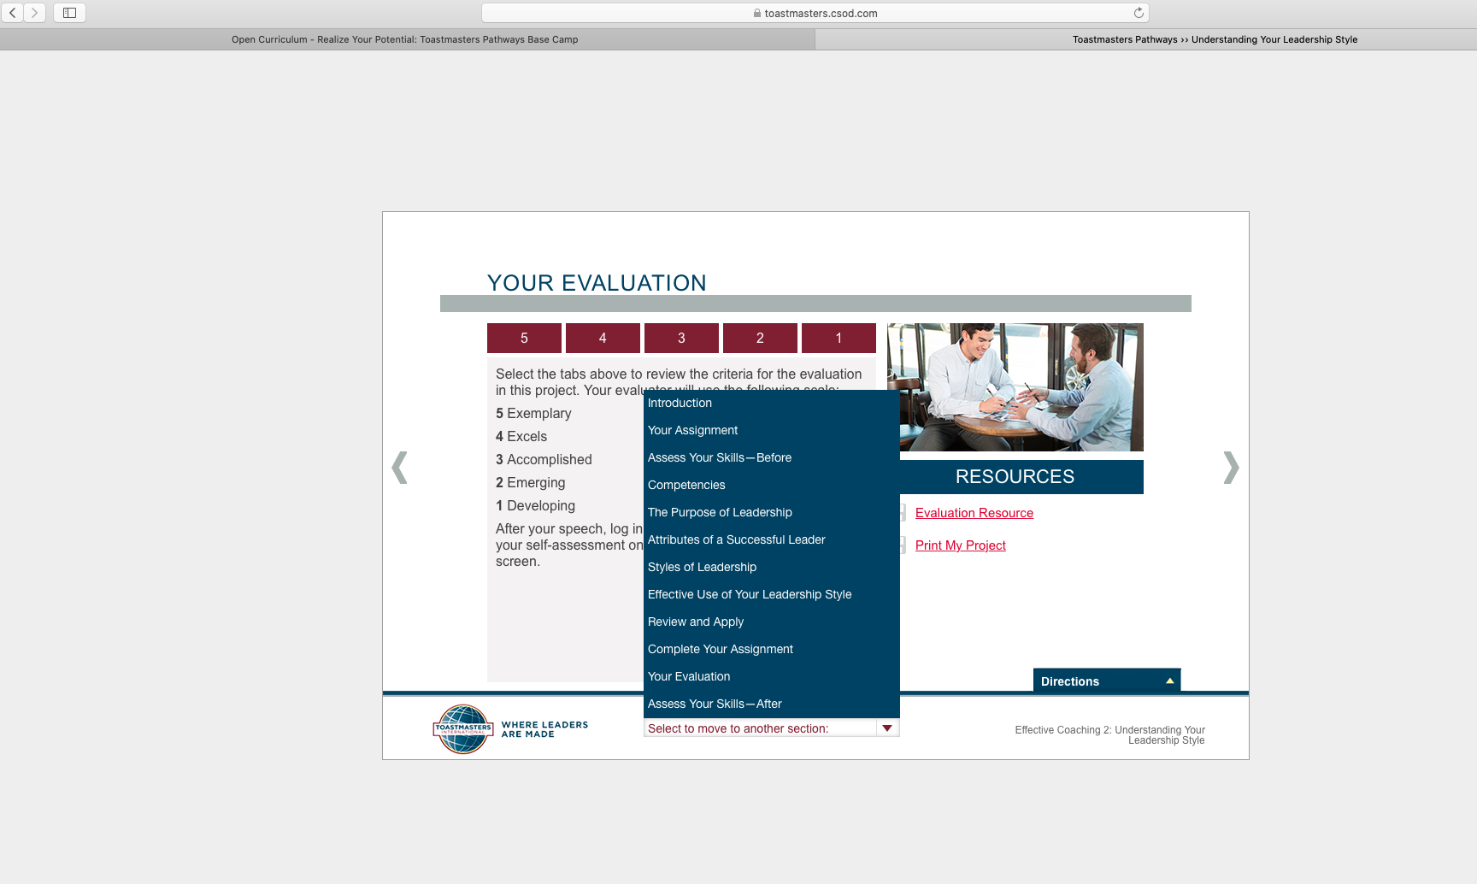
Use this red arrow to pop up the “table of contents”

Slide 18
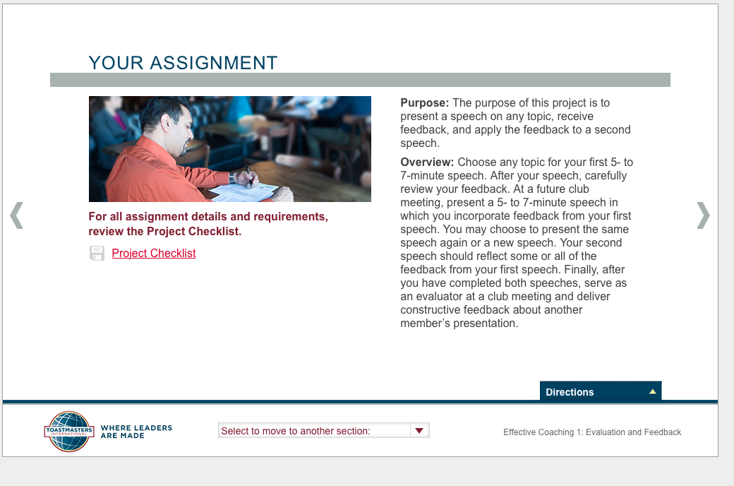
Use the tools like this Project Checklist to get an overview of the tasks you need to do

Slide 19
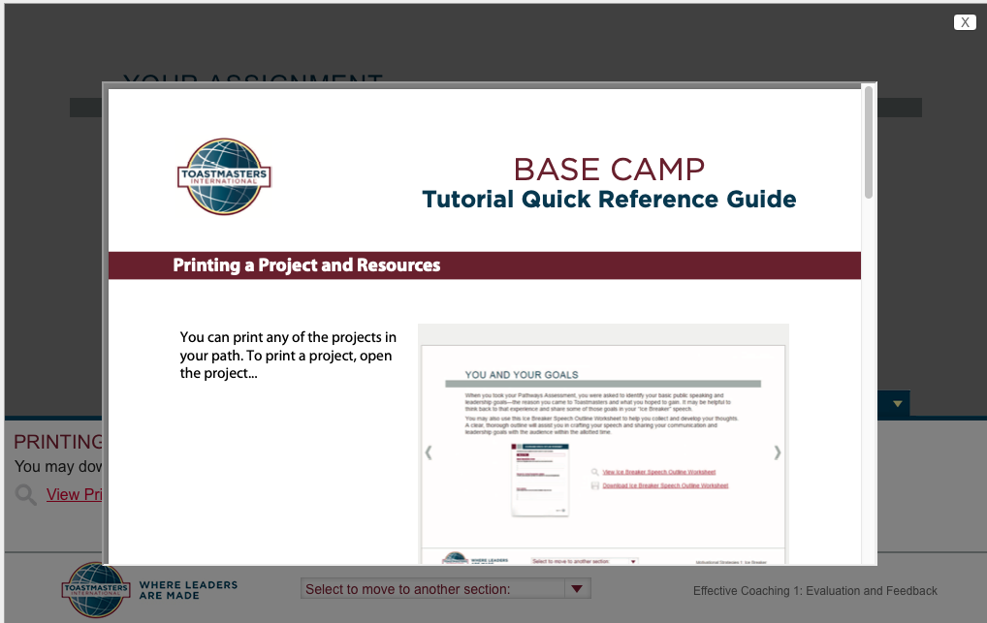
How to print it

Slide 20
See this?

Slide 21
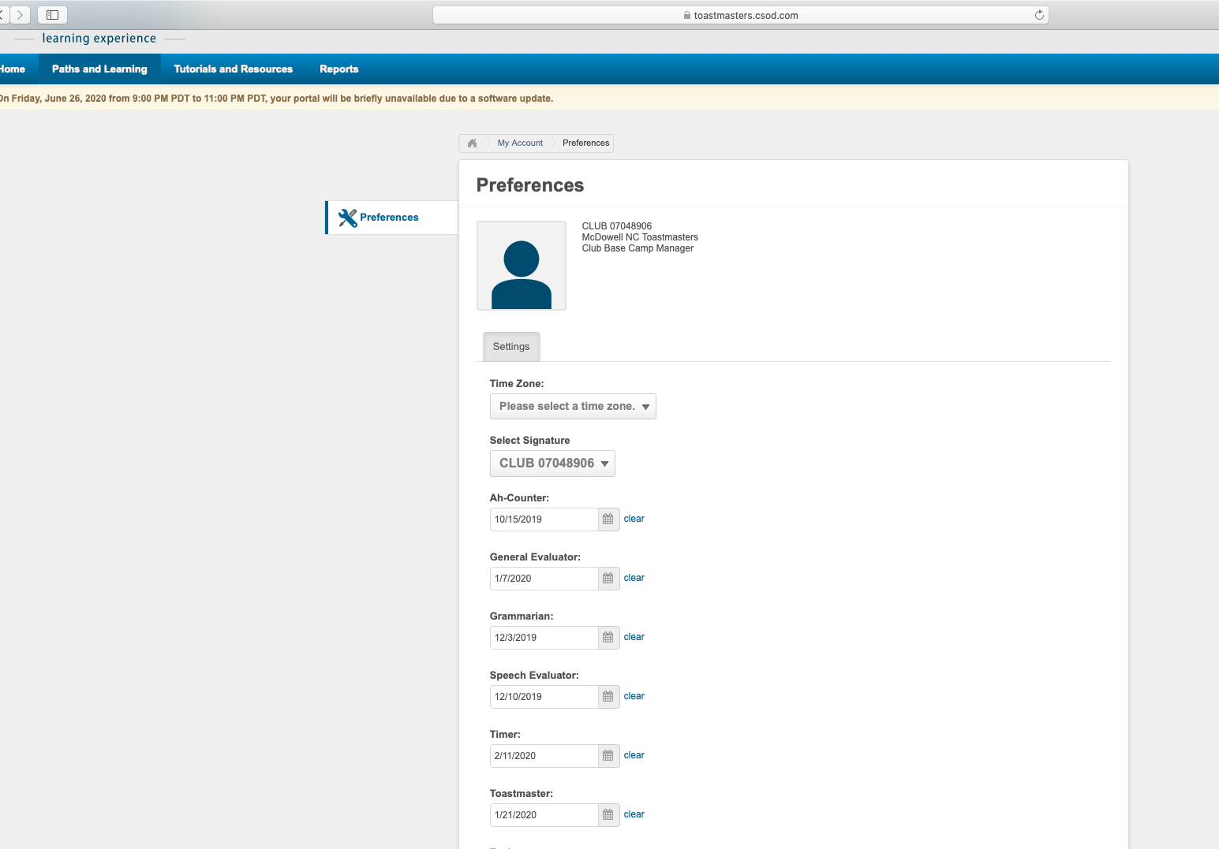
Record your meeting roles here

Slide 22
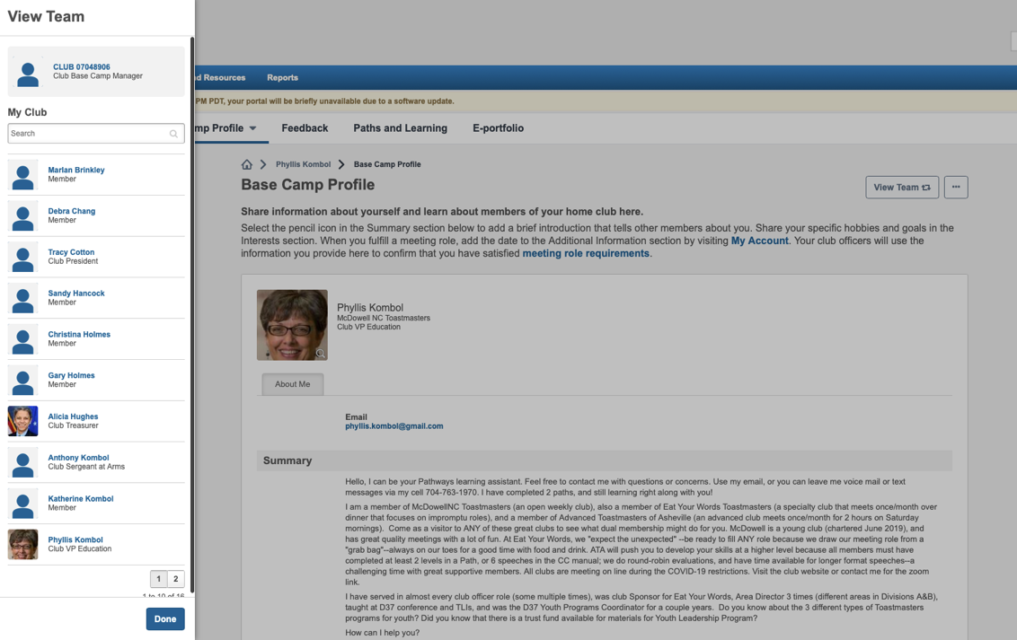
Your profile; team member list

Slide 23
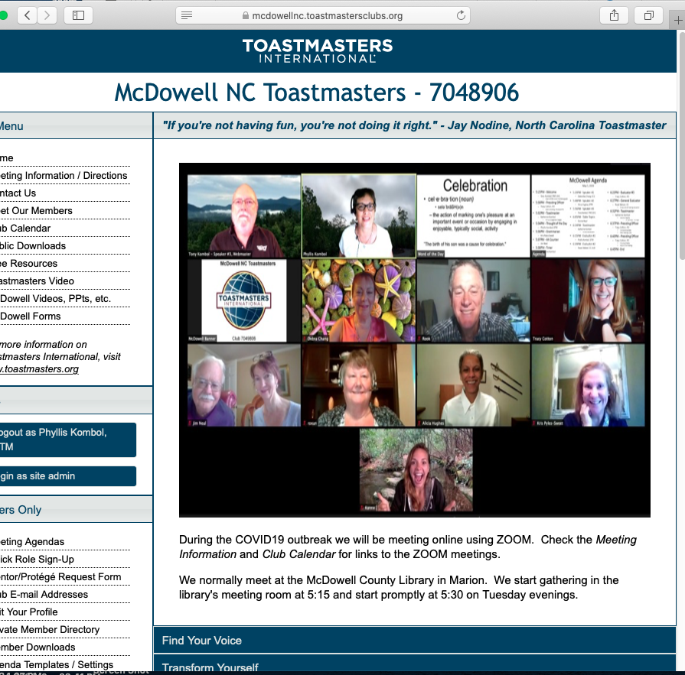
How to complete a project—the details
(example Evaluation and Feedback Project)
Go to EYW, ATA or McDowellNC FTH for 12-minute video and/or ppt resource

Slide 24
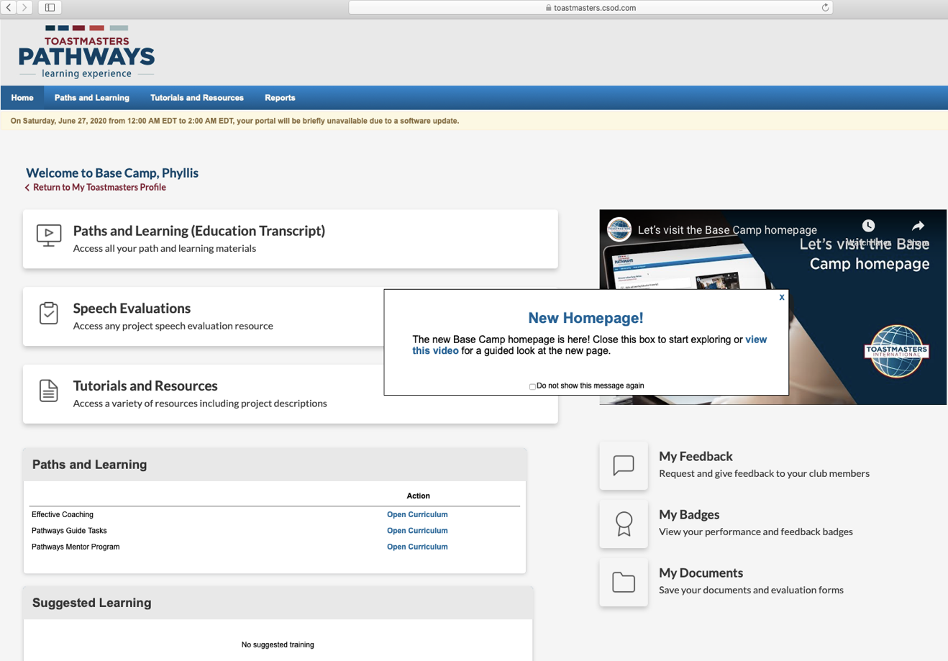
Evaluations, Tutorials & Resources
Next

Slide 25
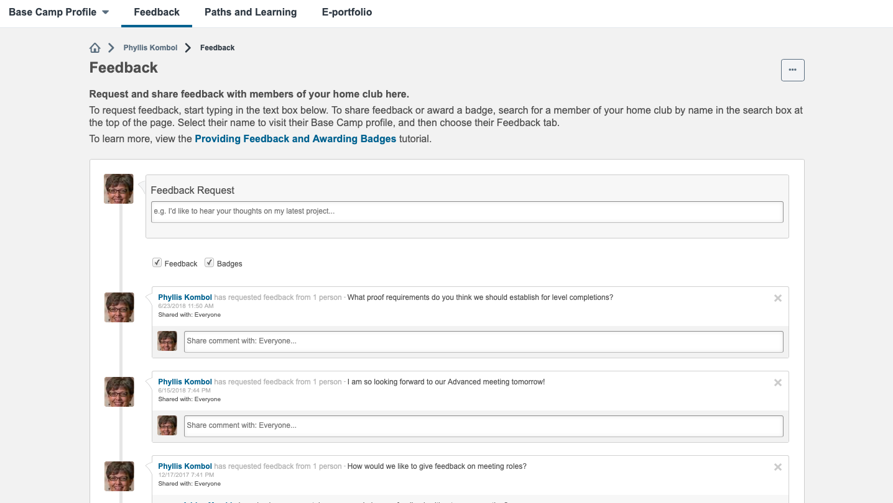
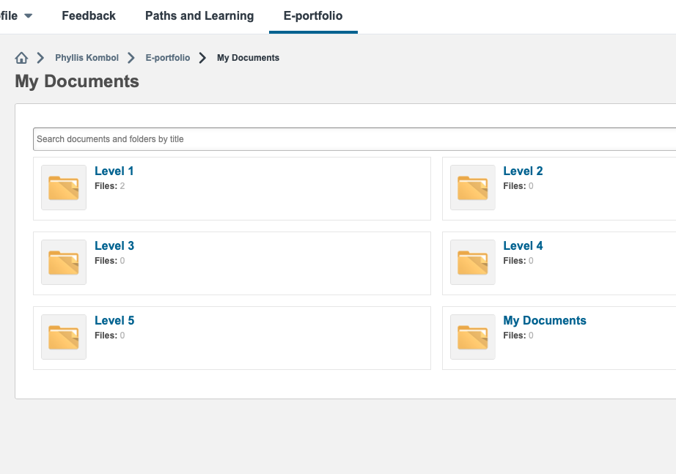
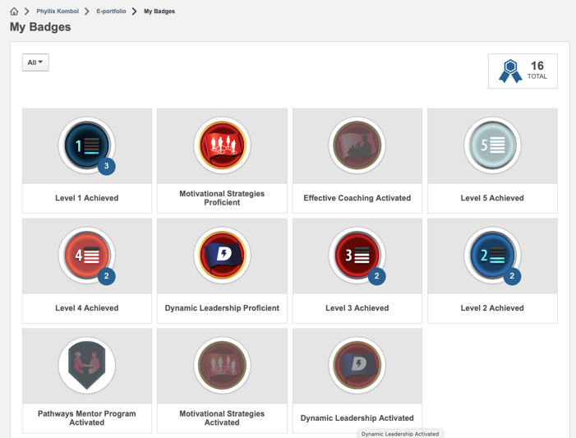
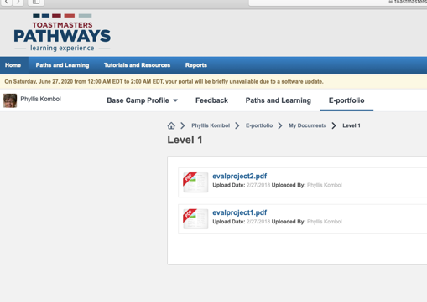

Slide 26
How to complete a LEVEL:
One step at a time
Level 1 (same for every Path) = 3 Projects
Ice Breaker Project
  1 speech “The Ice Breaker”
Evaluation and Feedback Project
  “First” Speech –get feedback
  “Second” Speech—apply the feedback received
  Evaluator Speech—evaluate another member’s speech
Researching and Presenting Project
  1 speech demonstrating research on a topic, distinguishing between fact/opinion sources, and citing sources
Enter a Level Completion Approval Request

Slide 27
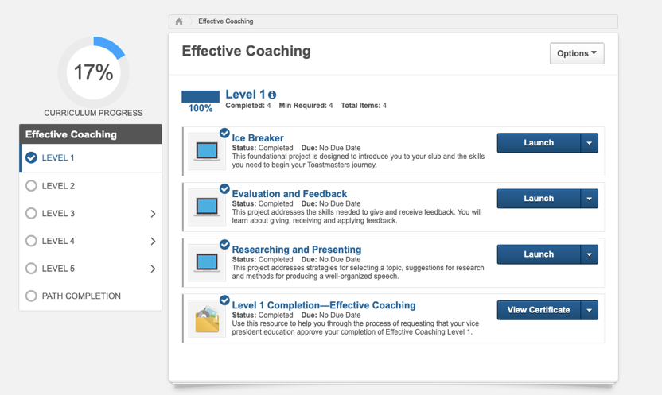
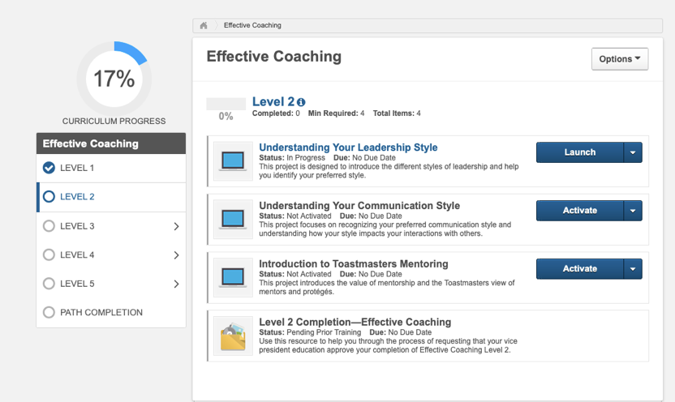
After all projects done in a level, the final step in that level is to request a level completion approval.

Slide 28
What happens when you put in a
Level Completion Approval request
Who gets the request?
  How can you check where it is likely to go?
  How can you be sure they got it?
  What if you are a member of multiple clubs?
  How do you decide which club “gets the credit”?
What do they do?
When should they do it?
  Why?
What else do they need to do so that the club “gets the DCP credit”?

Slide 29
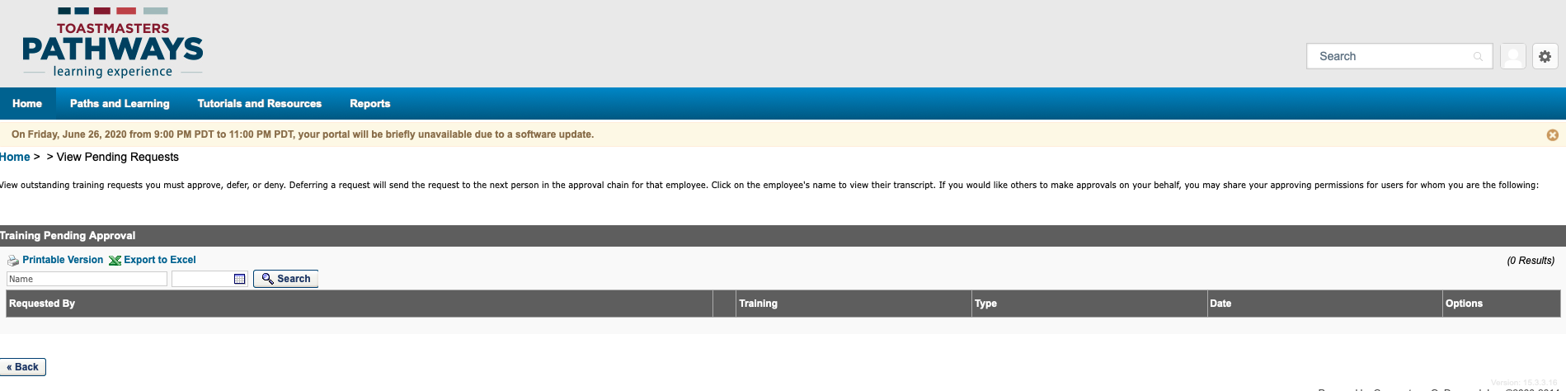

Slide 30
Help your current members transition from the legacy education program to Pathways and YES, it will seem like it’s all uphill!

Slide 31
Help them find their way… invite them in, with your help.
Walk with them.
Maybe ask them to evaluate introductory resources that you will be using with new members:
Watch one, do one, teach one

Slide 32
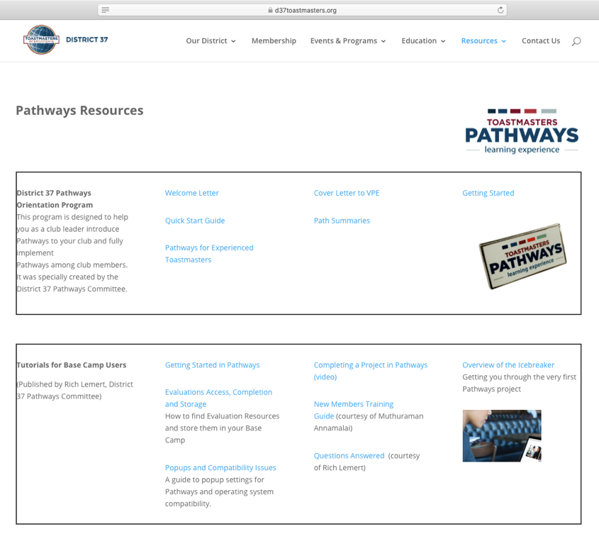
Pathways Resources from D37toastmasters.org
Screenshots walk the member through accessing Pathways, selecting a Path, completing the Ice Breaker Project
Brief summary of each of the 11 Paths (4 pages)
Slideshow presentation from Lemert/Hye
(22 slides with notes incl DTM in Pathways)
D37toastmasters.org→Resources→ Pathways Resources

Slide 33
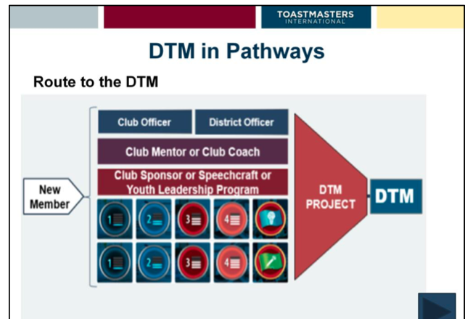
DTM in Pathways

Slide 34
For your new members: make the path smooth and easy; help them see the long view

Slide 35
2
1
3
Pathways for your new members—
Don’t confuse the issue by talking about
“how it used to be”

Slide 36
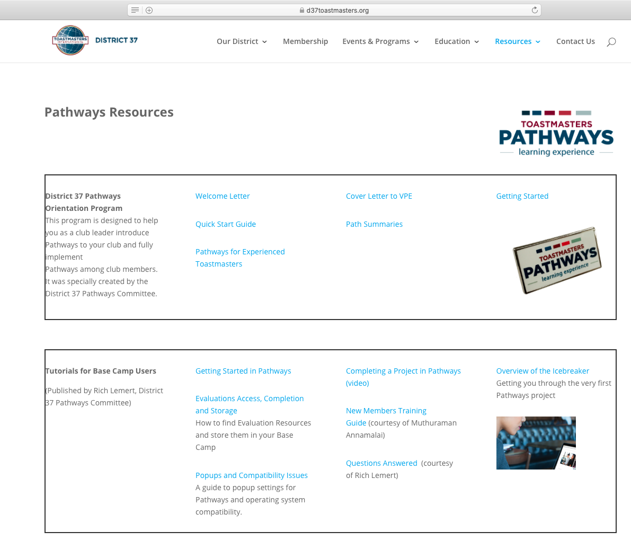
Orientation and education
Mentoring, monitoring and guiding
Resources from D37toastmasters.org
Box 1
  Welcome Letter
  Quick Start Guide
  Path Summaries
  Getting Started
Box 2
  Getting started in Pathways
  Overview of the Icebreaker
  Completing a Project (video)
  Evaluations Access…
  If needed, Popups

Slide 37
Club Officers, how will you use this?
SAA
Treasurer
Secretary
VP-PR
VP-M
VP-E
President
IPP

Slide 38
Club Officer HINTS
Toastmasters.org→login
  use your email used when enrolled as a member of Toastmasters, password
Leadership Central→Club Central
  Get roster—See who is enrolled in Pathways
  Also
    Submit payments for new members/renewals
    Submit education awards (after Pathways approval by BCM)
    Check DCP status

Slide 39
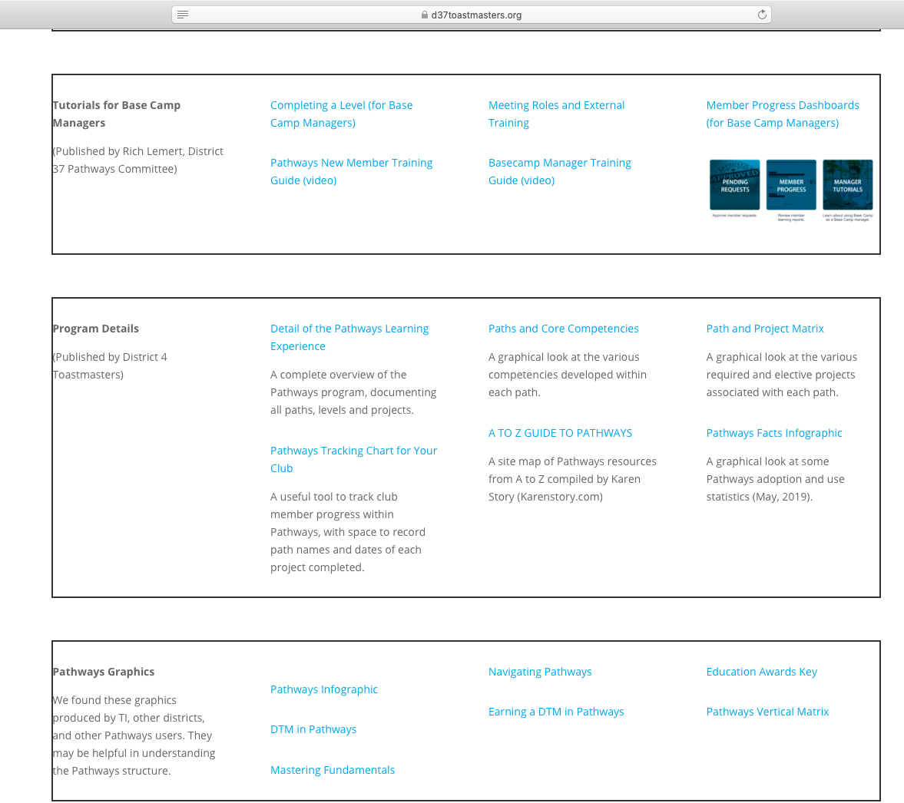
More resources from D37toastmasters.org for Club Officers
3
Paths and Core Competencies (box4)
Path and Project Matrix (box 4)/Pathways Vertical Matrix (box 5)
Completing a Level (for BCM) (box 3)
Meeting Roles (show members this) and External Training (box 3)
Member Progress in Dashboards (for BCM) (box 3)
Graphics (box 5)
  Infographic
  Mastering Fundamentals
  Education Awards Key
4
5

Slide 40
Base Camp Manager Labyrinth
Next 11 slides

Slide 41
Log in→Pathways→ Base Camp

Slide 42
Now log in as Base Camp Manager

Slide 43
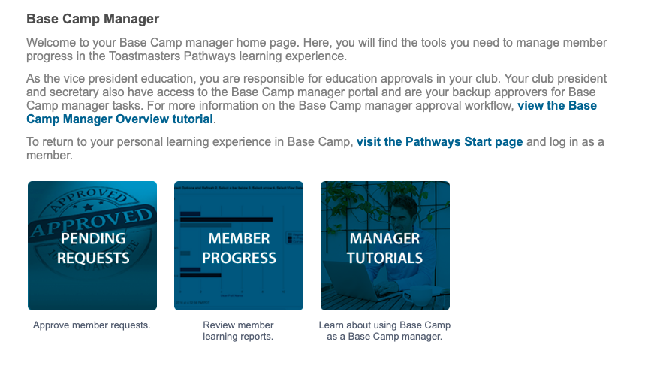
BASE CAMP MANAGER TASKS
2
1

Slide 45
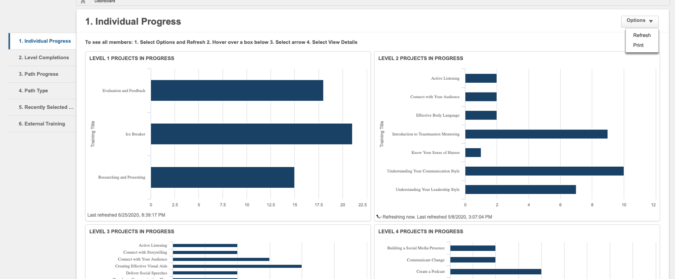

Slide 46
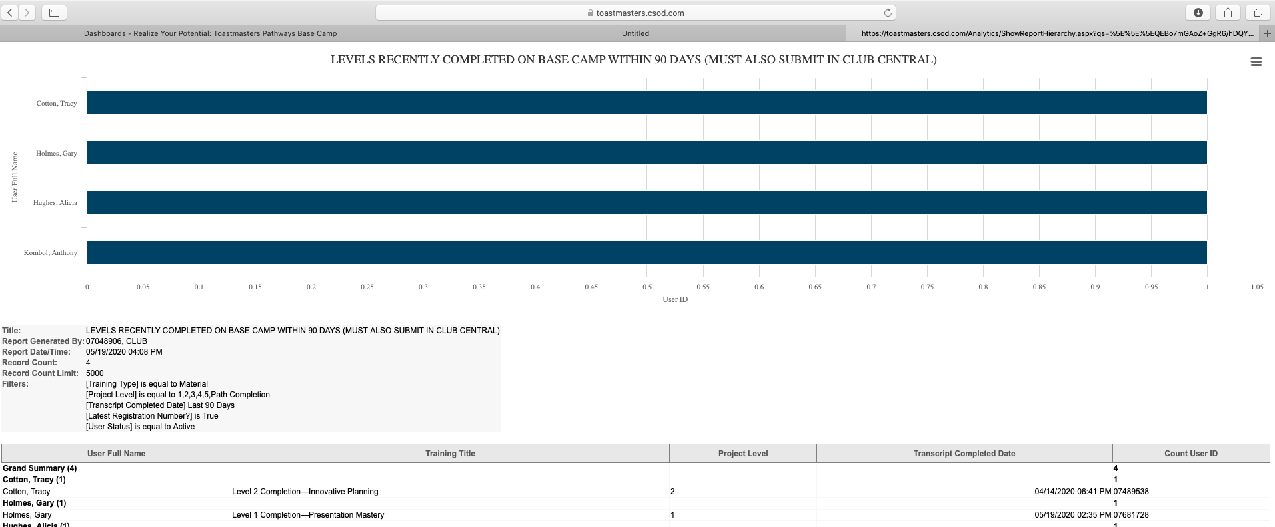

Slide 47
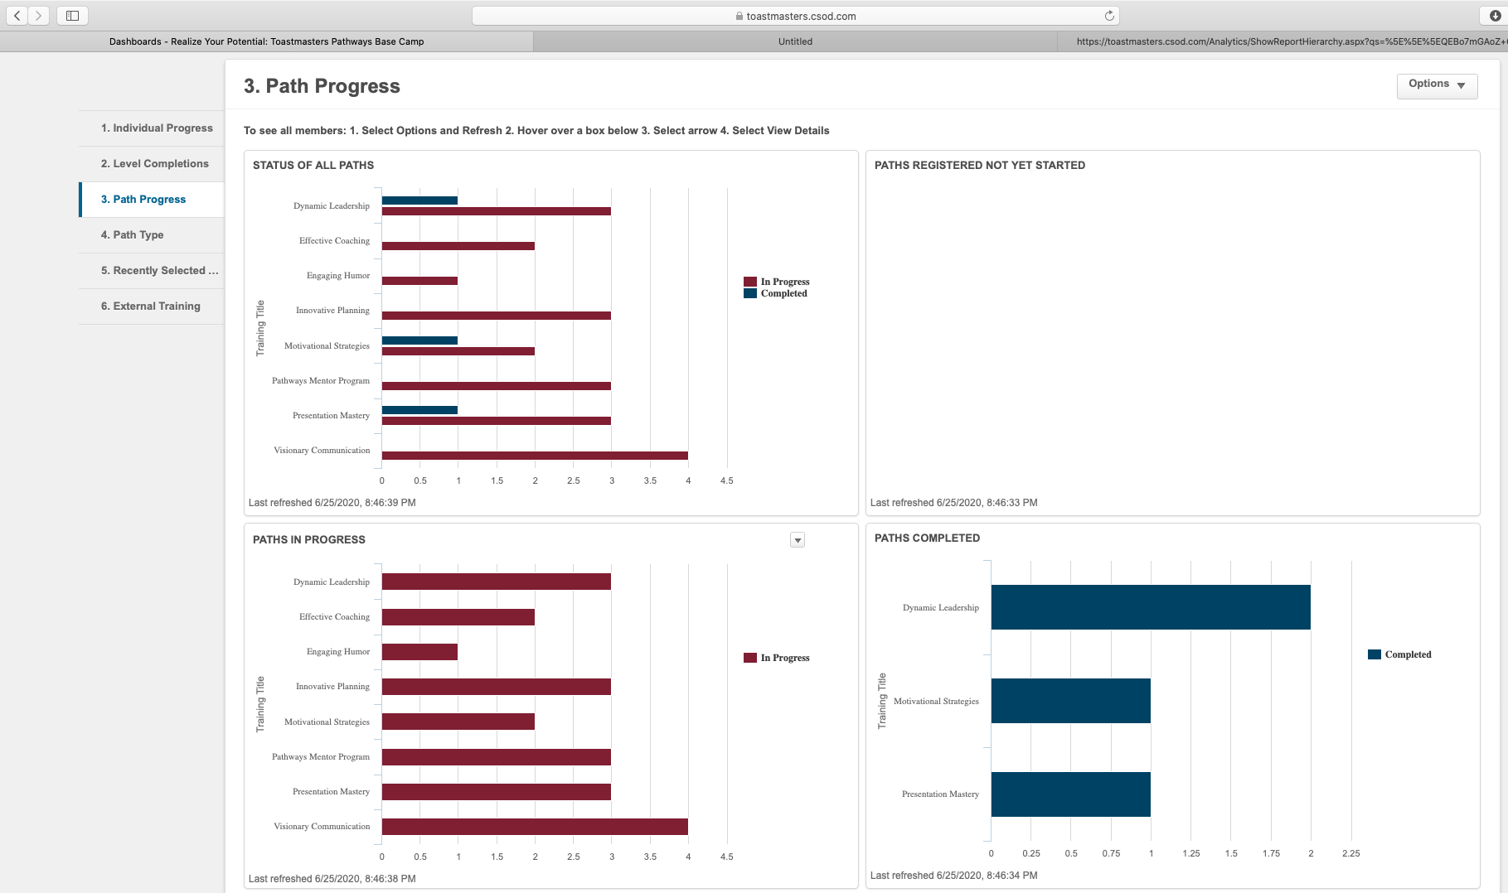

Slide 48
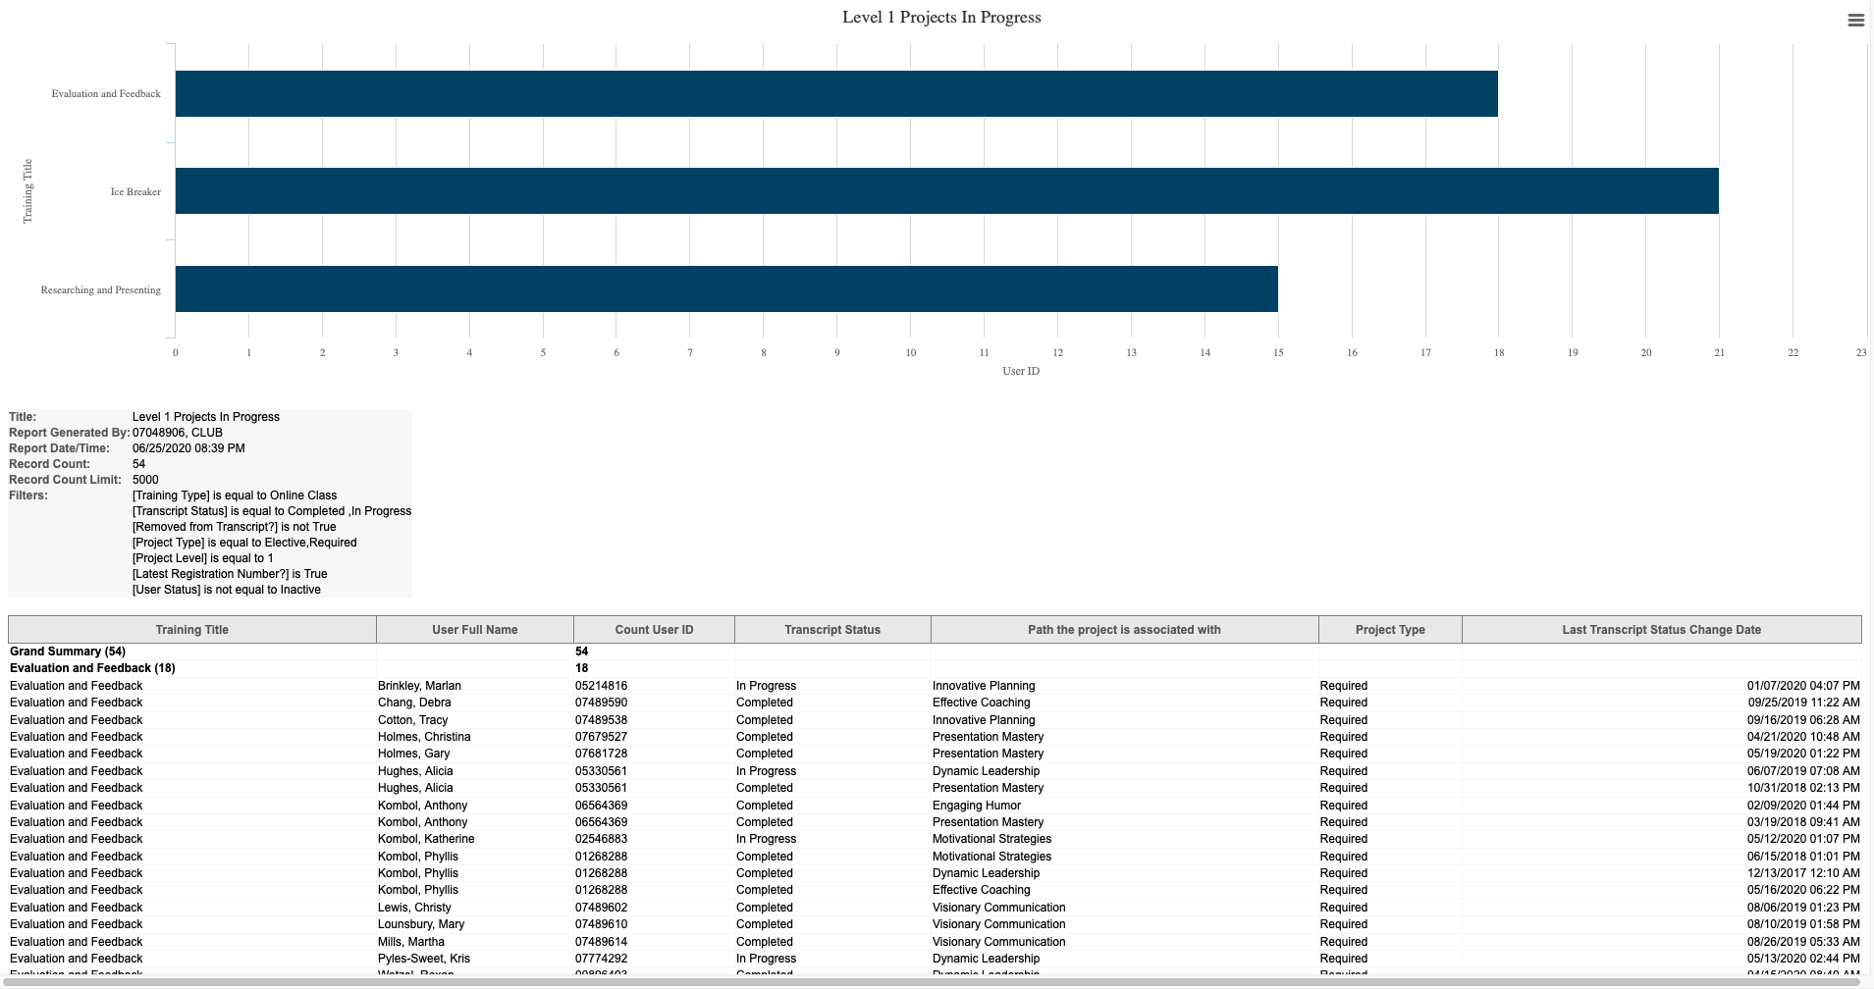

Slide 49
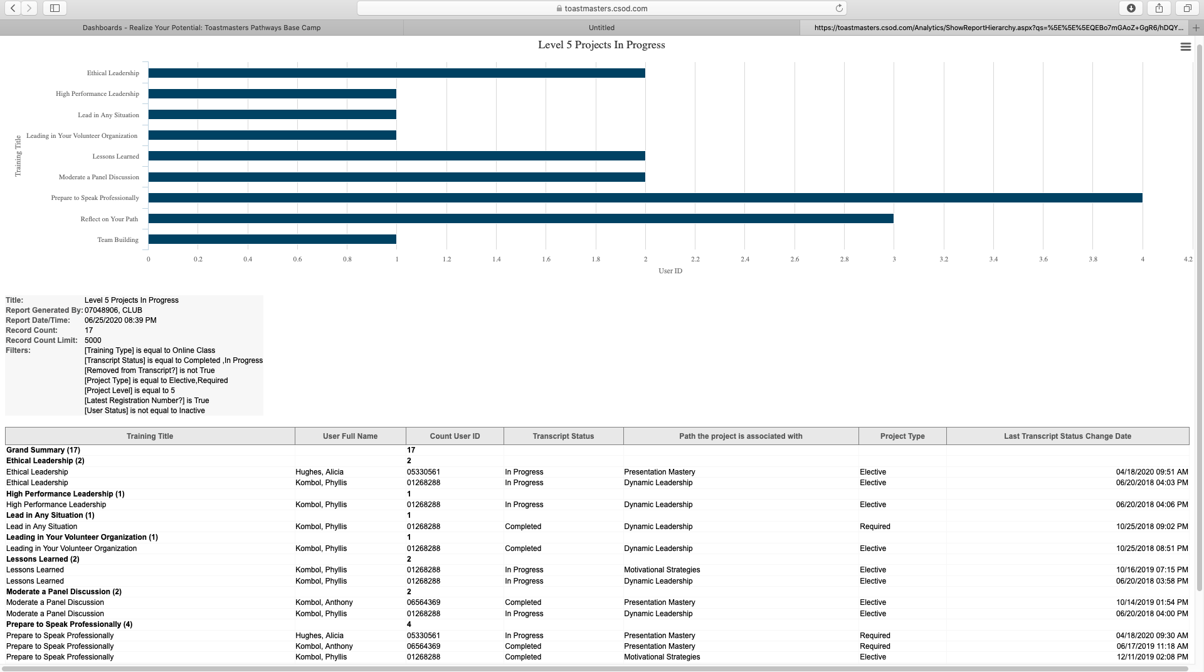

Slide 50
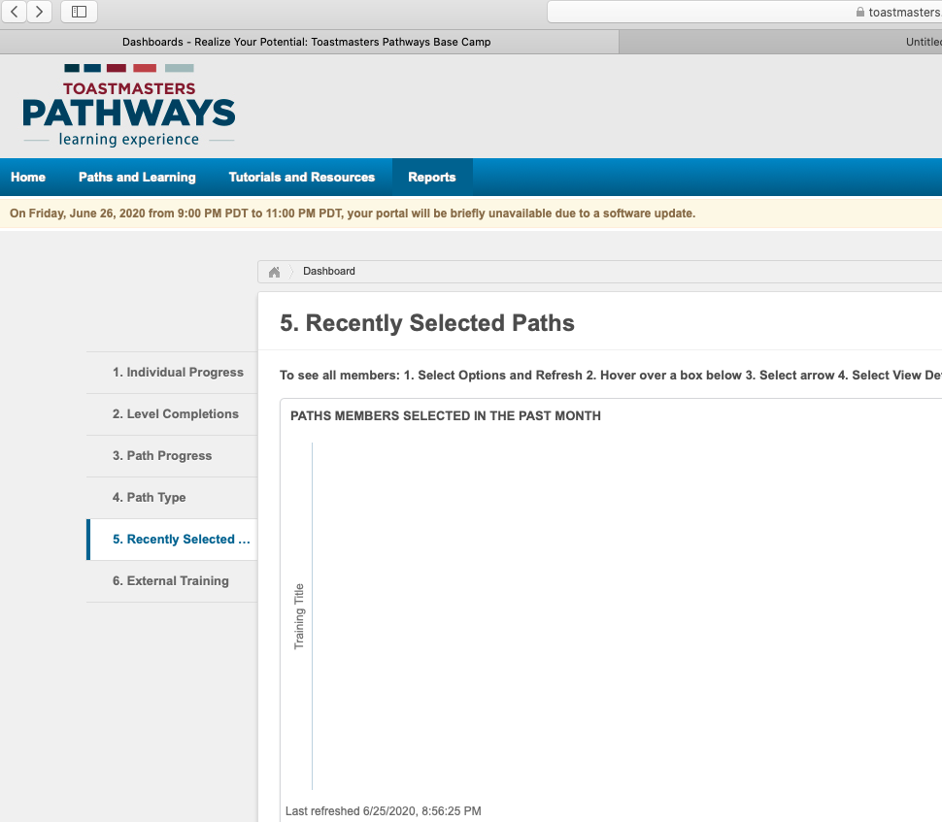

Slide 51
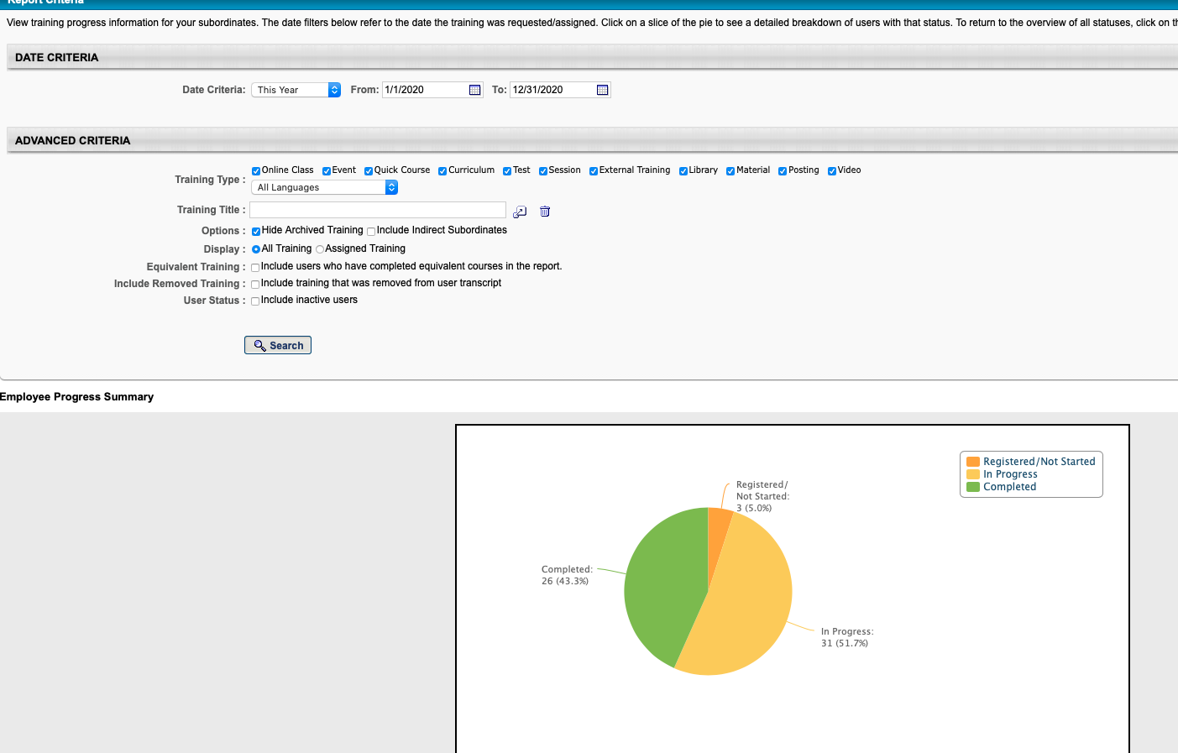
Another way to look at it:
Training Details

Slide 52
Resources
Next 5 slides

Slide 53
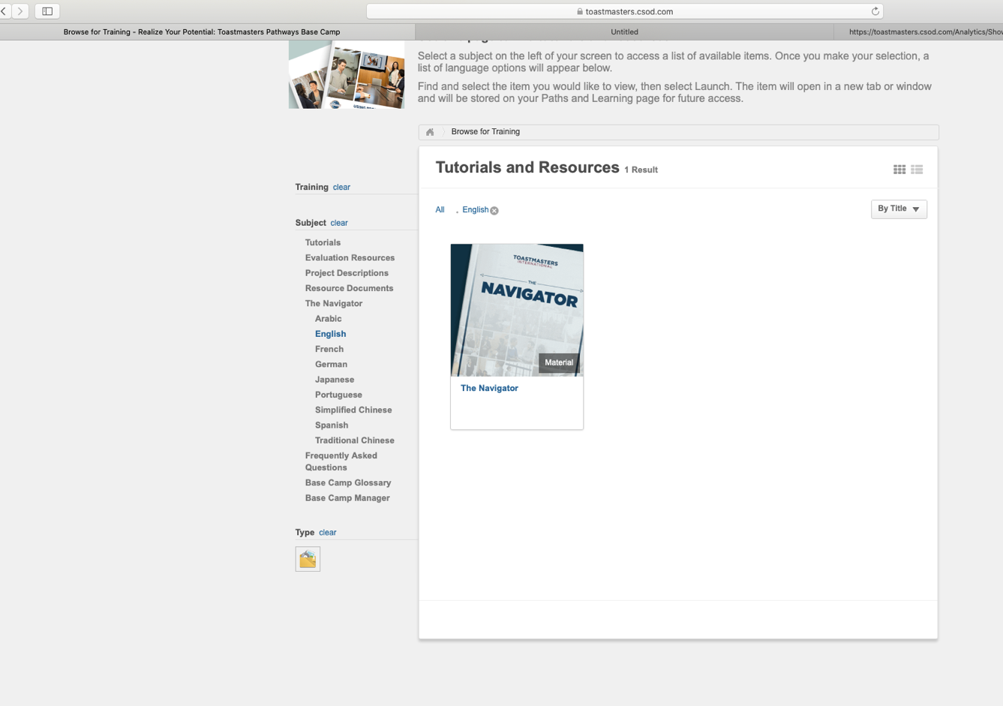
Tutorials and
Resources
Including
The
Navigator

Slide 54
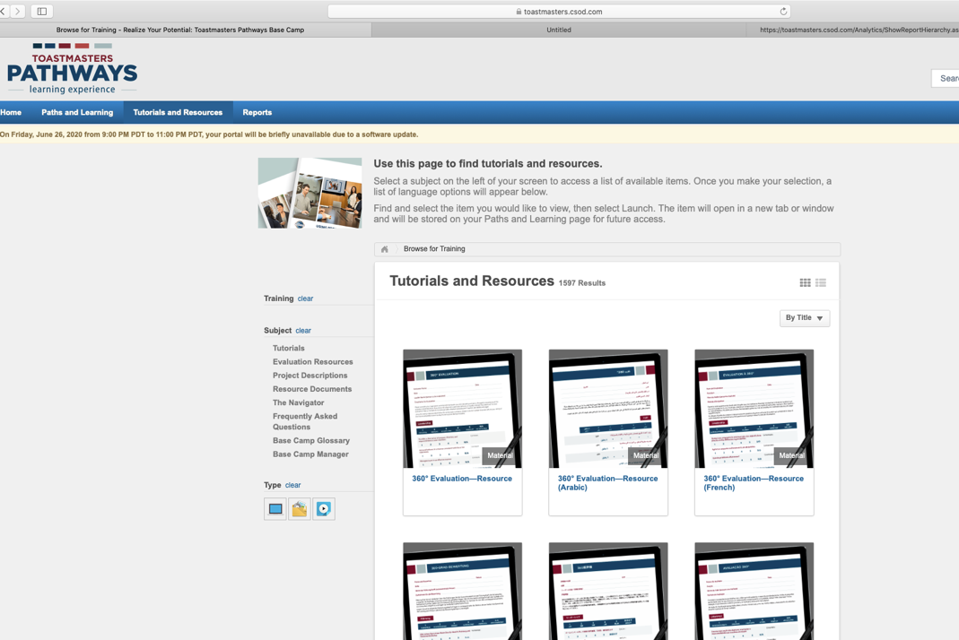
Where to get Speech Evaluation Resources

Slide 55
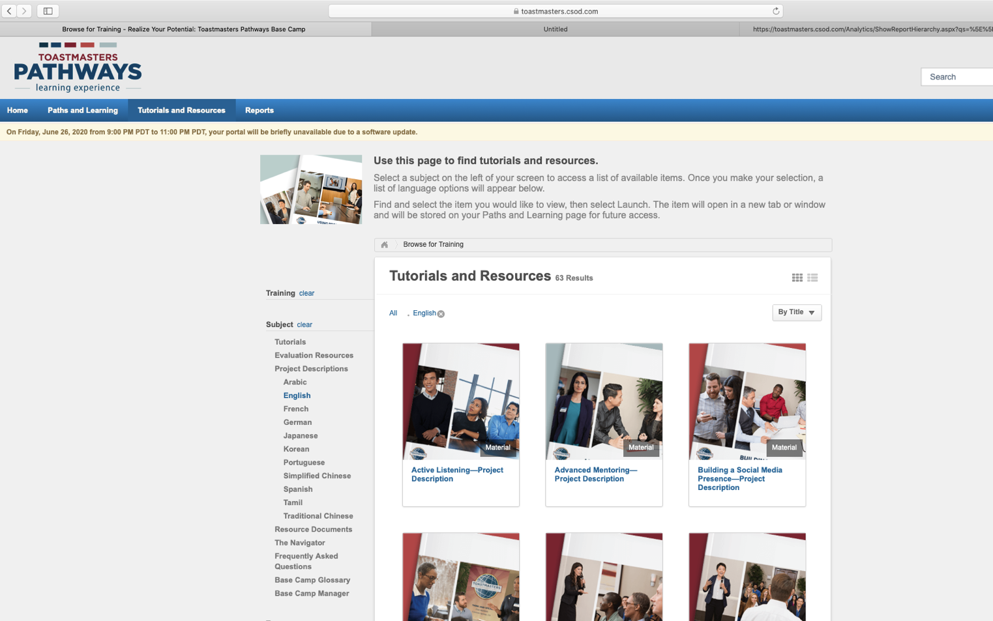
Project
Descriptions

Slide 56
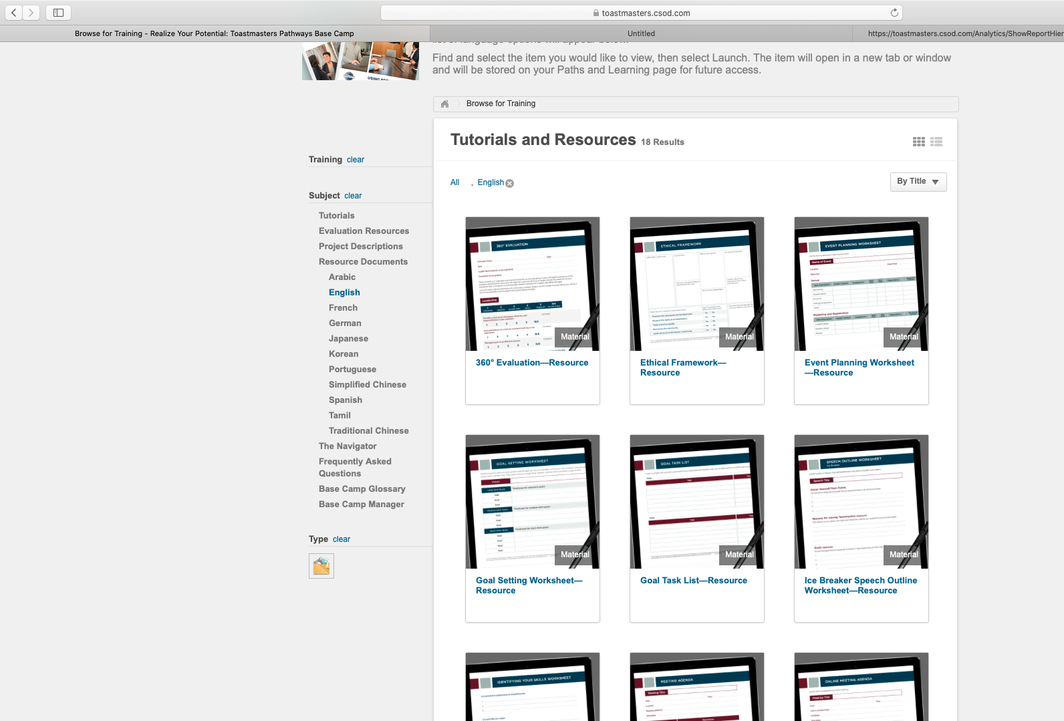
Resource Documents
> Worksheets >360 Eval
>Checklists

Slide 57
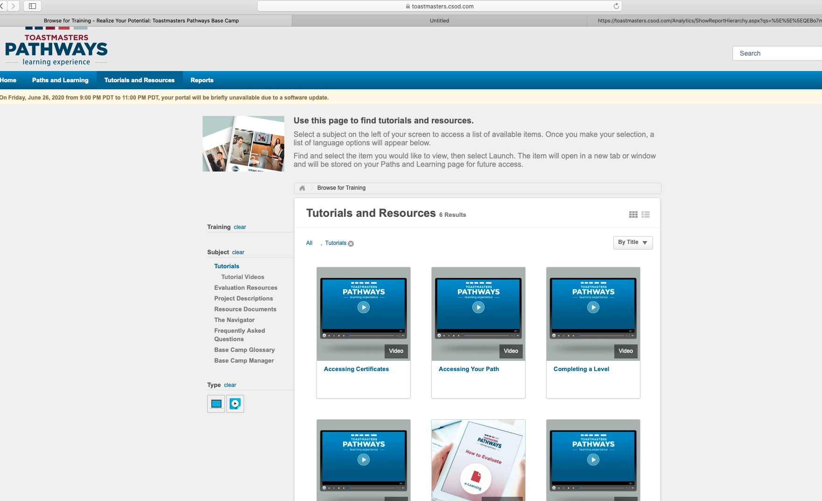

Slide 58
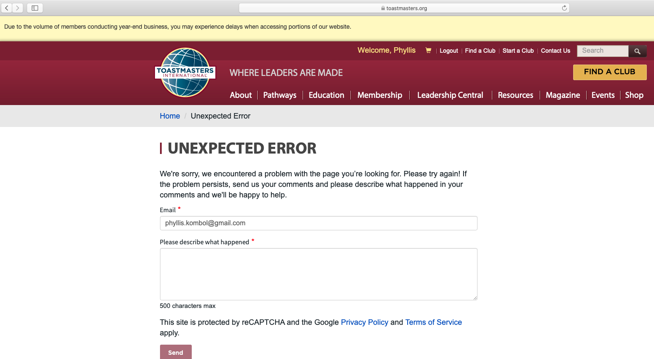
Go exploring... AFTER July 1

Slide 59
BEFORE YOU SET OUT,
GATHER YOUR RESOURCES

Slide 60


Slide 61
https://literarydevices.net/a-journey-of-a-thousand-miles-begins-with-a-single-step/
Lao Tzu, a renowned Chinese philosopher, wrote
(probably the 4th or 6th century)
“A Journey of a Thousand Miles…”

Slide 62
https://literarydevices.net/a-journey-of-a-thousand-miles-begins-with-a-single-step/
The original text is:
“A journey of a thousand li starts beneath one’s feet.”
Here li means “mile”
This quote was first used in Chinese classic text; Tao Te Ching attributed to Lao Tzu

Slide 63
Commit RIGHT NOW
What will YOUR next steps be?
1.
2.
3.

Slide 64
How to reach me
Phyllis.Kombol@gmail.com
704-763-1970 (cell)
Advanced Toastmasters of Asheville: 3rd Saturday 9:00-11:00 AM
Eat Your Words Toastmasters (Concord/I85): 2nd Wednesday 6:00-8:30 PM
McDowellNC Toastmasters (Marion): weekly Tuesdays 5:15-6:45 PM

