Slide 1
Toastmasters D37 DEC
How to invite people to Toastmasters
Pathways Education Program
Phyllis Kombol, DTM
Pathways “Park Ranger”
July 18, 2020

Slide 2
Objective:
By the end of this session, participants can locate
Pathways resources
For guest packets
For prospective members
For new members
For members transitioning from legacy program to Pathways

Slide 3
Disclaimer:
Suggestions
  My opinion/recommendations
Pathways is Toastmasters
NOT the only “right” answer
What are your best practices?

Slide 4
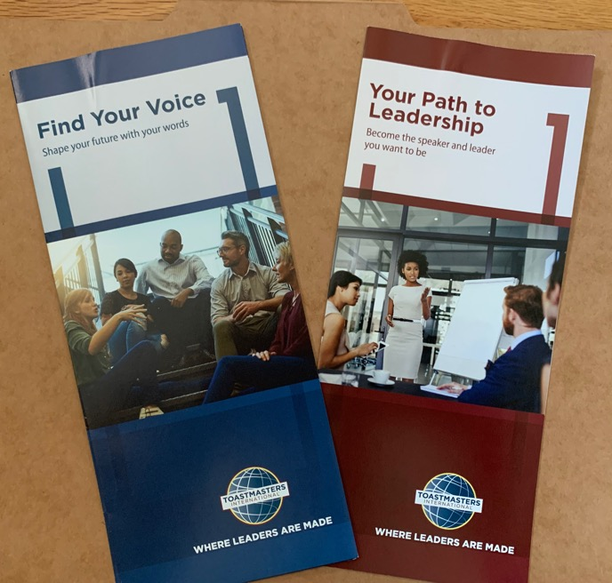

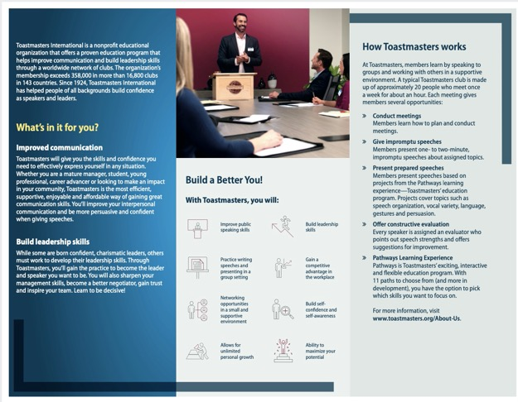
For Guest Packets:
Toastmasters.org
  Marketing Brochures
    All About Toastmasters Item 124
    Find Your Voice Item 99
    Your Path to Leadership Item 101
  Send in mail
Link: Toastmaster Magazine

Slide 5
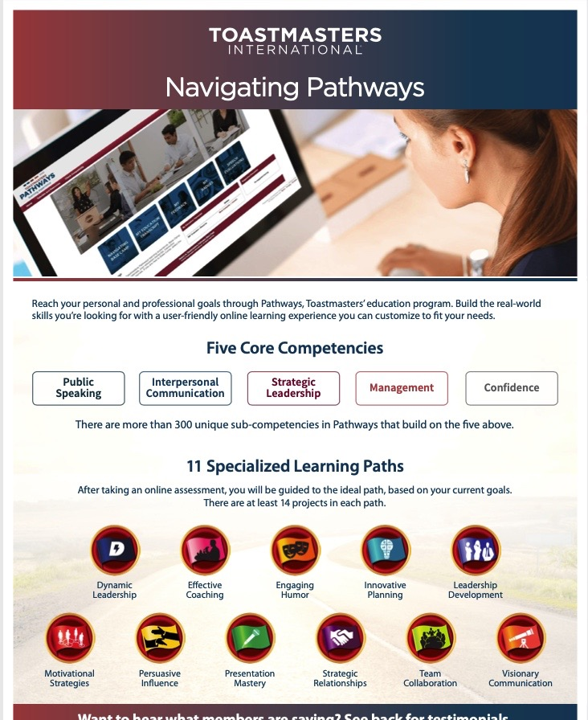
For Guest Packet:
Toastmasters.org-->Marketing Fliers –one page, customizable
  10 Tips for Public Speaking Item 105
  Benefits of Toastmasters Membership Item 354F
  Become a Better Leader Item 131
  Navigating Pathways Item 133

Slide 6
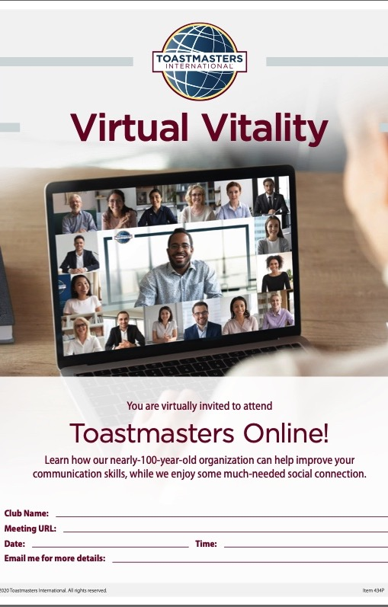
For Guests:
Toastmasters.org
Online Resources
  Virtual Vitality
  Quick Links/Resources Item 434P https://www.toastmasters.org/resources/online-prospect-flier

Slide 7
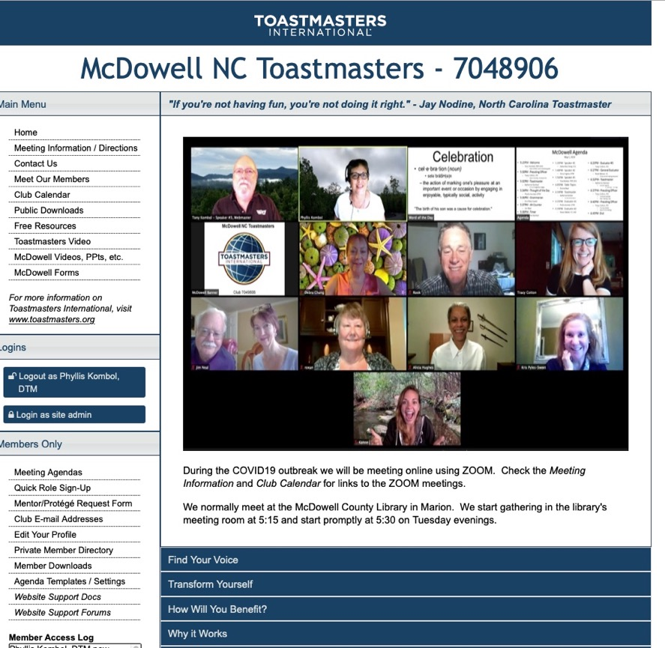
For Guests:
Club-Specific
How did they find you?
  Social media is up to date
  Prompt response
FTH (club website)
  Invite (requires them to opt-in)
  Send/share Agenda
  Meet our members
  Club specific trifold or flier?
  —see Brand Manual

Slide 8
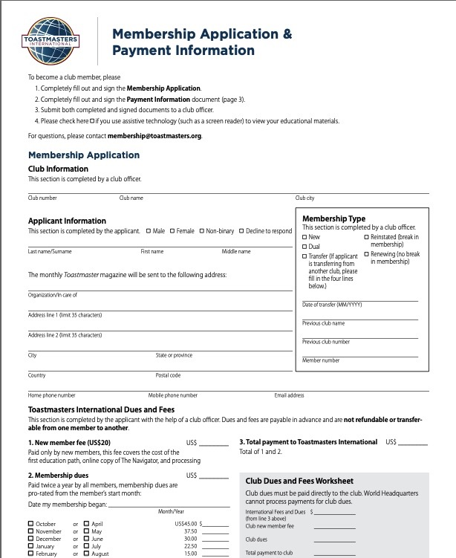
For Guests:
At the meeting
Contact info
Introductions
  Meeting roles & speaker intros
Table Topics
  What is it?
  Members first
  THEN invite them to try
Reaction/Comments at end of meeting
Close the sale:
  Would you like to come again?
  Can I send you a membership application?

Slide 9
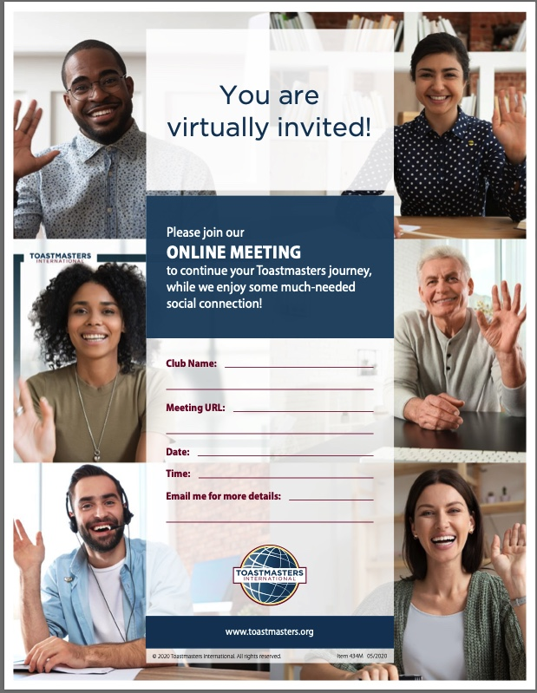
For Guests: follow up
Prospective Members
Email or phone call
Invitation to attend again
https://www.toastmasters.org/Resources/Online%20Member%20Flier
Agenda
Something specific to your club
Something generic re Toastmasters
  Toastmasters magazine link
  Brochure or Navigating Pathways
Toastmasters.org/club website

Slide 10

For Prospective Members
How to get enrolled—
  Application form with help
  Immediate enrollment
Watch for TI email
Three websites
  Toastmasters.org
  D37toastmasters.org
  FreeToastHost or other club-specific website
A Toastmasters Wears Many Hats
Ice Breaker

Slide 11
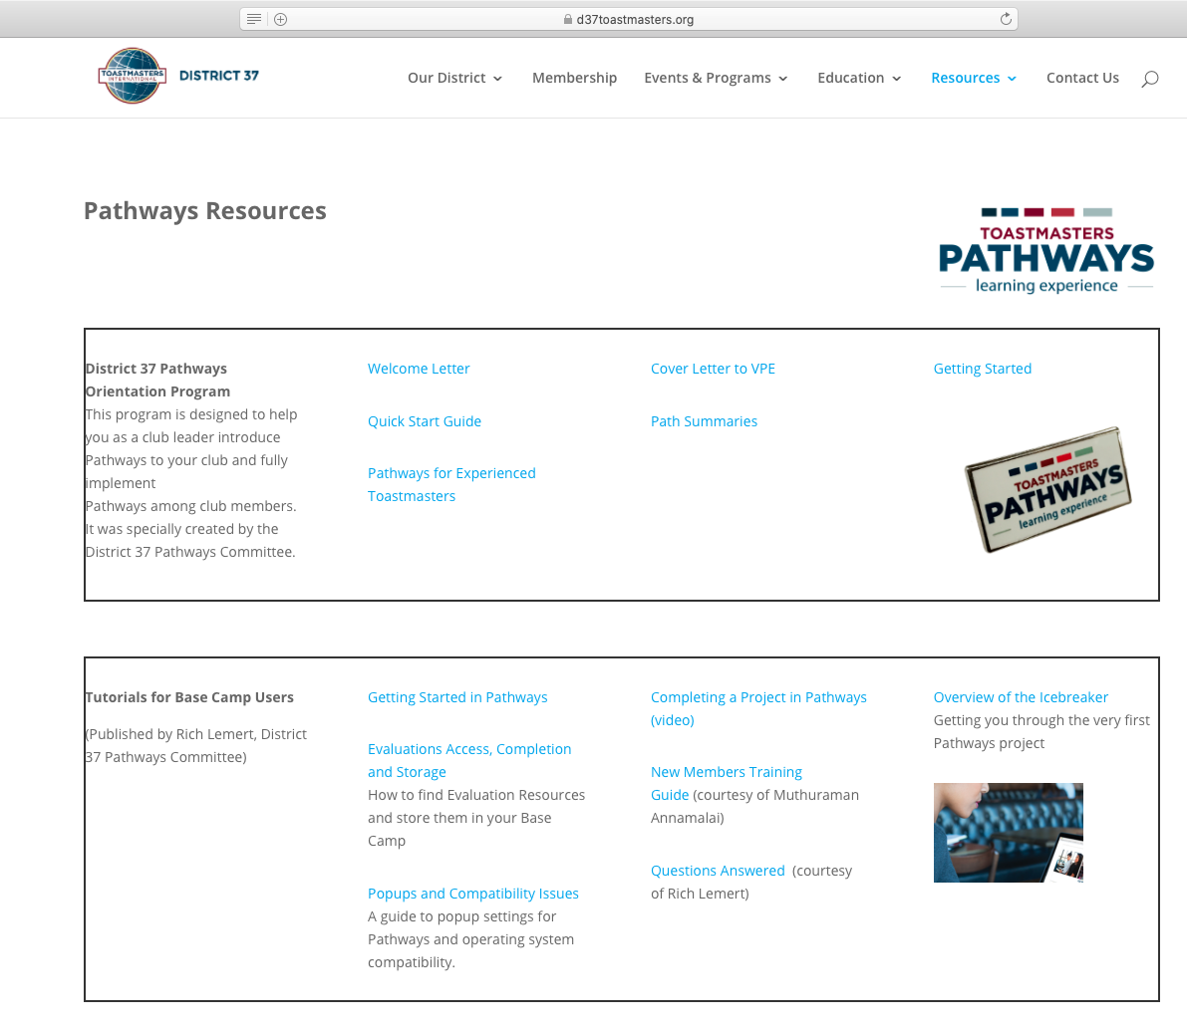
New Member
Orientation and education
Resources from D37toastmasters.org
Box 1
  Welcome Letter
  Quick Start Guide
  Path Summaries
  Getting Started
Box 2
  Getting started in Pathways
  Overview of the Icebreaker
  Completing a Project (video)
  Evaluations Access…
  If needed, Popups

Slide 12
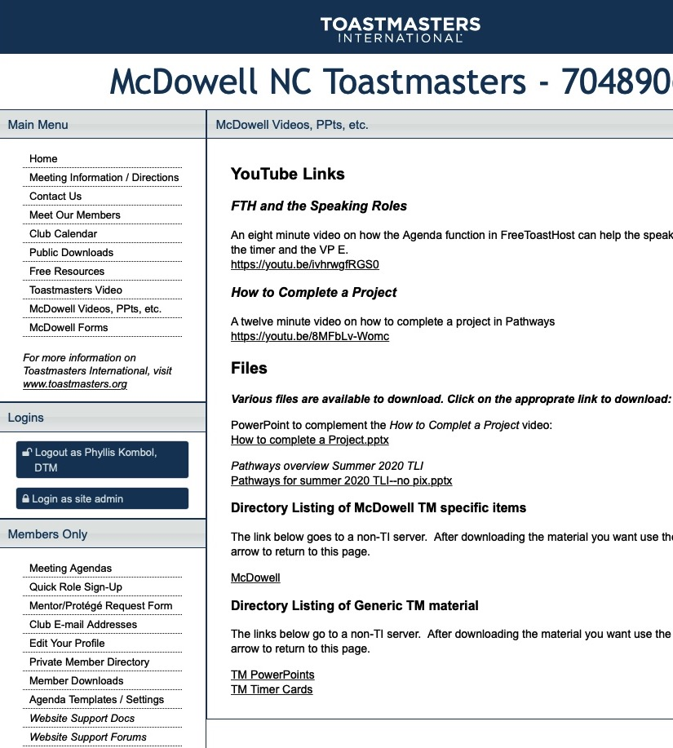
For New Members
Navigator
VPE letter (d37)
  Vote them in
  Induction
How to get started
  Choosing a path—
    Paths and competencies
    Comparisons/distinctions
  Ice Breaker
  How to complete a project

Slide 13
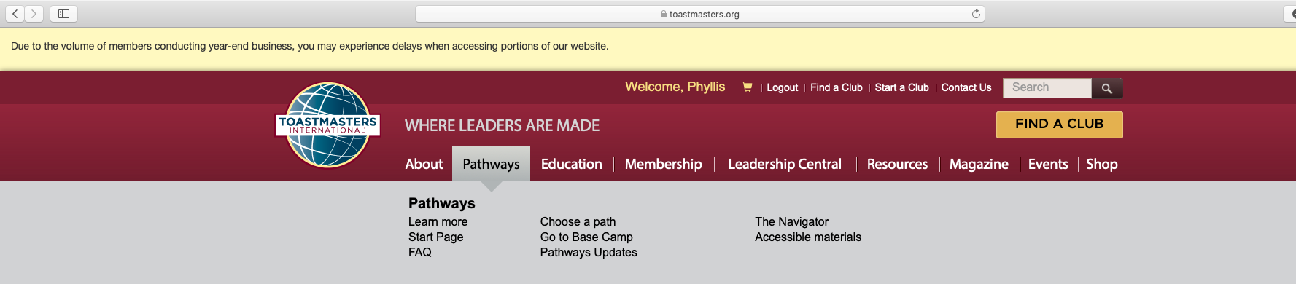
2
1
3
Pathways for your new members—
You might need a mentor (or officer) to walk through it with them.
Don’t confuse the issue by talking about
“how it used to be”

Slide 14
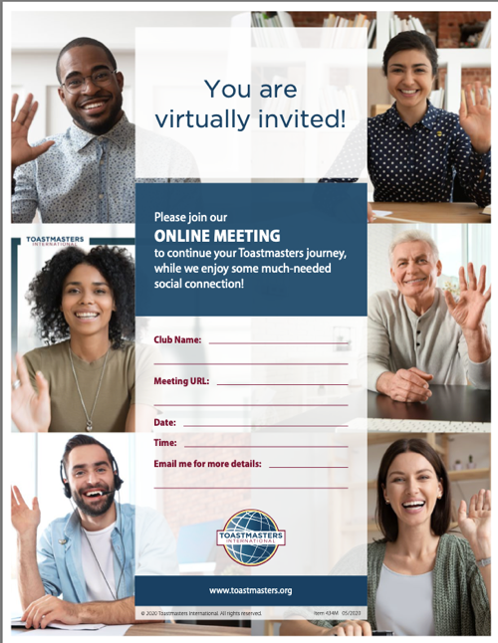
For Transitioning Members
Moving from legacy program to Pathways
Have they ever been to toastmasters.org?
Logging in
Finding the Pathways tab
Selecting a Path
Working in the curriculum
  Walk through it with them
  Screenshare on Zoom or in person
  Common “not obvious” things
You are virtually invited…
Club website→videos/ppts→TM PowerPoints-->Zoom Intro
Just like a new member…
And more—adult learners hate to feel dumb and outside of their comfort zone:
CHANGE can be HARD!

Slide 15
Club Officers and Area Directors
Toastmasters.org
  Resources
  Marketing
Pathways Base Camp Manager tools
Leadership Central
  Club central
  District central
  Distinguished Club Program
    Club status
    Daily reports
Clipartlook.com

Slide 16
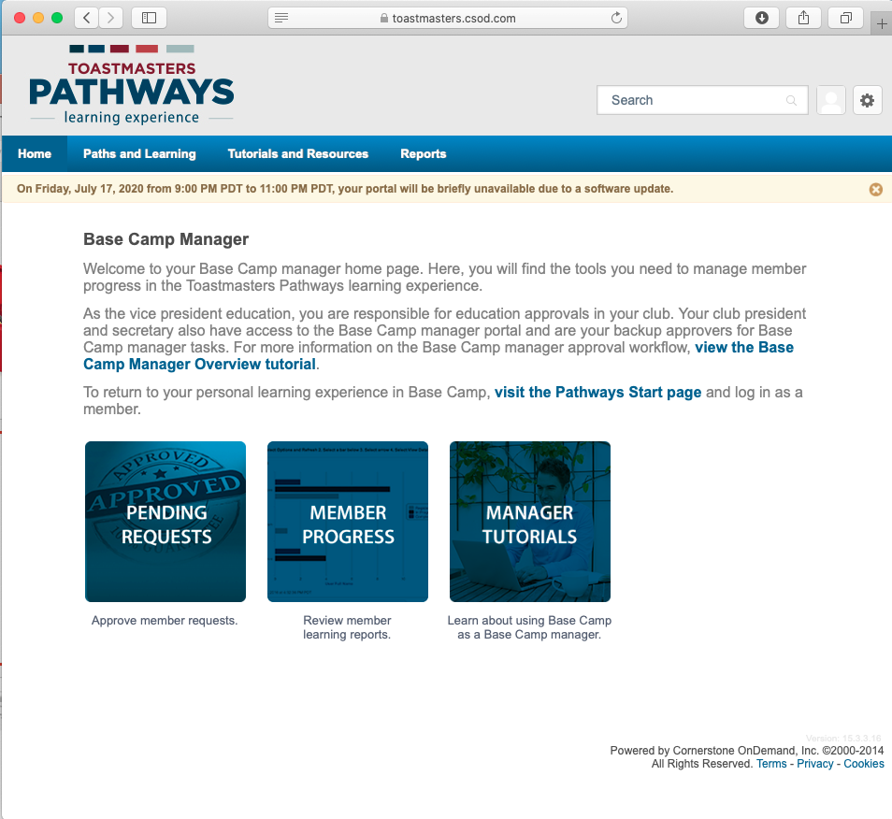
BCM Tools: when logged is as BCM

Slide 17
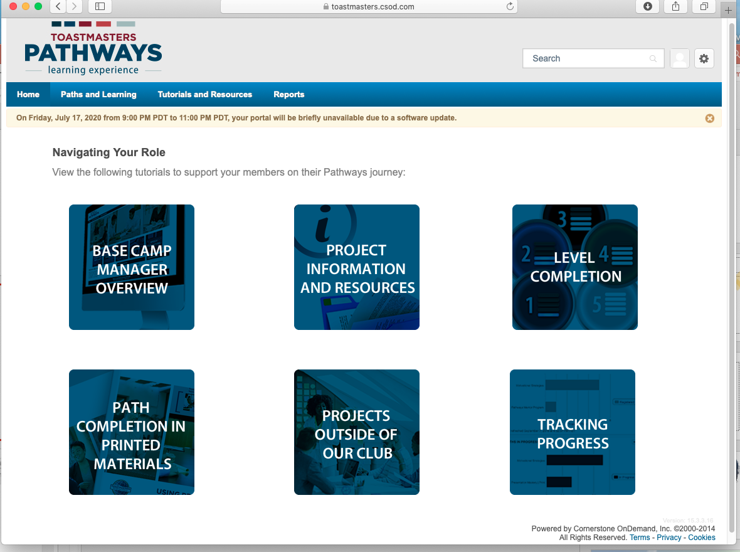
Going deeper into the BCM role specifics

Slide 18
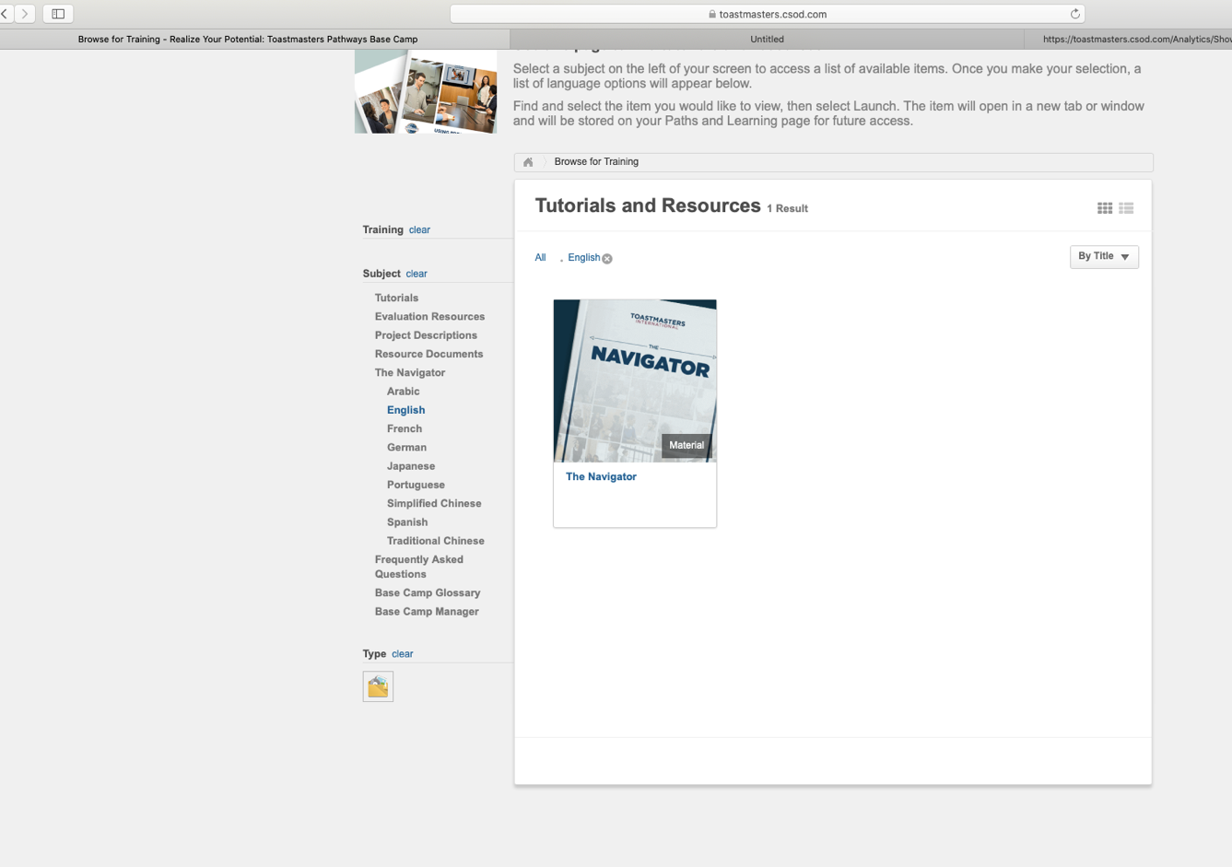
Tutorials and
Resources

Slide 19
Tutorials and
Resources
Including
The
Navigator

Slide 20
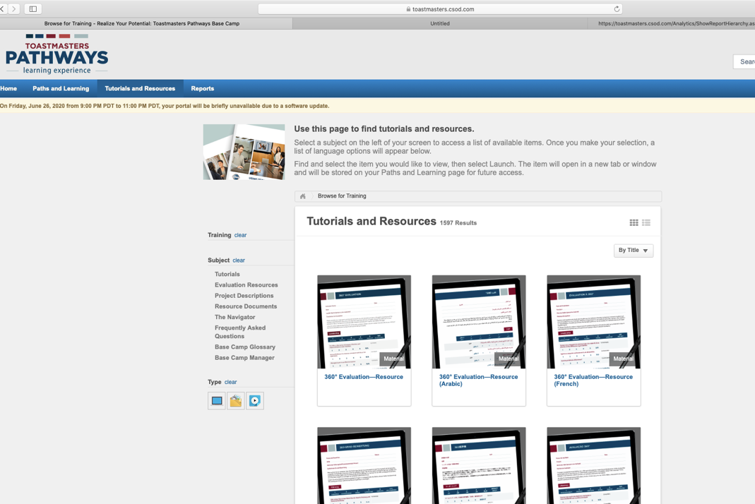
Where to get Speech Evaluation Resources

Slide 21
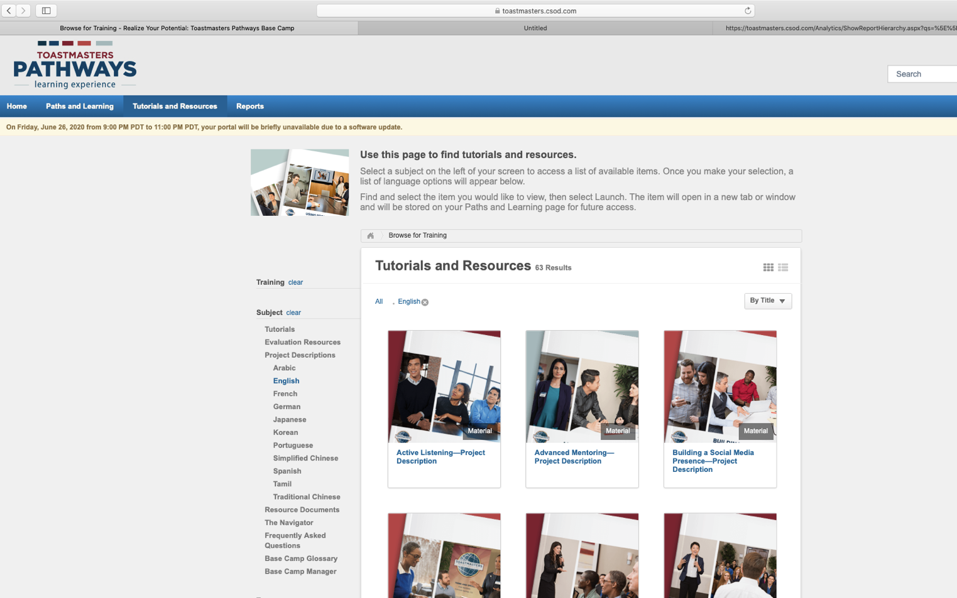
Project
Descriptions

Slide 22
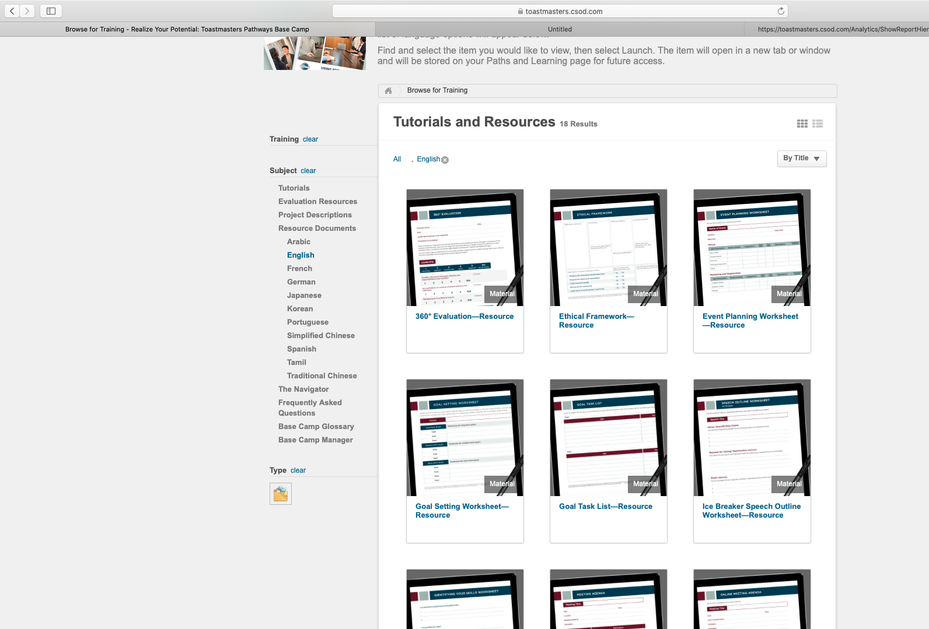
Resource Documents
> Worksheets
> 360 Eval
> Checklists

Slide 23
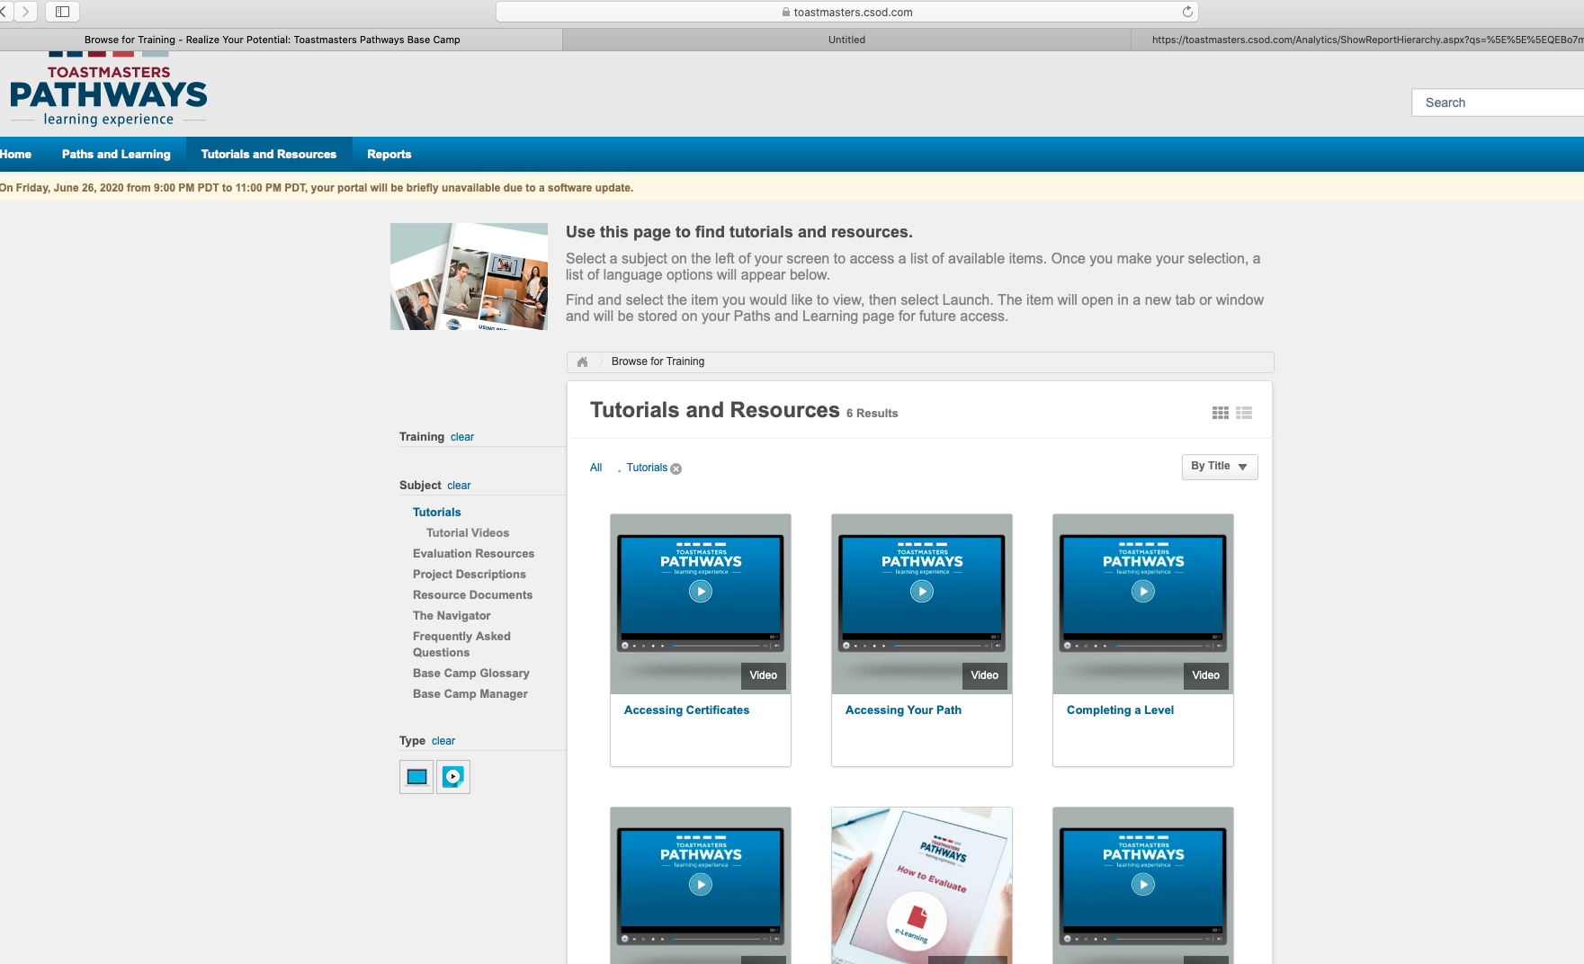
Watch and listen and learn

Slide 24
How to reach me
Phyllis.Kombol@gmail.com
704-763-1970 (cell)
Advanced Toastmasters of Asheville: 3rd Saturday 9:00-11:00 AM
Eat Your Words Toastmasters (Concord/I85): 2nd Wednesday 6:00-8:30 PM
McDowellNC Toastmasters (Marion): weekly Tuesdays 5:15-6:45 PM

