Slide 1
Zoom for Toastmasters
A Quick Introduction to Using Zoom

Slide 2
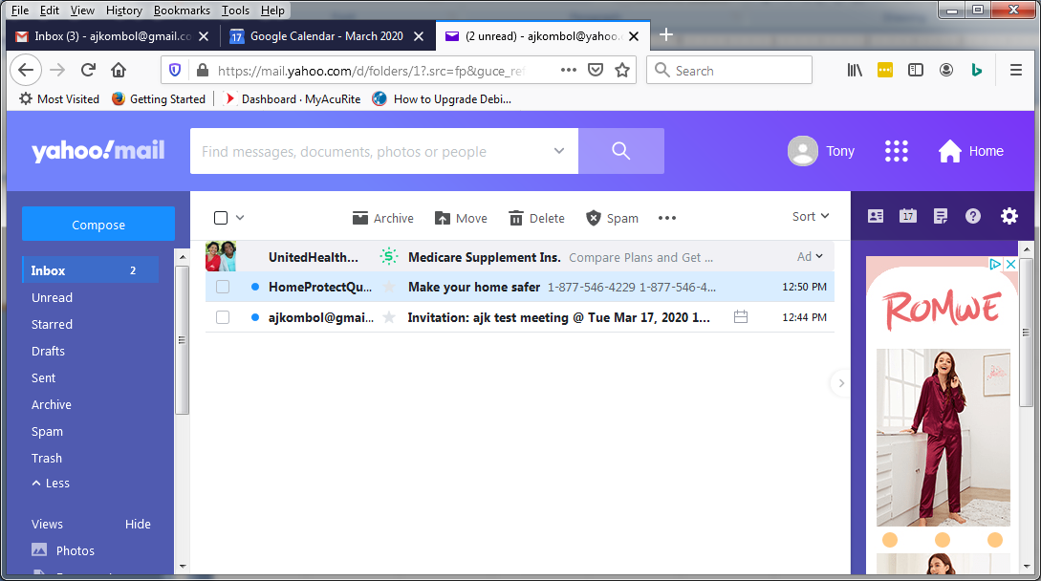
Sample Email Invite

Slide 3
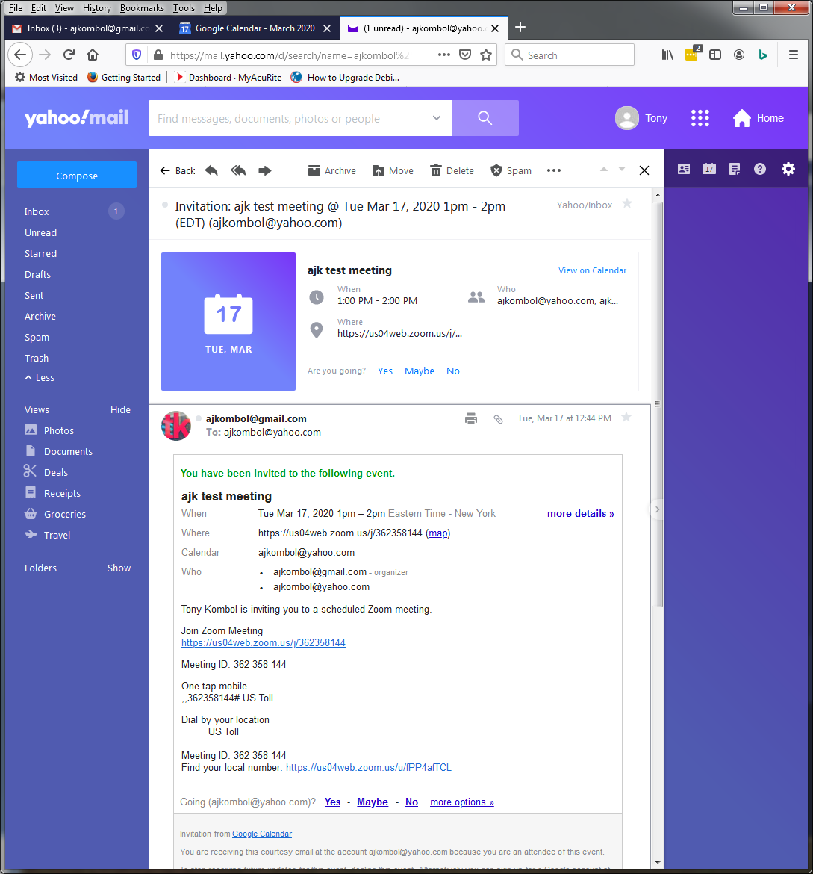
Contents of the Email
Contains:
  Date and time
    Note: meeting is not restristed to those times
  Link to Zoom
  For PRO accts
    Call in numbers

Slide 4
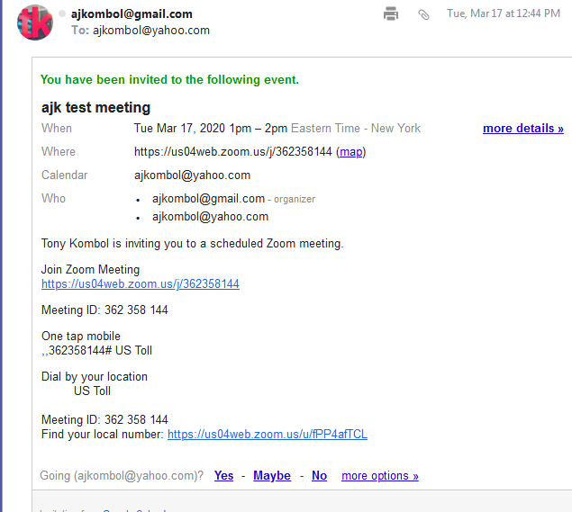
Details
Click Here
Free accounts don't have a working telephone #

Slide 5
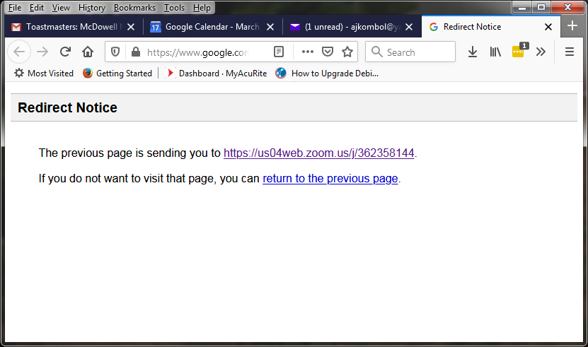
Redirect to a Zoom Server
You might get a redirect:

Slide 6
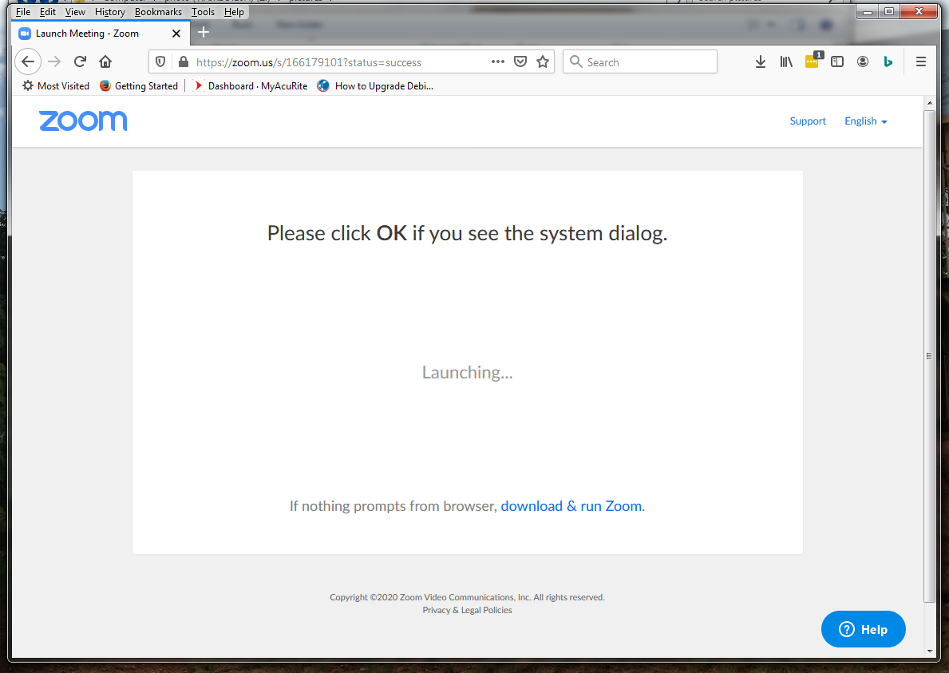
If you have not used Zoom before, first download the app, then proceed to next screen

Slide 7
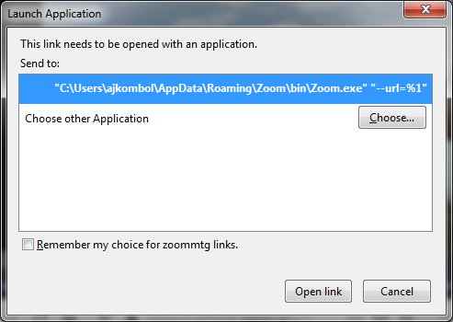
Once the Zoom app has been installed
Launch the Zoom app:

Slide 8
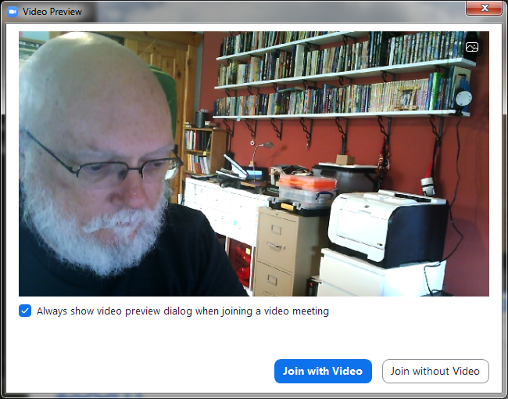
Join with Video

Slide 9
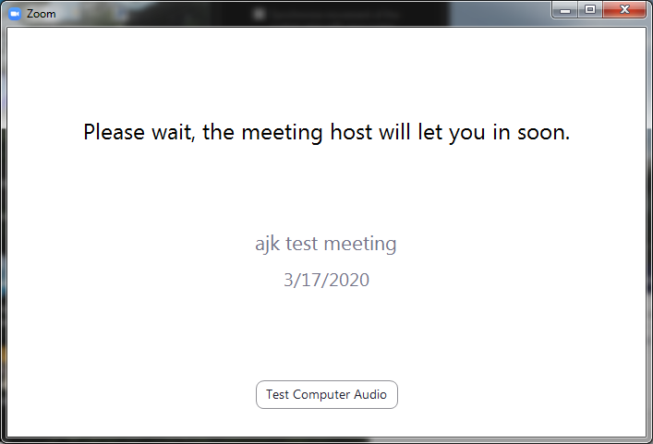
Wait for the Host
While waiting for host you can test your computer audio

Slide 10
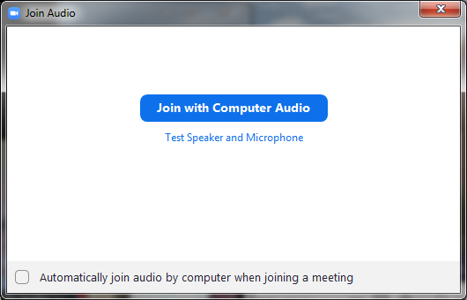
Join allowing to use Audio

Slide 11
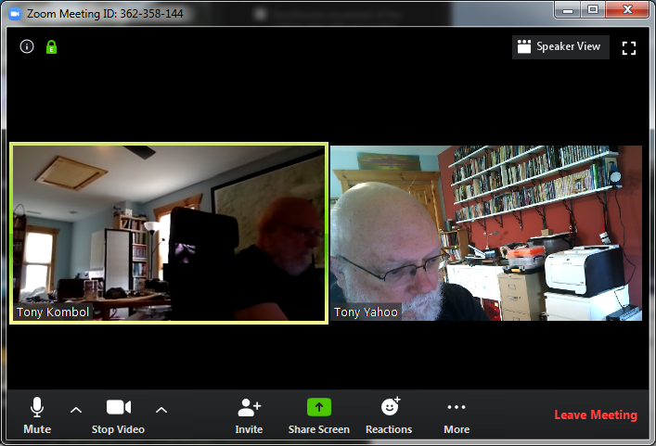
Success!

Slide 12
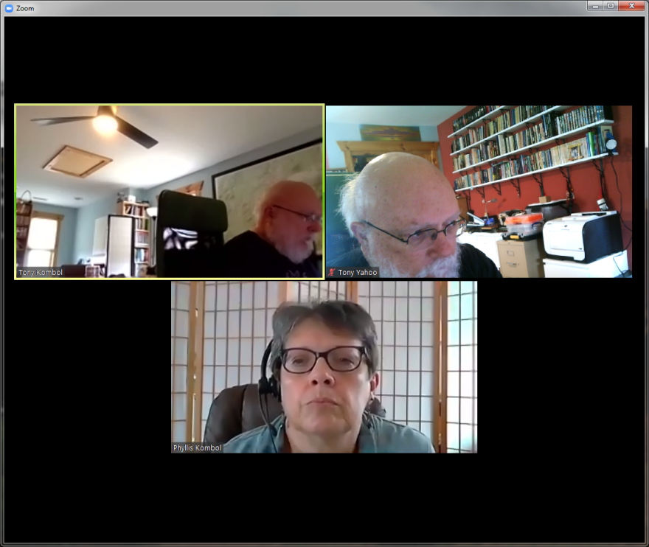
Three participants in Gallery View
The Green Box shows who is talking

Slide 13
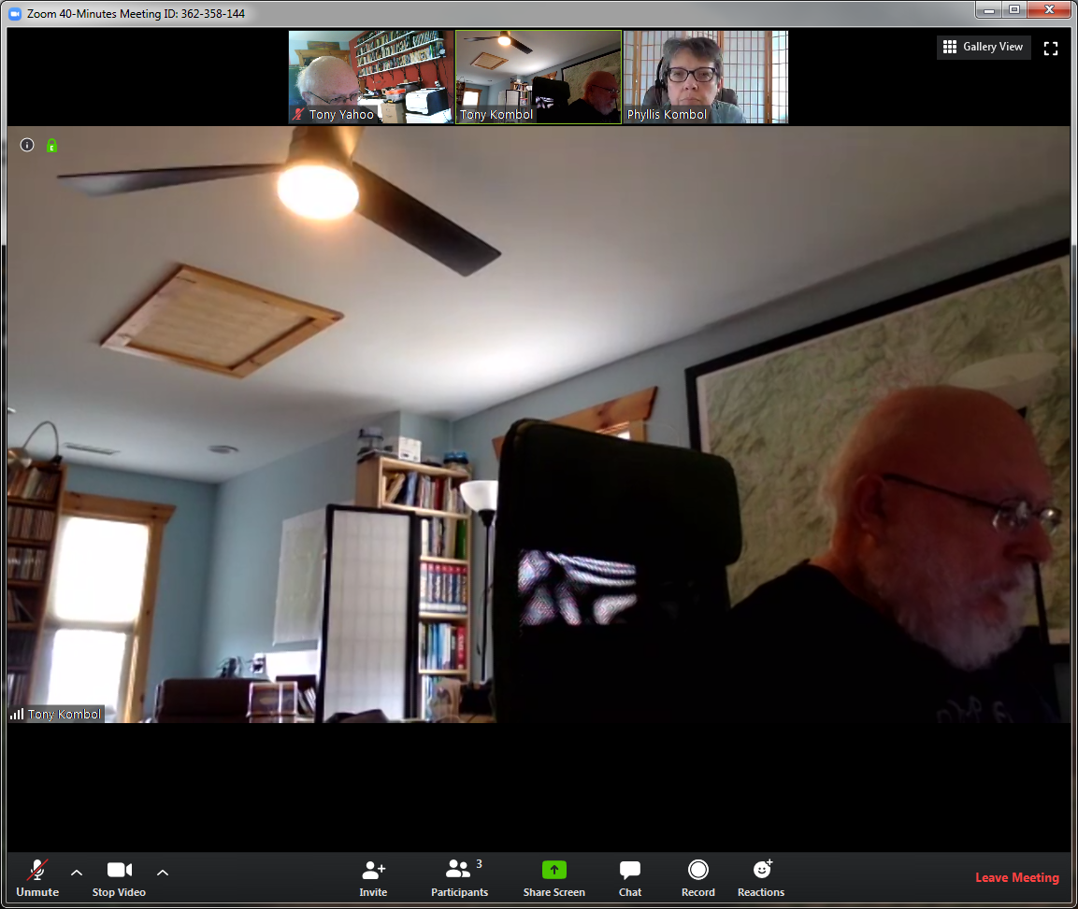
Three in Speaker View
Toggles between Speaker
View and Gallery View

Slide 14
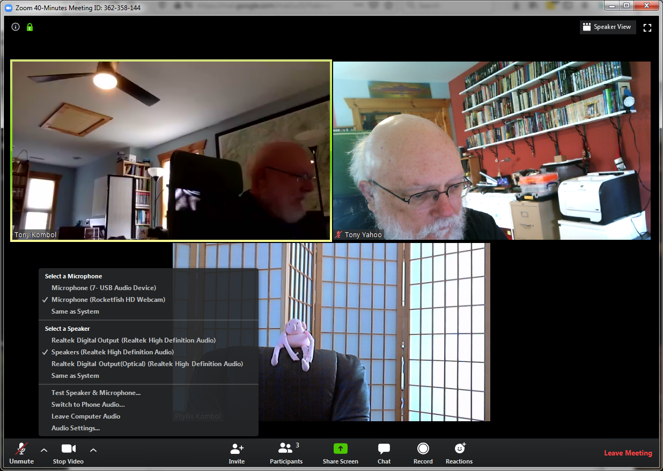
Audio Options

Slide 15
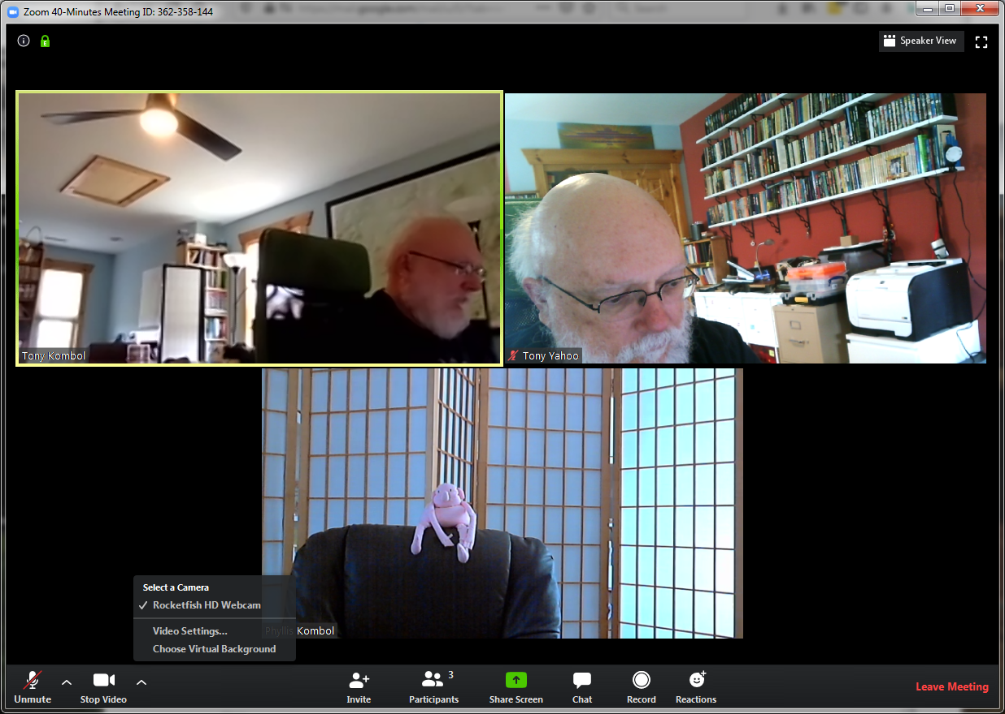
Video Options

Slide 16
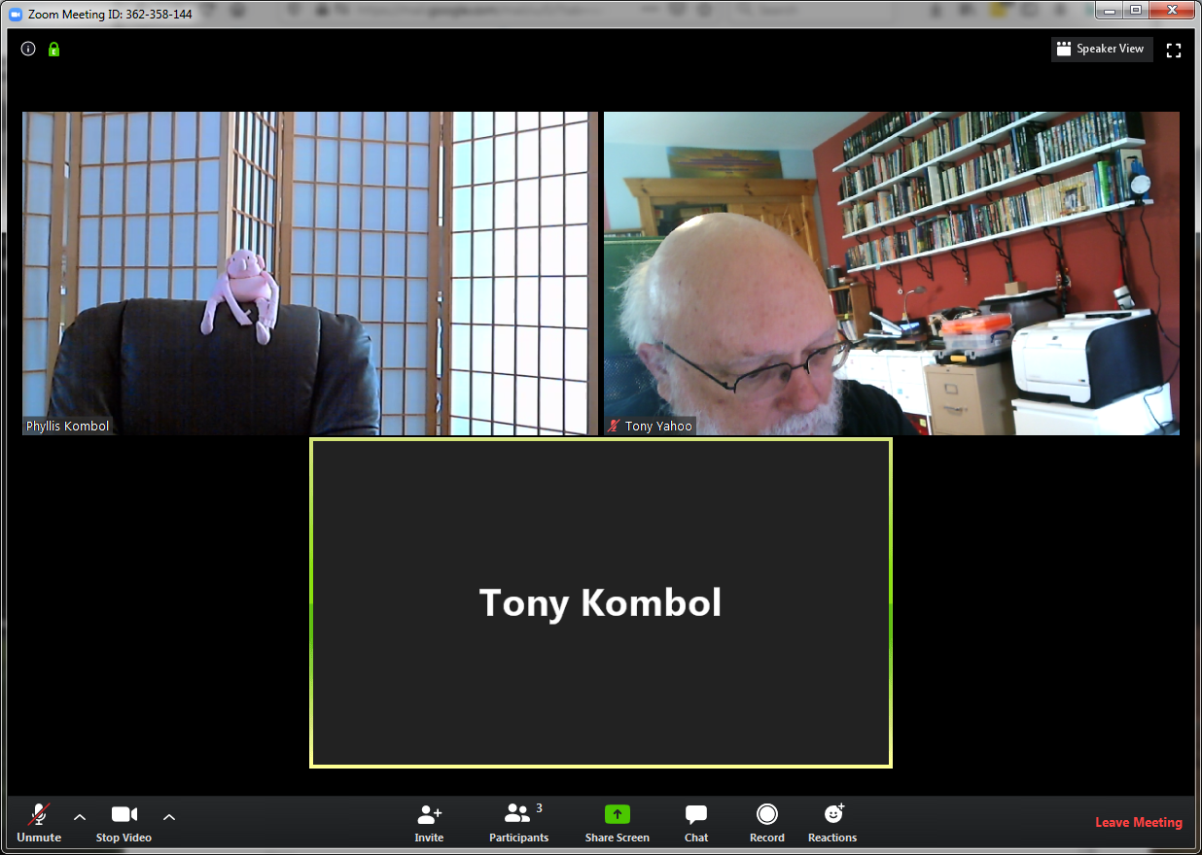
Stop video

Slide 17
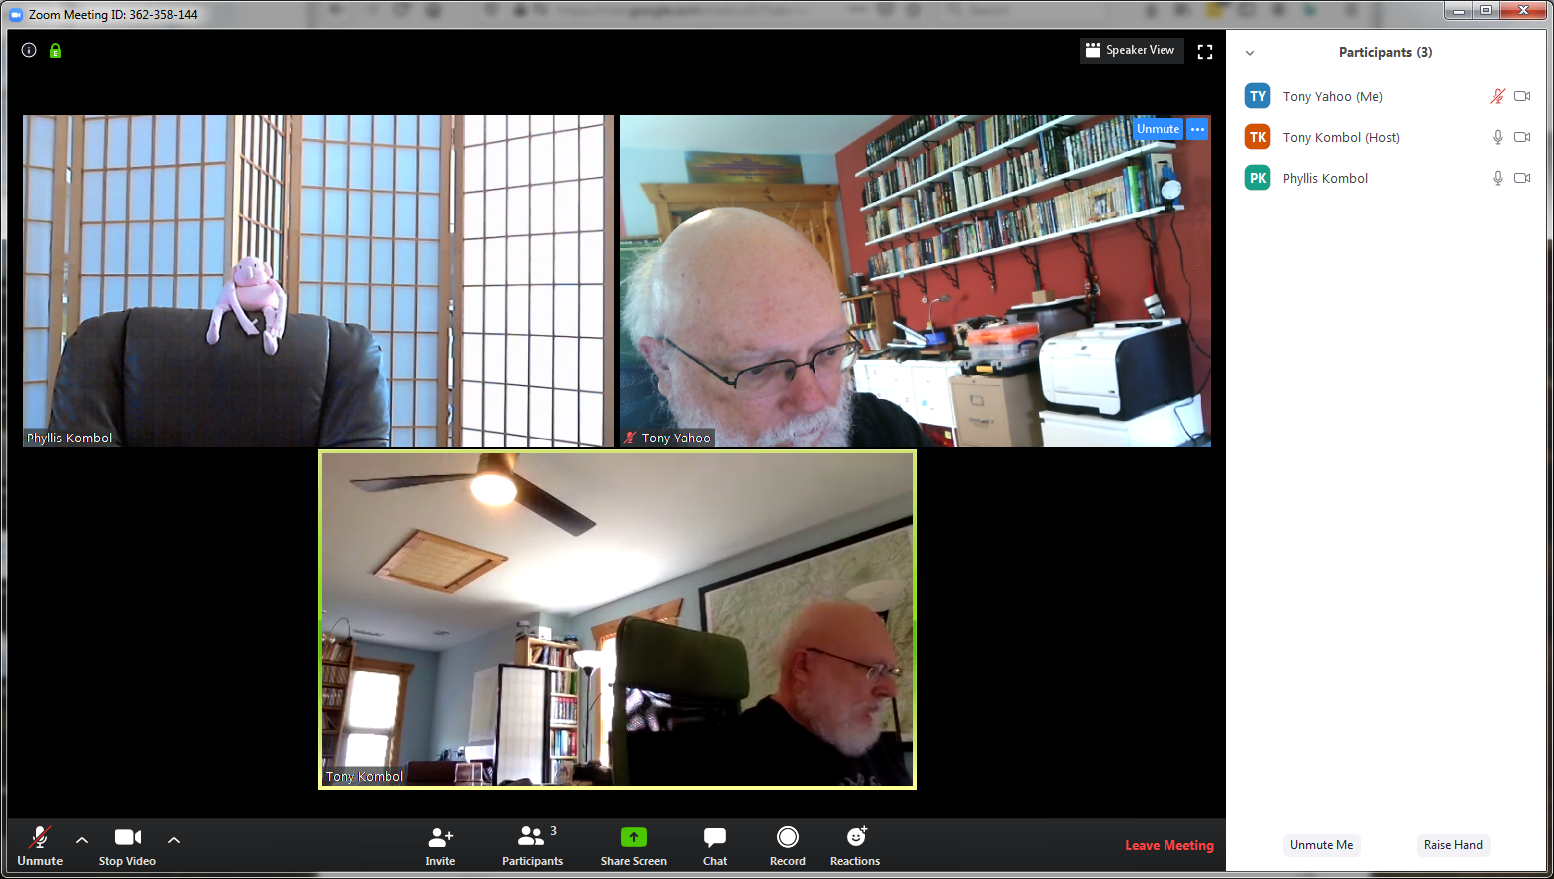
Participants

Slide 18
Share

Slide 19
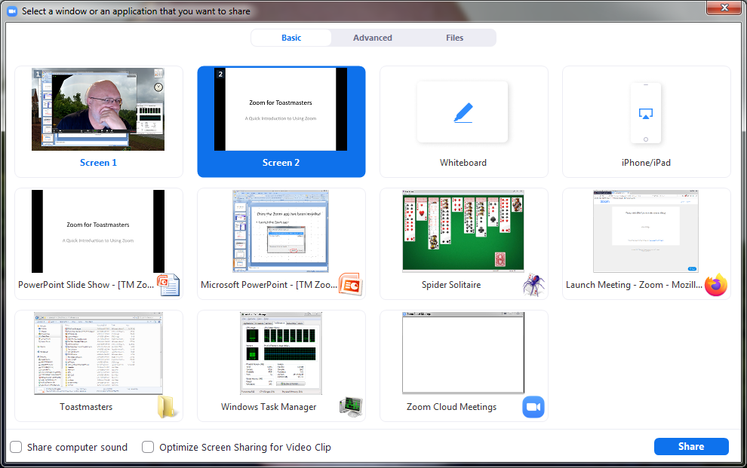
Share

Slide 20
Share Hints
PowerPoint
  First start the presentation
    F5 keyboard button
    -or-
    Click Slideshow tab then From Beginning
  Share the PowerPoint Slide Show screen
    Not the Microsoft PowerPoint editing screen

Slide 21
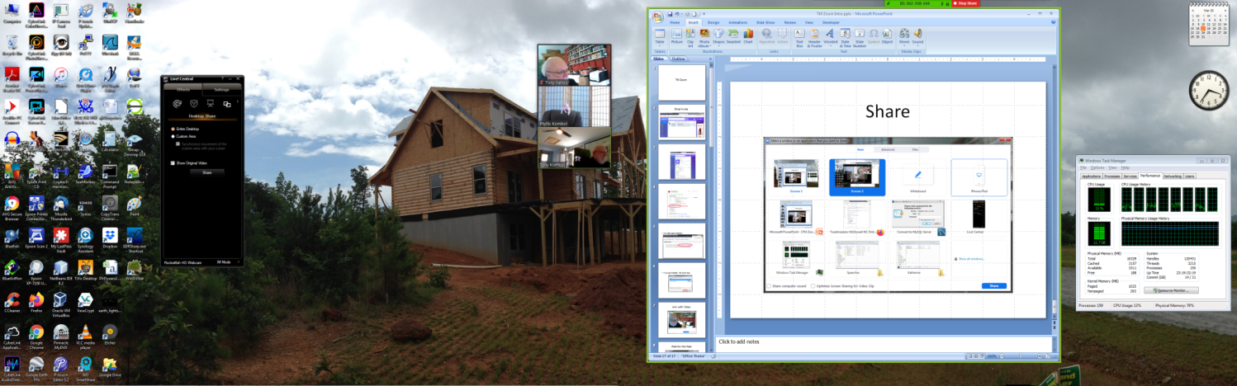
Shared
Zoom
ThumbnailVideo
Being shared
Stop Share
Note the fine green line
around the shared item

Slide 22
Pin

Slide 23
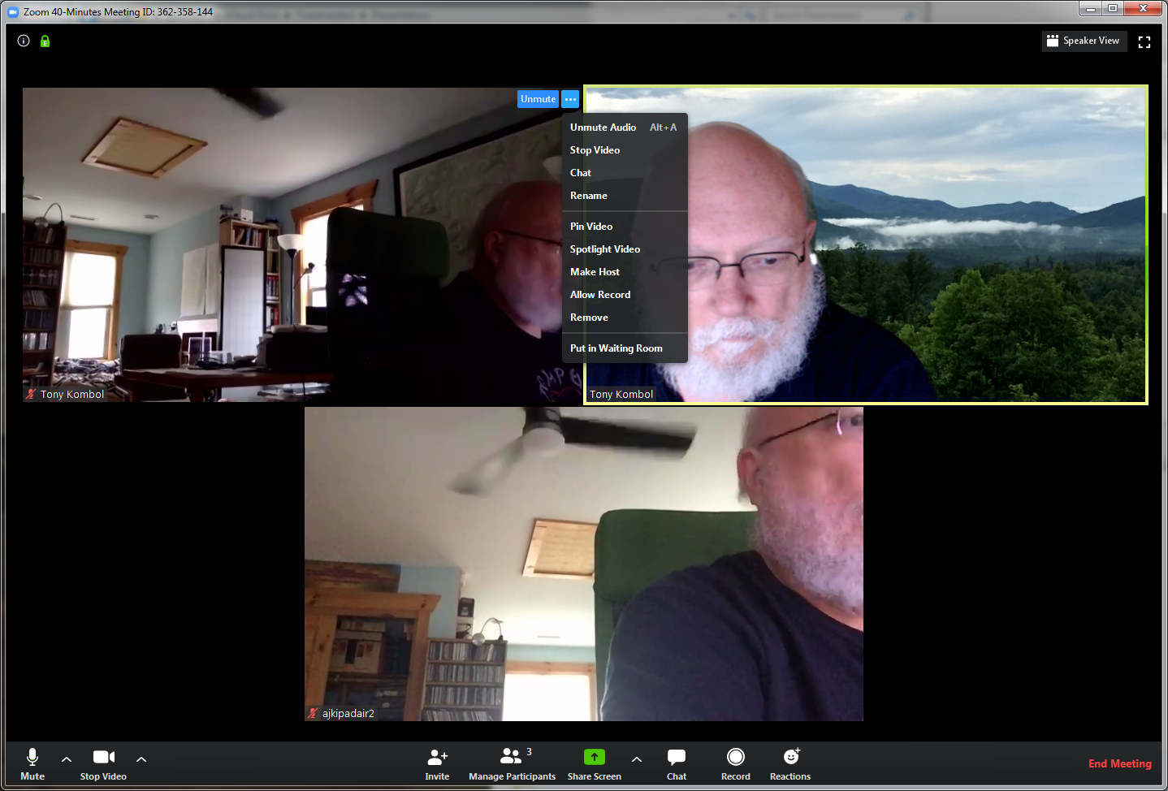
Pin
A specific Speaker View can be "pinned". This can be started in either view. Click on the … and select Pin Video.

Slide 24
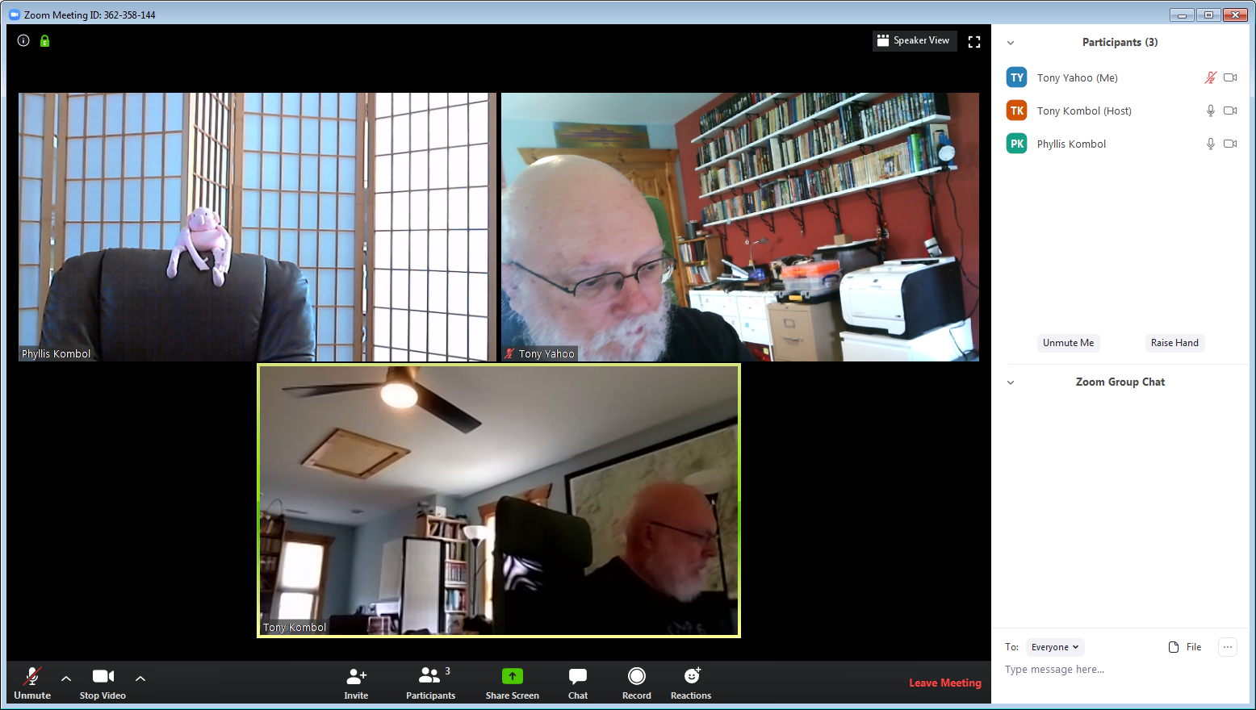
Chat

Slide 25
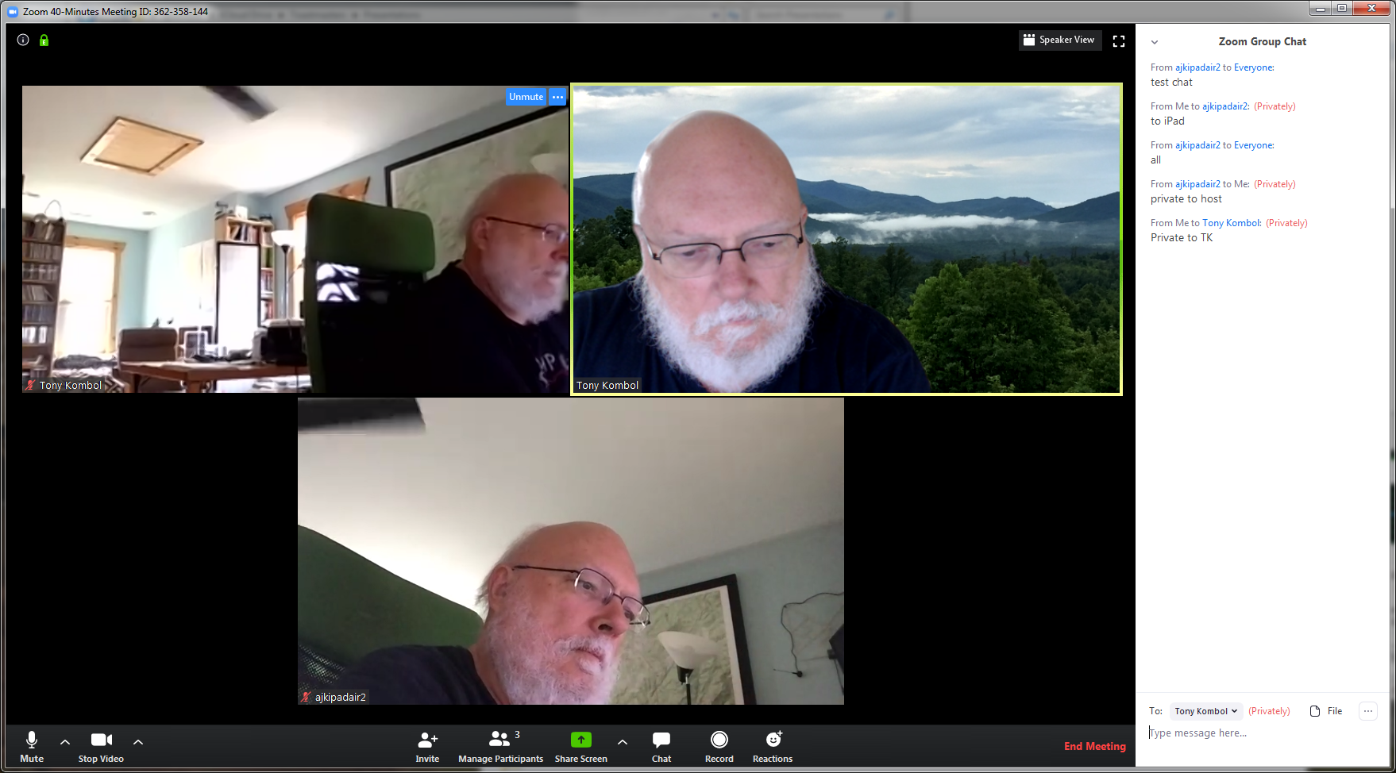

Chats can be Public or Private

Slide 26
Chats can be saved
Click on the … and option to save the chat will show. Your chat is saved in your Documents → Zoom directory.

Slide 28
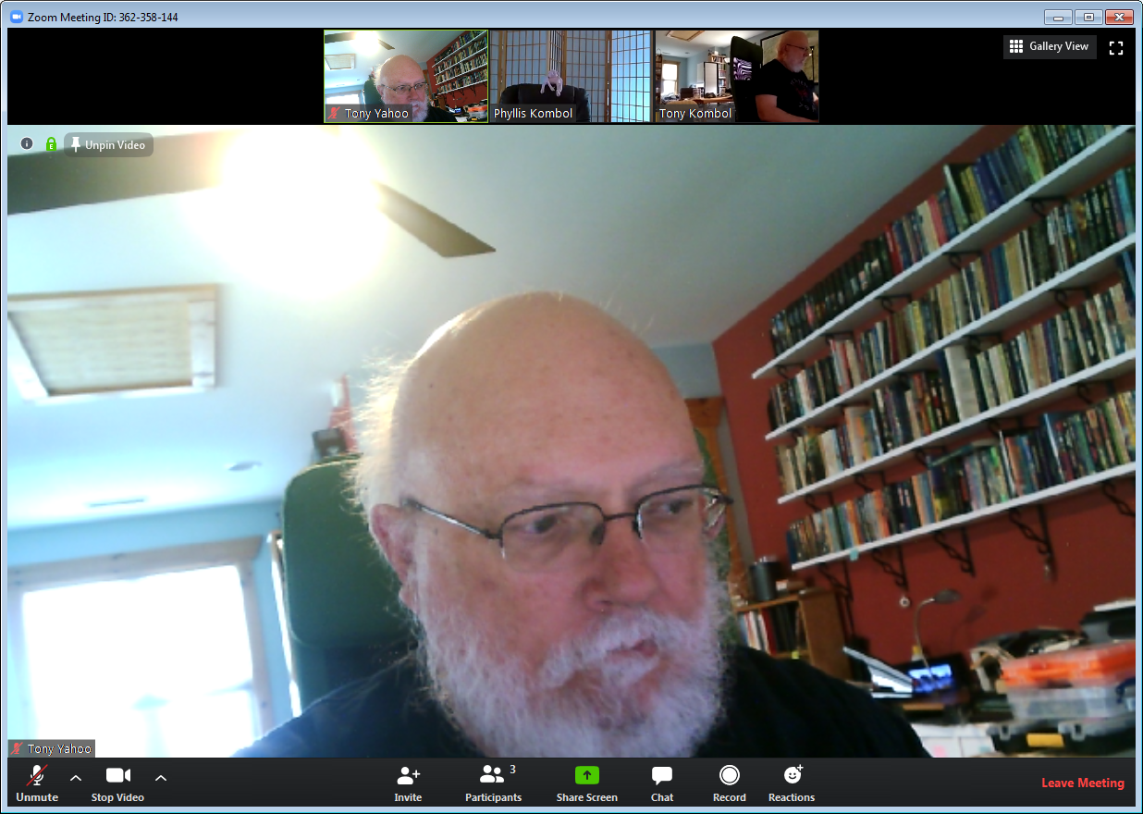
Blind me with Science

Slide 29
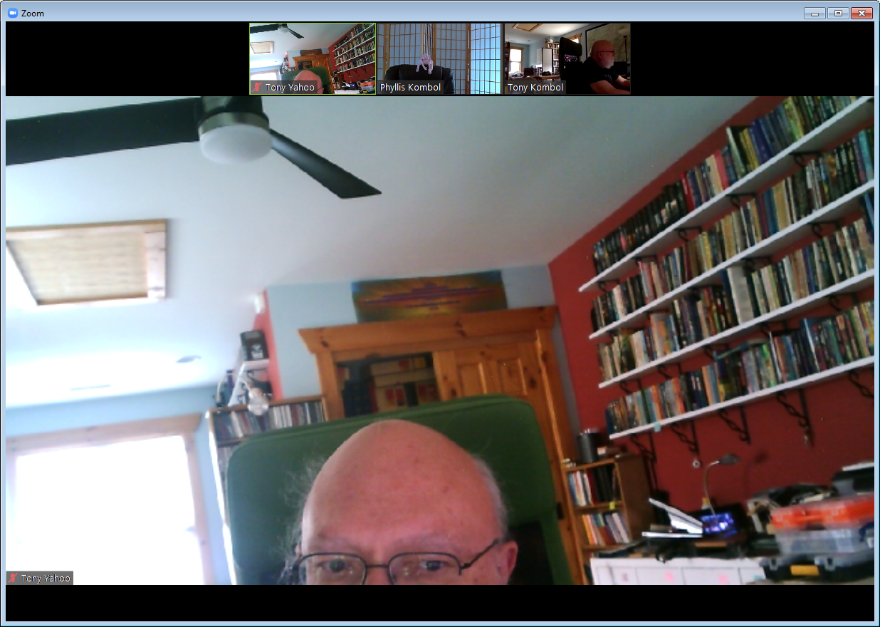
Kilroy was NOT here!

Slide 30
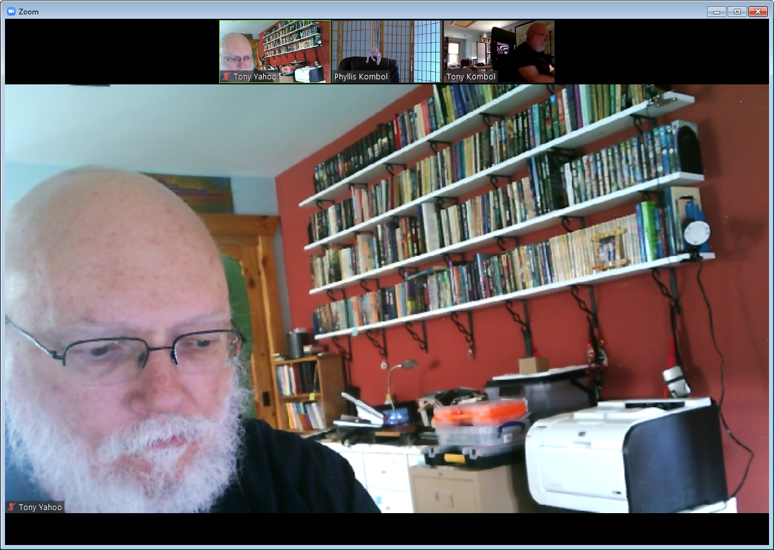
Busy, Busy, Busy

Slide 31
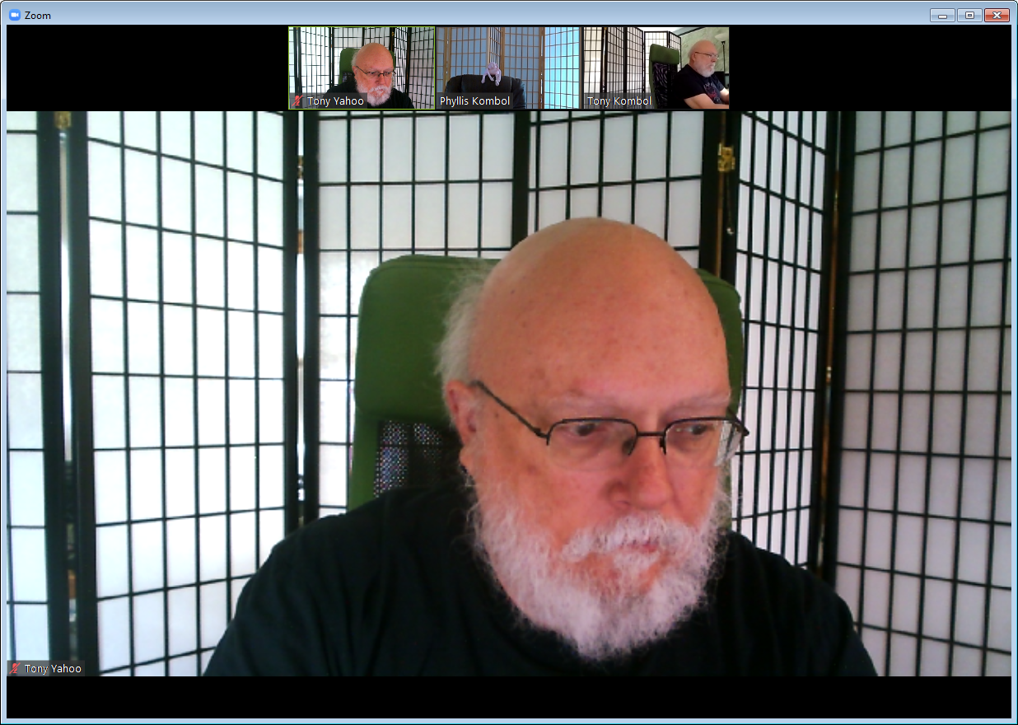
Keep mute on except when speaking

Slide 32
Optional but not Necessary
Reactions
  Some people have noted they don't see them
Virtual Background
  Note: need at least an i5 quad core processor

